Slide 1
What difficulties did the early settlers encounter?
By Roger Liu

Slide 2
Plan for today
Quiz: What is settler colonialism?
Peer Teaching: Of Plymouth Plantation
A Model of Christian Charity
Activity: Imagining the encounter
Group work: Decide your culture fair topic
Lecture: What difficulties did the settlers encounter?
Self-reflection: Answer the guide question in your notebook

Slide 3
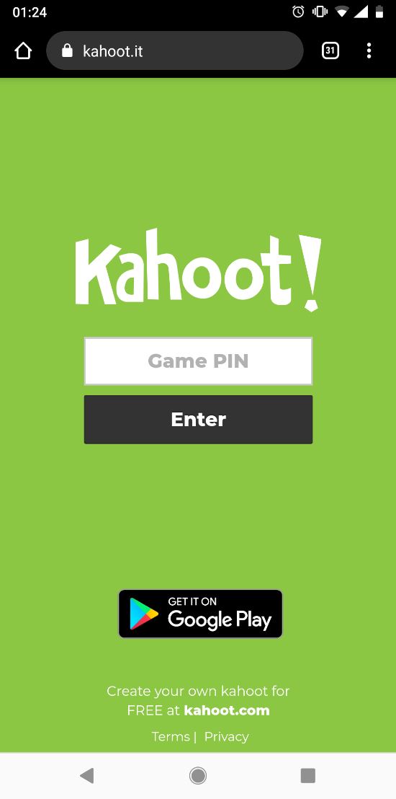
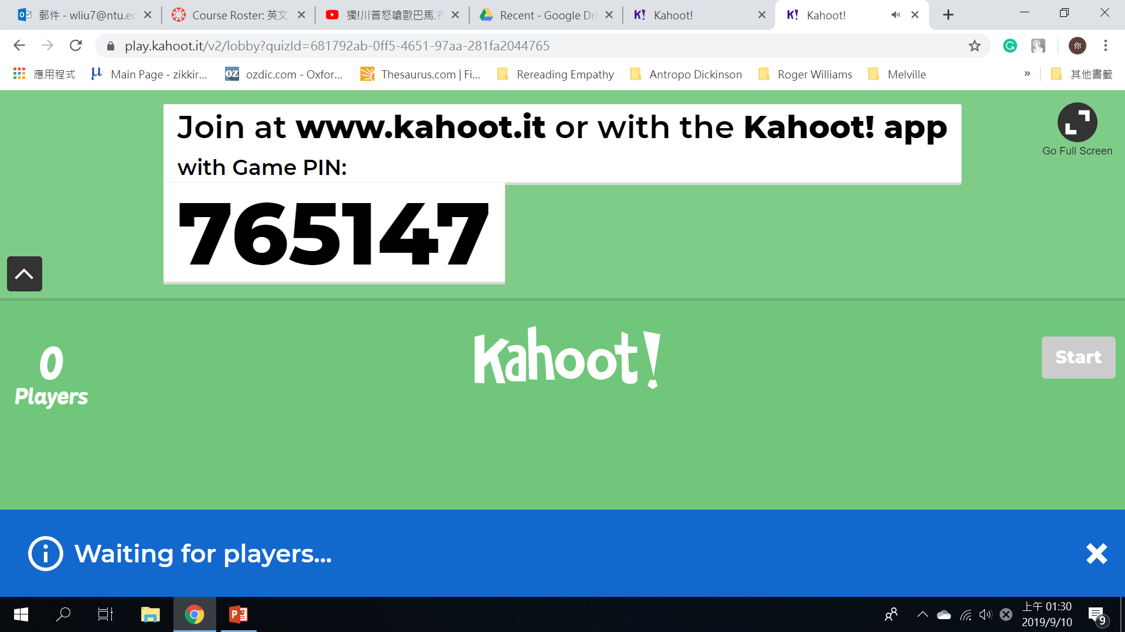
Quiz

Slide 4
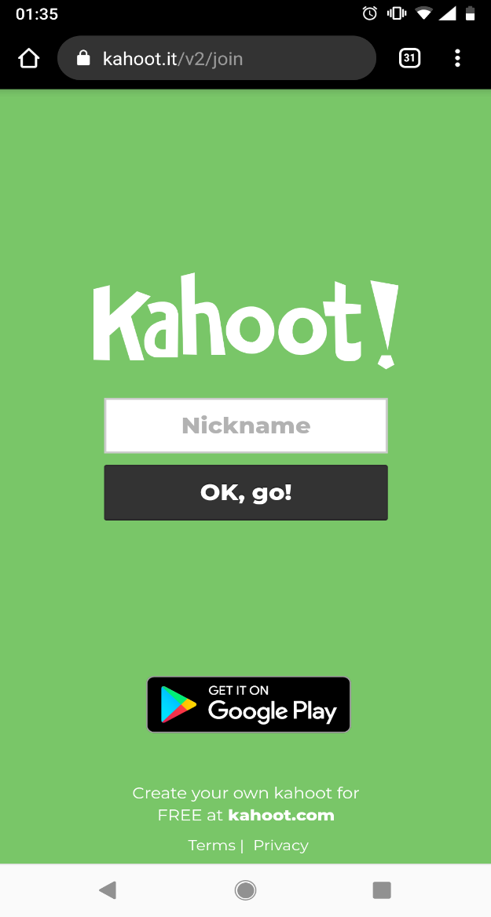
Quiz
Put your student ID number here

Slide 5
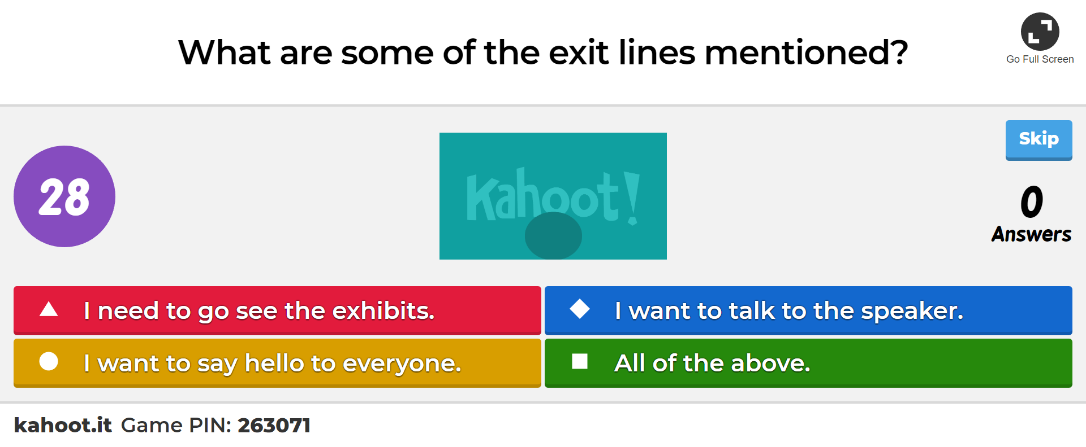
Quiz

Slide 6

Peer Teaching: Round One
Form small groups (2-4 people in a group).
Share notes, communicate ideas, ask questions.

Slide 7
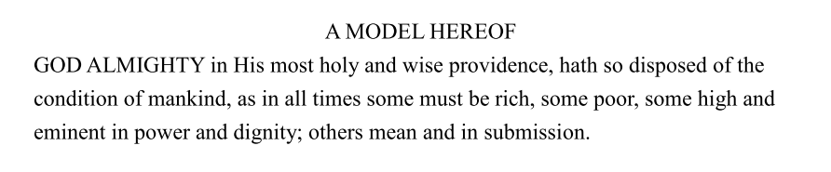
Peer Teaching: Round Two
Our task: Does the claim make sense or does it serve some political purpose?

Slide 8
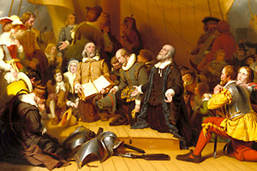
Peer Teaching: Round Two
When? Why?
Winthrop’s listeners were taking great risks. They were leaving their homes to establish their lives anew in a foreign, unknown, uncivilized place. They needed to be assured that their risks would pay off.
https://americainclass.org/a-model-of-christian-charity/

Slide 9
Peer Teaching: Round Two
Each group will read one paragraph together and discuss whether the “reason” convinces you.
Present to the class
    What the argument is
    Why do you find it convincing or not so convincing

Slide 10

Peer Teaching: Round Three
Read the “objection” first and, without consulting Winthrop’s answer, discuss how you would argue against that objection

Slide 11
Peer Teaching: Round Four
Advantages of love or Christian charity (p. 10)

Slide 12
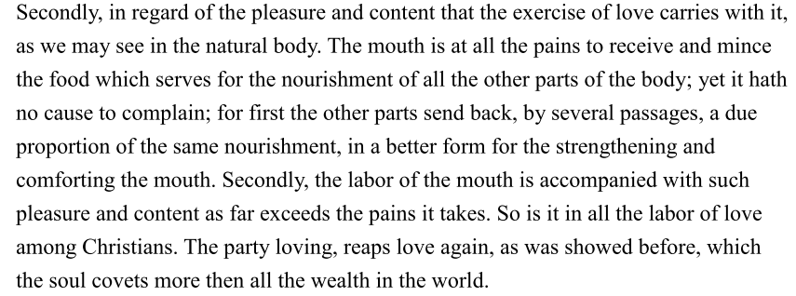
Peer Teaching: Round Four
Advantages of love or Christian charity (p. 10)

Slide 13
Where did social inequality go?
It’s taken as a given.

Slide 14
Activity: Imagining the Encounter
Take out your reading journal or a piece of paper
Try to complete the story:
One day you stay at NTUST late to study American literature. Suddenly you notice a light source outside of the window. It’s a UFO. Two aliens come out of the flying saucer and begin to walk towards you . . .

Slide 15
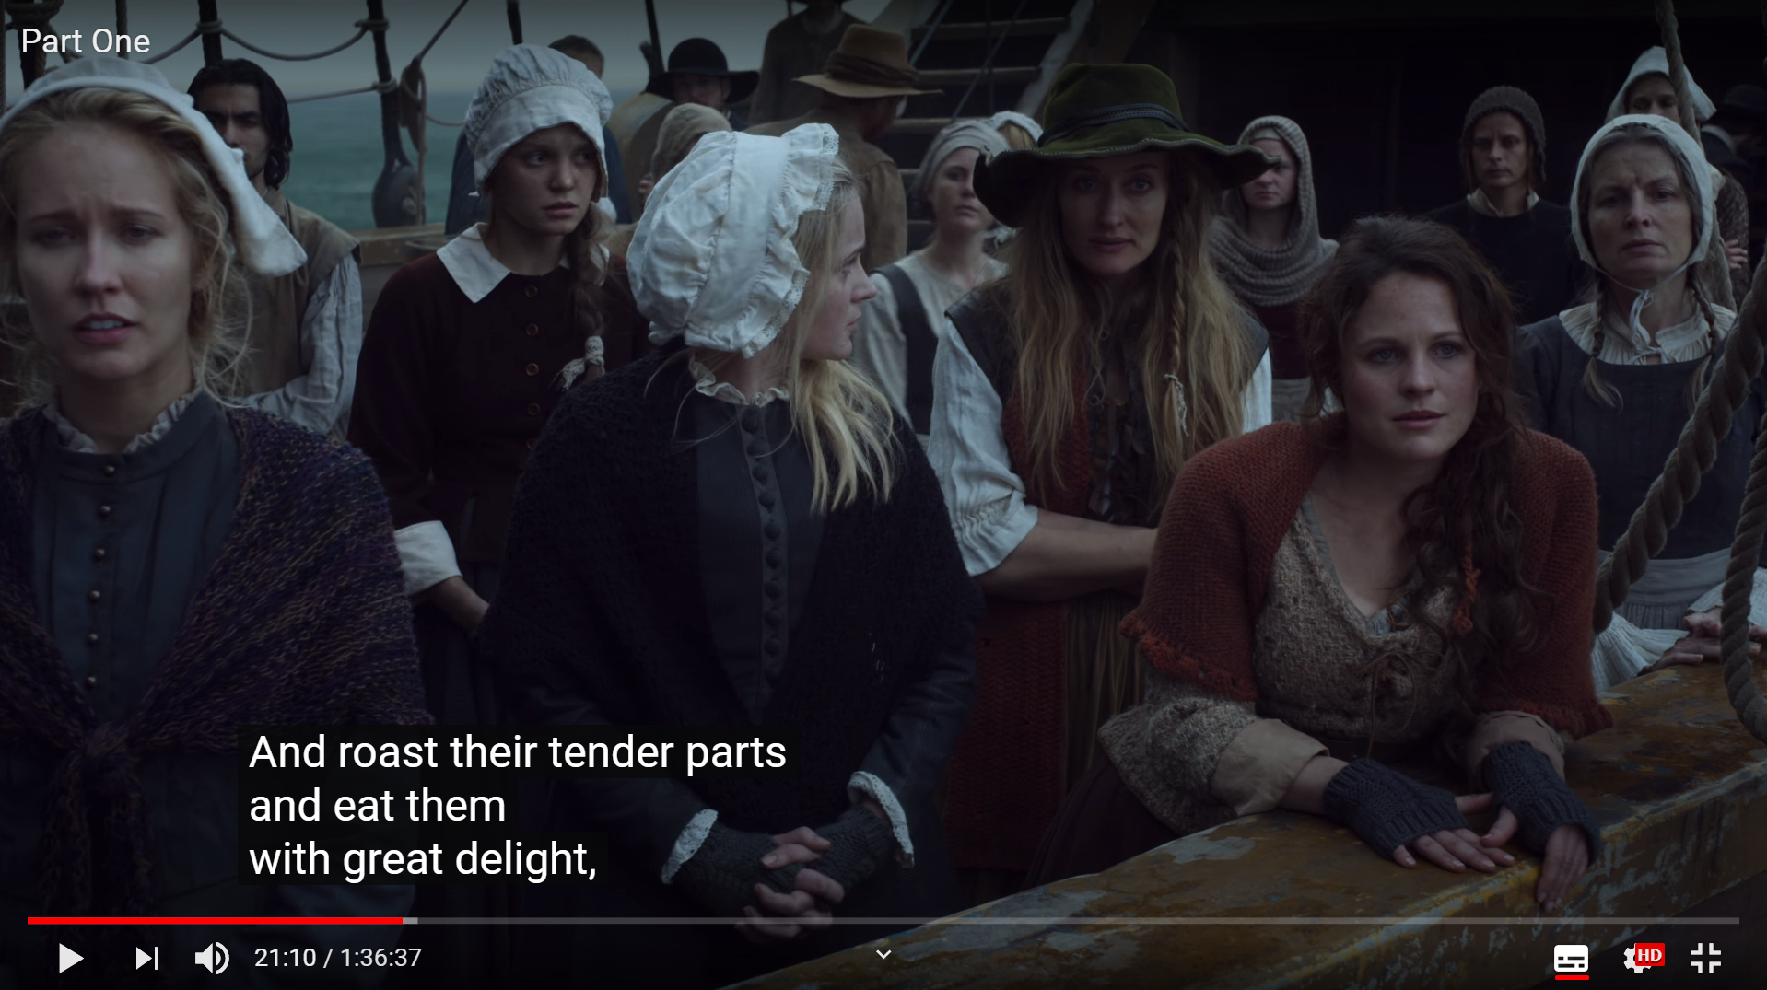
Activity: Imagining the encounter

Slide 16
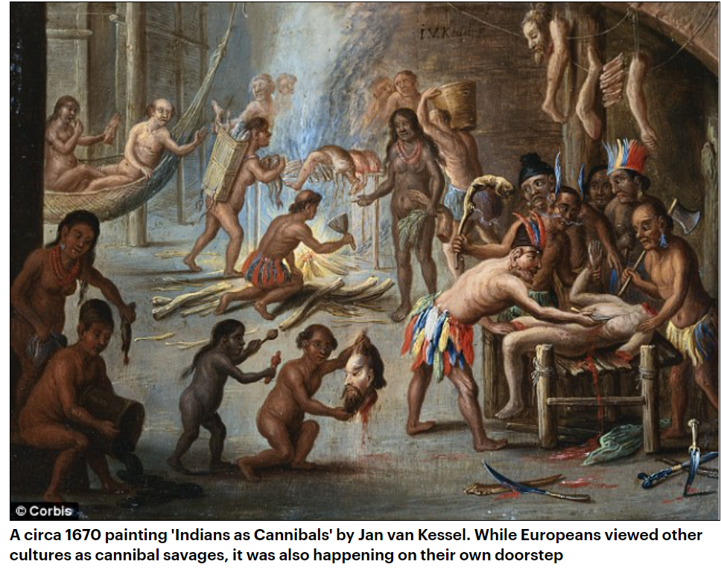
Activity: Imagining the encounter
https://www.dailymail.co.uk/sciencetech/article-2141858/Tough-news-swallow-Europeans-saw-wrong-cannibalism-1900s-new-books-claim.html

Slide 17
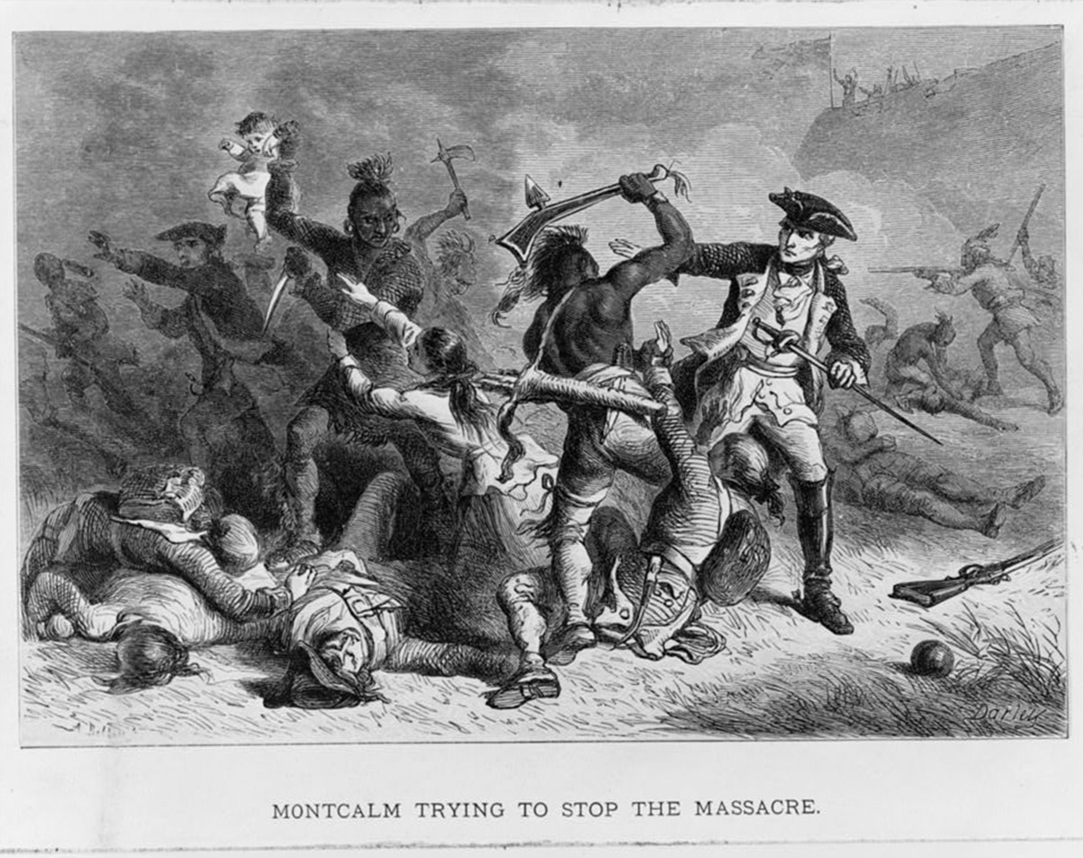
Activity: Imagining the encounter
http://www.americanyawp.com/text/04-colonial-society/

Slide 18


Activity: Imagining the encounter

Slide 19
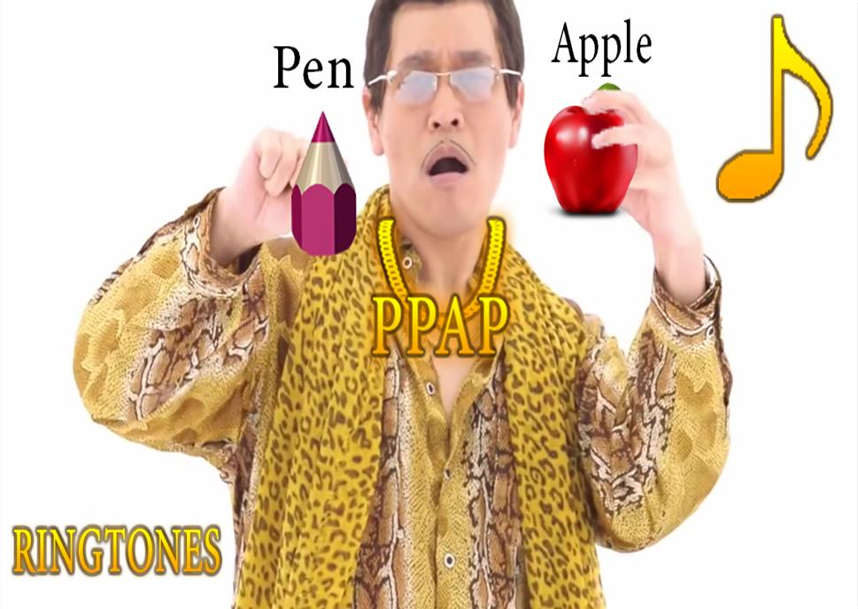
Activity: Imagining the encounter
Bradford: Indians are like wolves
Winthrop: We should love even our enemies
https://images.app.goo.gl/UDFEWP8jEqeZBwweA

Slide 20
What about Indians?
They are the “other”
in the eyes of the settlers—
so no need to love them.

Slide 21
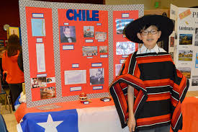
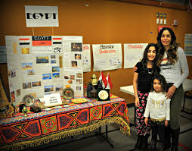
Decide your culture fair topic

Slide 22
Lecture: Difficulties for settlers
Brainstorm for difficulties settlers might encounter
 | Item
1
2
3
4
5
6
7

Slide 23
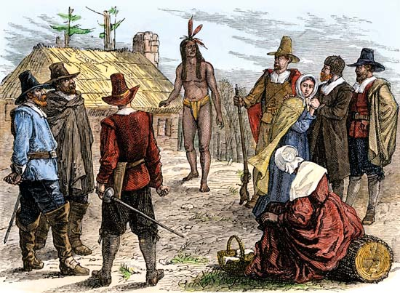

Lecture: Difficulties for settlers
Samoset and Squanto → Question of language/culture

Slide 24
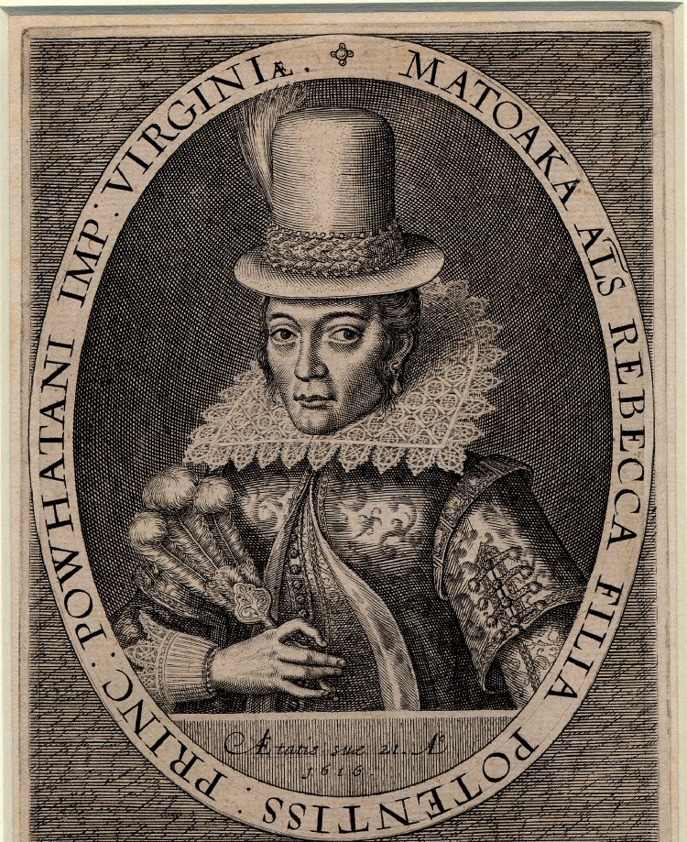
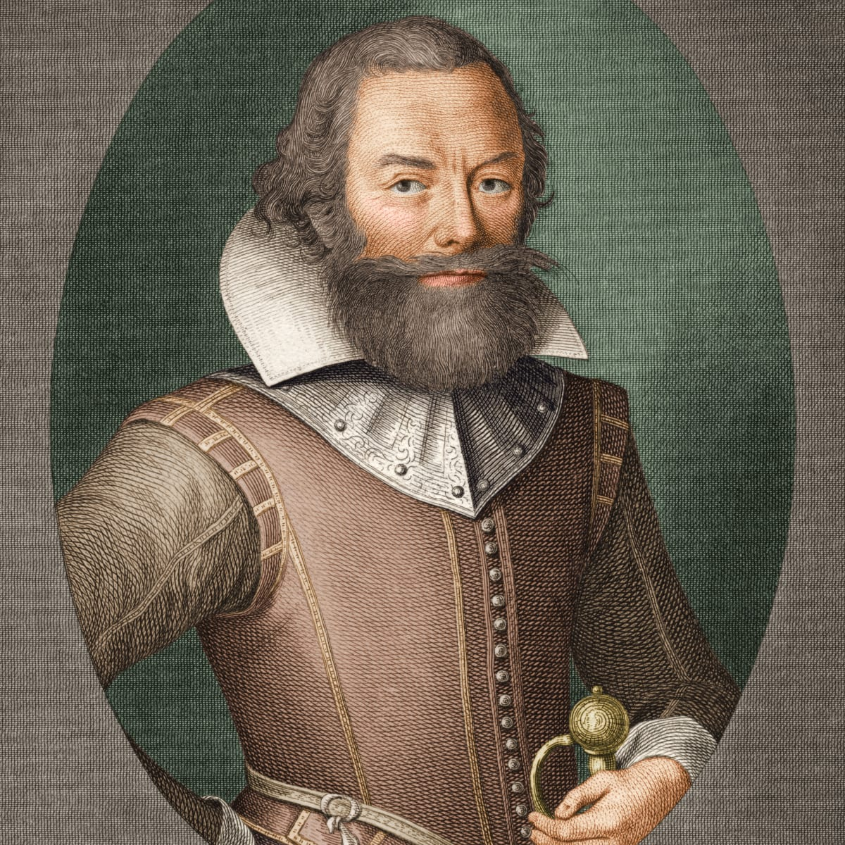
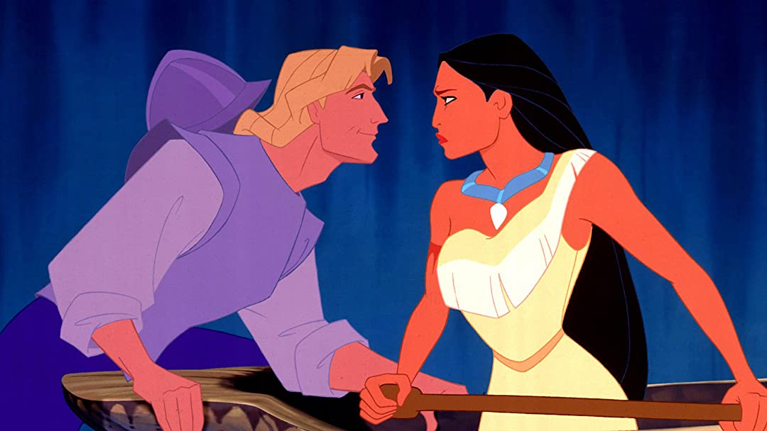
Lecture: Difficulties for settlers
John Smith and Pocahontas

Slide 25
Lecture: Difficulties for settlers
At his entrance before the King, all the people gave a great shout. The Queen of Appamatuck was appointed to bring him water to wash his hands, and another brought him a bunch of feathers, instead of a towel, to dry them. Having feasted him after their best barbarous manner they could, a long consultation was held, but the conclusion was, two great stones were brought before Powhatan: then as many as could laid hands on him, dragged him to them, and thereon laid his head, and being ready with their clubs to beat out his brains
https://www.digitalhistory.uh.edu/disp_textbook.cfm?smtID=3&psid=4213

Slide 26
Lecture: Difficulties for settlers
Pocahontas, the King's dearest daughter, when no entreaty could prevail, got his head in her arms, and laid her own upon his to save him from death: whereat the Emperor was contented he should live to make him hatchets, and her bells, beads, and copper; for they thought him as well of all occupations as themselves.
John Smith,
The General History of Virginia,
New England, and the Summer Isles
https://www.digitalhistory.uh.edu/disp_textbook.cfm?smtID=3&psid=4213

