Slide 1
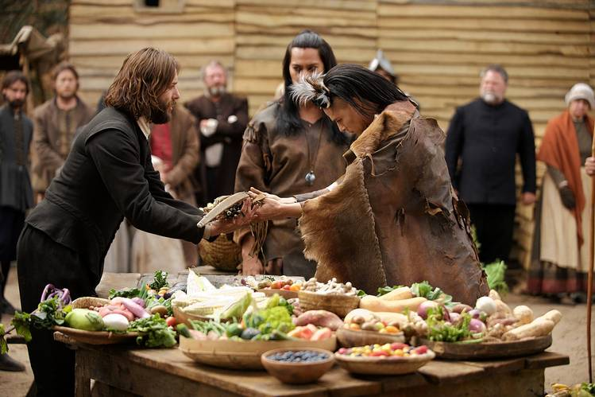
What is settler colonialism? 定居殖民主義
By Roger Liu

Slide 2
Plan for today
Peer Teaching: The two videos
Activity: Touring colonial spaces
Lecture: What is settler colonialism
Video: Saints and Strangers, Part One
Self-reflection: Answer the guide question in your notebook

Slide 3
Peer Teaching: Round One
Get together with students who watch the same video (2-4 people in a group).
Share notes, communicate ideas, ask questions.

Slide 4
Peer Teaching: Round Two
Exchange group members.
Follow the steps:
Side A starts by stating the main argument of the video and offer examples from the notes.
Side B takes notes, ask questions, and tries to give a summary of Side A’s presentation.
Side B repeats step one.

Slide 5
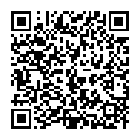
Peer Teaching: Round Three
Each group will go to Google document to share four things:
One similarity between the two videos
One difference between the two videos
One interesting observation/fact
One question that bothers you

Slide 6
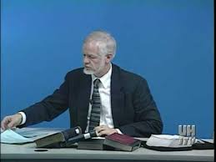
The Puritan Vision of America
The Puritan Vision of America
By Barry Wood (U. of Houston)
Target audience: For those who know little about the history of the Reformation (a religious movement 宗教改革)
Theme: Puritans are a deeply religious group
Advantages: It covers two texts that we are going to read, Bradford’s and Winthrop’s.
32:37 acoustic shock

Slide 7
The Puritan Vision of America
Part 1 [~25:50]: Why the Reformation?
(corruption/abuses, justification by faith)
Part 2 [25:50-33:00]: Who are the Puritans?
(no to the Anglican Church, congregationalism,
William Bradford)

Slide 8
The Puritan Vision of America
Part 3 [33:00~44:30]: Of Plymouth Plantation
(journal of early years, Mayflower Compact,
Samoset, Squanto, Thomas Morton, Pequot War)
Part 4 [44:30-1:03:10]: Three uses for words
(Exegesis: indexical, referential, imaginary)
(Puritan worldview, Satan, God’s justice/providence)
Part 5 [1:03:10~]: A Model of Christian Charity
(“The eyes of all people are upon us”, Cotton
Mather, American Jeremiad)

Slide 9
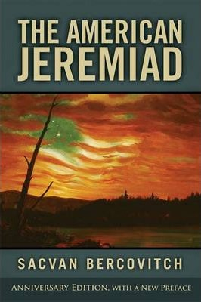
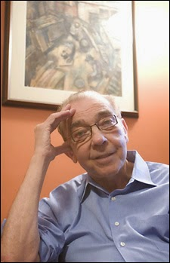
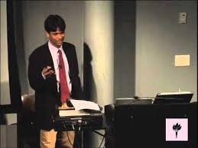
American Puritanism (I)
American Puritanism (I)
By Cyrus Patell (New York U.)
Target audience: For those who want to know about Puritan theological views
Theme: Puritan writings rely heavily on biblical types.
Advantages: It teaches you how to carefully read Puritan texts.

Slide 10
American Puritanism (I)
Part 1 [~5:08]: Type as biblical/world exegesis
(Winthrop’s journal: Overcoming Satan)
Part 2 [5:08~16:06]: John Calvin and Puritan theology
(fatedness, covenant of works/grace, doctrine of
election, Arminianism and good works, Hawthorne,
writing fiction bad?, original sinfulness)

Slide 11
American Puritanism (I)
Part 3 [16:06~40:20]: Bradford vs. Mourt’s Relations
(virgin land, Puritan plain style, Mayflower’s arrival,
natural resources and promotional literature, wicked
man dead at sea as providence, tired colonists,
violent Indians, Indians as having no languages)
Notes:
Mourt’s relations: promotional, says good things about America, Bradford: self-serving, mixed with biblical worldview, “their lights can shine out more brightly”

Slide 12
American Puritanism (I)
Part 4 [40:20~1:13:27]: Winthrop and Christian charity
(Winthrop’s group not as strict as Bradford’s, the great
migration since 1630, middle sorts/class migrants, joint
stock company, Massachusetts Bay Colony, layman’s
sermon, St. Paul, don’t focus too much on worldly
things, community bound by love, Arabella, justifies
economic inequality, body politics, community
first/individual second, justice vs. mercy, exclusive love,
exclusive contract with God, city on the hill)
Part 5 [1:13:27~]: Reagan’s American exceptionalism
Notes:
Economic inequality: opening lines of the sermon “some are created rich, some are poor”→ God’s will

Slide 13
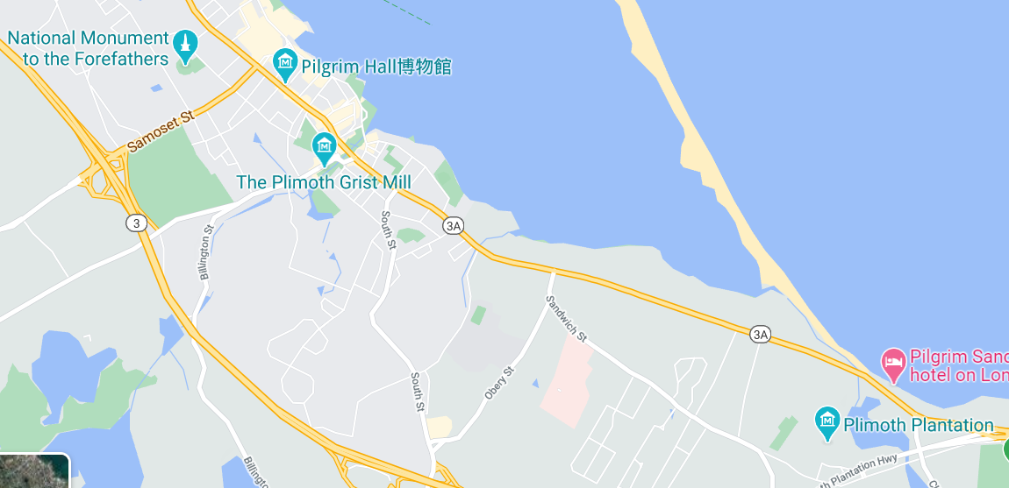
Activity: Touring colonial spaces

Slide 14
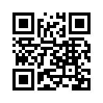
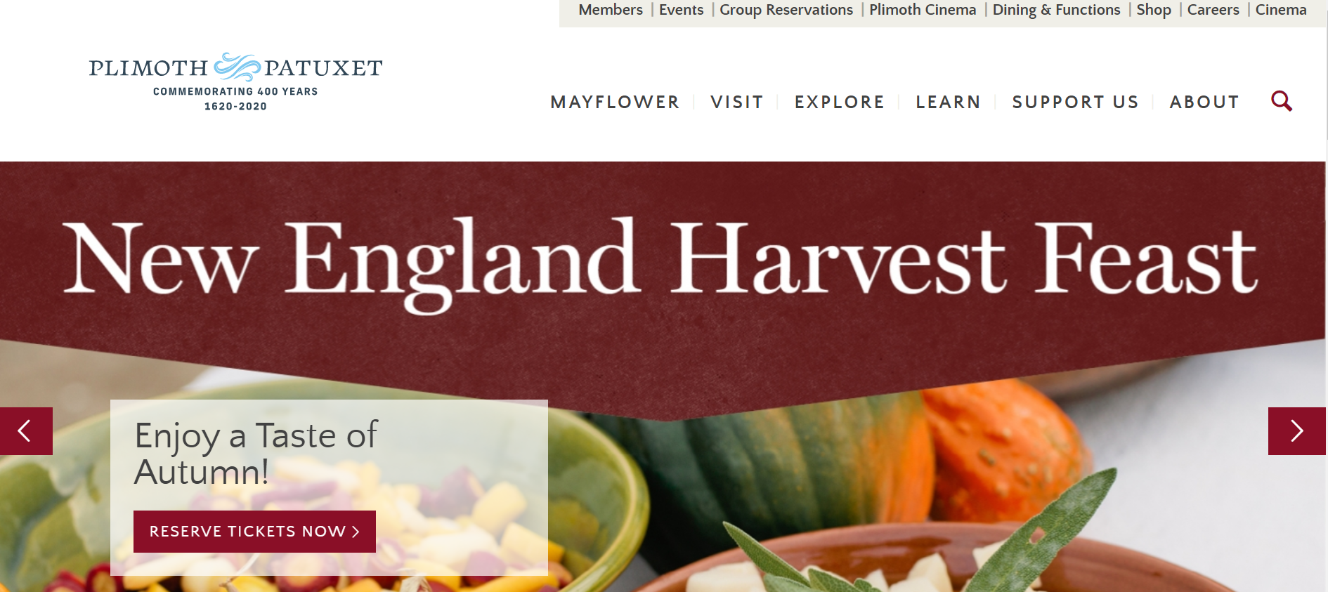
Activity: Touring colonial spaces

Slide 15
Activity: Touring colonial spaces
Get into 6 groups
Choose one topic from the website’s Plimoth
Online-History@Home page
Possible topics: recipes, speech, cloths,
Thanksgiving,
games,
riddles, etc.

Slide 16
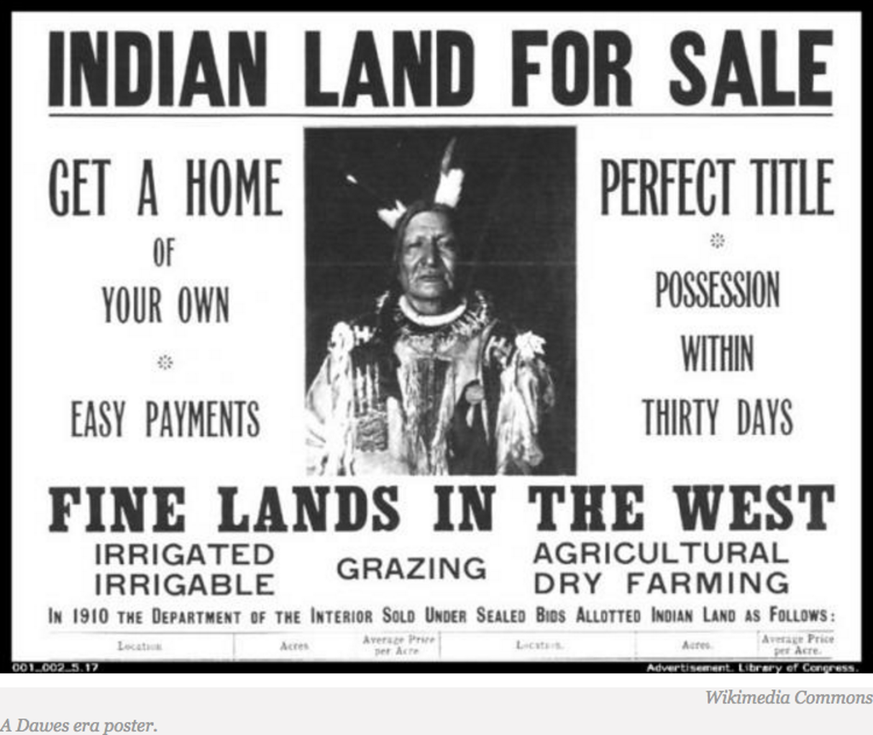
Lecture: What is settler colonialism?

Slide 17
What is settler colonialism?
Colonialism
Colonists come and go (indigenous cultures might be kept)
Settler
colonialism
Colonists are stuck in the colonies (indigenous cultures disappear)

Slide 18
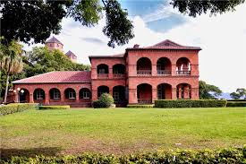
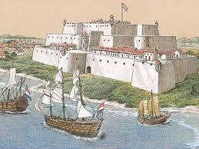
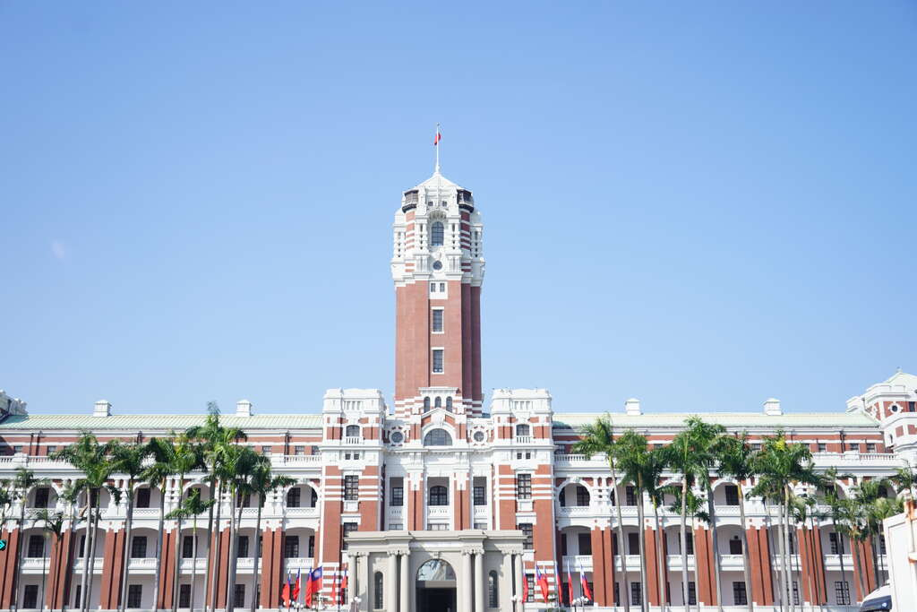
What is settler colonialism?
Notes:
三貂角 (San Diego 西班牙人) 熱蘭遮城/安平古堡 (Zeelandia 荷蘭人) 紅毛城 (San Domingo 西班牙人) 總統府 (總督府 日本)

Slide 19
What is settler colonialism?
Colonialism as a concept has its roots in European expansionism and the founding of the so-called New World. The British, French, Dutch, Portuguese, Spanish, and other European powers established colonies in new places they "discovered" from which to facilitate trade and extract resources, in what can be thought of as the earliest stages of what we now call globalization. The mother country (known as the metropole) would come to dominate indigenous populations through their colonial governments, even when the indigenous population remained in the majority for the duration of colonial control.
https://www.thoughtco.com/american-settler-colonialism-4082454

Slide 20
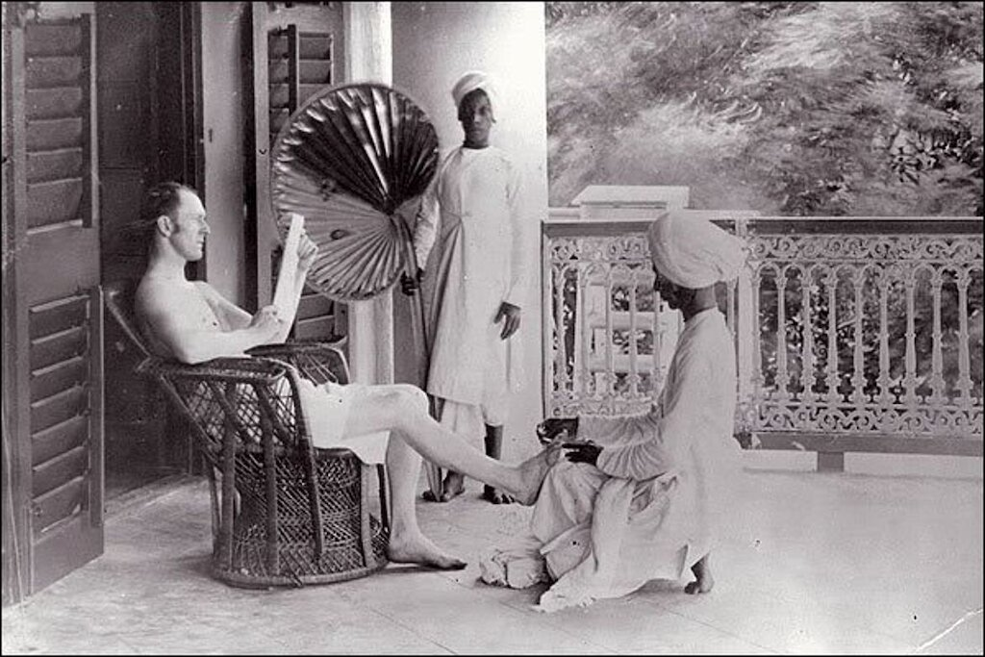
What is settler colonialism?

Slide 21
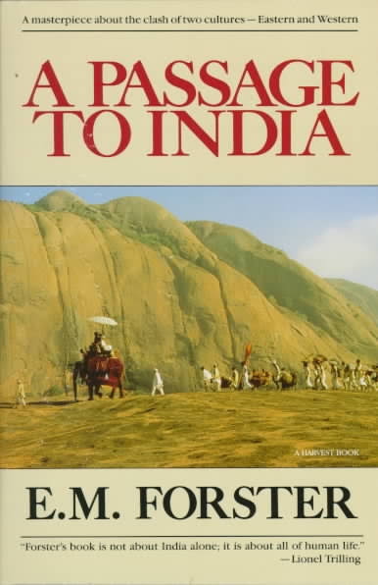
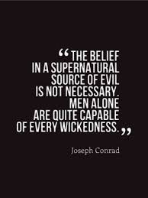
What is settler colonialism?

Slide 22
What is settler colonialism?
「花菜賣多少錢？」巡警問。
「大人要的，不用問價，肯要我的東西，就算運氣好。」參說。他就擇幾莖好的，用稻草貫著，恭敬地獻給他。
「不，稱稱看！」巡警幾番推辭著說。誠實的參，亦就掛上『稱仔』稱一稱，說：
「大人，真客氣啦！纔一斤十四兩。」本來，經過秤稱過，就算買賣，就是有錢的交關，不是白要，亦不能說是贈與。
「不錯罷？」巡警說。
「不錯，本有兩斤足，因是大人要的…… 」參說。這句話是平常買賣的口吻，不是贈送的表示。
「稱仔不好罷，兩斤就兩斤，何須打扣？」巡警變色地說。
「不，還新新呢！」參泰然地回答。
「拿過來！」巡警赫怒了。
「稱花（度目）還很明瞭。」參從容地捧過去說。巡警接在手裡，約略考察一下說：
「不堪用了，拿到警署去！」
「什麼緣故？修理不可嗎？」參說。
「不去嗎？」巡警怒叱著。「不去？畜生！」撲的一聲，巡警把『稱仔』打斷擲棄，隨抽出胸前的小帳子，把參的名姓、住處，記下。氣憤憤地，回警署去。

Slide 23
What is settler colonialism?
Characteristics of colonialism
Two classes of people
Focuses on economic gain
Usually violent rule

Slide 24
What is settler colonialism?
Settler colonialism has best been defined as more of an imposed structure than a historical event. This structure is characterized by relationships of domination and subjugation that become woven throughout the fabric of society and even becomes disguised as paternalistic benevolence. The objective of settler colonialism is always the acquisition of indigenous territories and resources, which means the native must be eliminated. This can be accomplished in overt ways including biological warfare and military domination but also in more subtle ways; for example, through national policies of assimilation

Slide 25
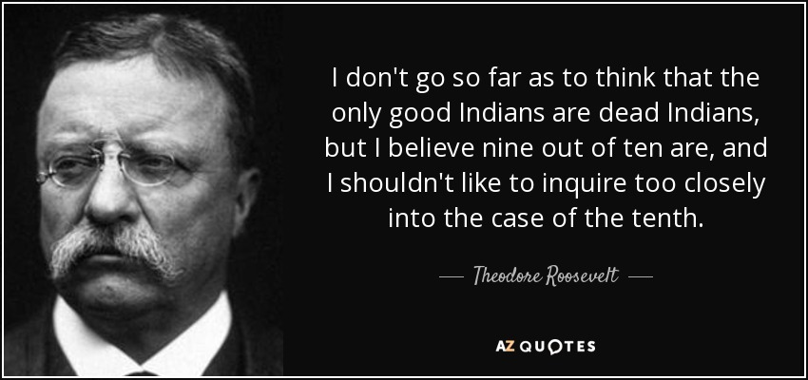
What is settler colonialism?
“The most vicious cowboy has more moral principle than the average Indian.”

Slide 26
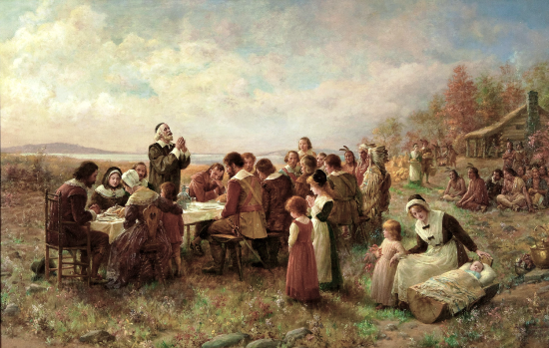
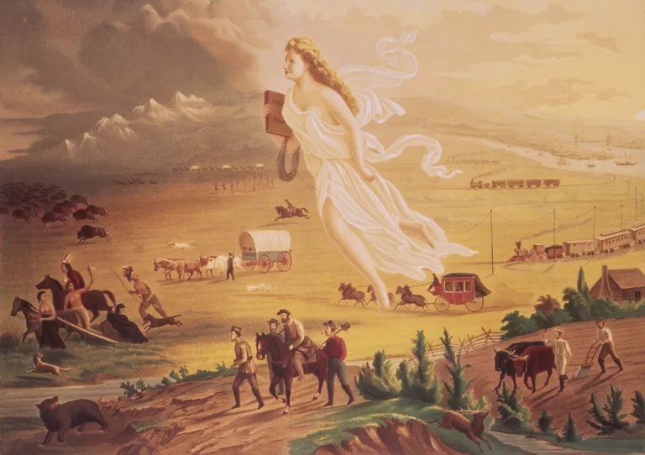
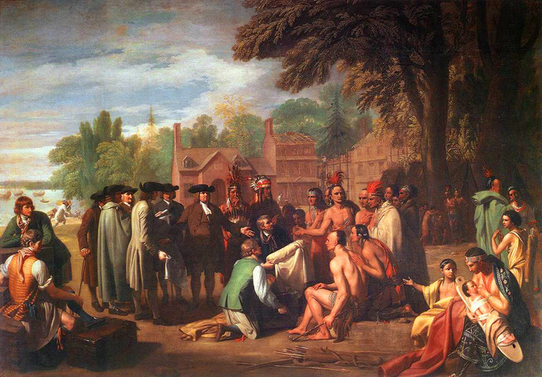
What is settler colonialism?
Notes:
“Manifest Destiny” “Treaty of Penn with Indians” “The First Thanksgiving at Plymouth”

Slide 27
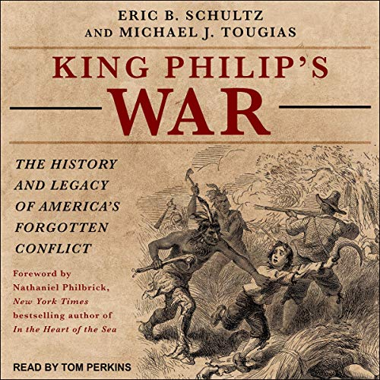
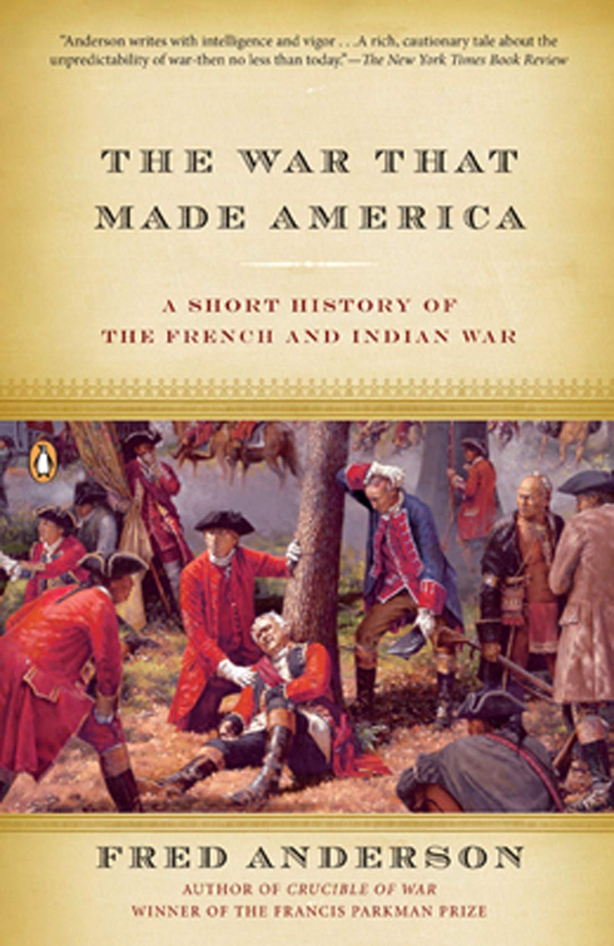
What is settler colonialism?

Slide 28
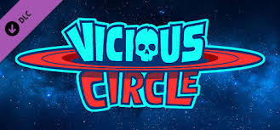
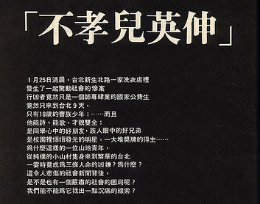
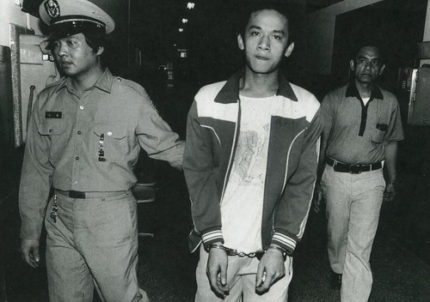
What is settler colonialism?
Notes:
Vicious circle: dominant group oppress minority because they are inferior → they become disadvantaged → dominant group can justify their inferiority

Slide 29
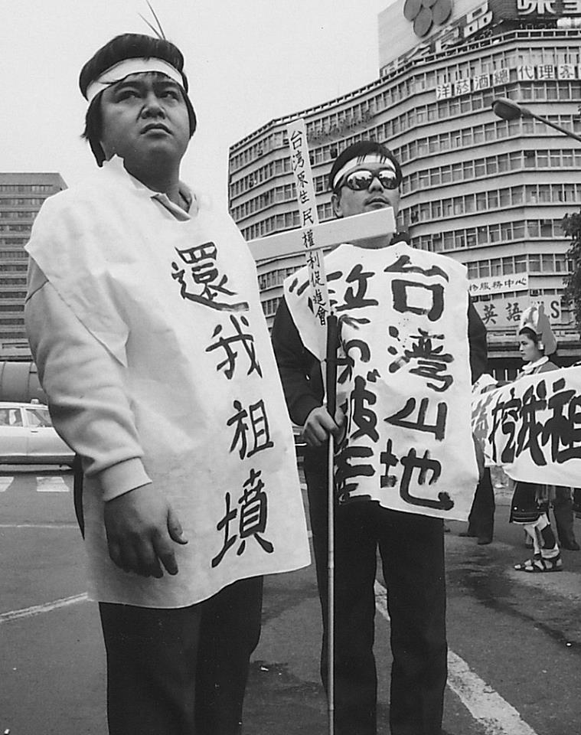
What is settler colonialism?

Slide 30
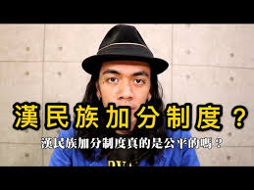
What is settler colonialism?
https://www.youtube.com/watch?v=ydreTEf52_U

Slide 31
What is settler colonialism?
Characteristics of colonialism | Characteristics of settler colonialism
Two classes of people | Division hard to see
Focuses on economic gain | Focuses on land acquisition
Usually violent rule | Violent rule + Cultural policy

Slide 32
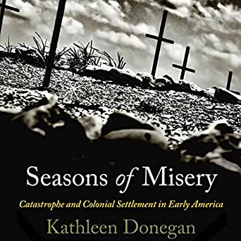
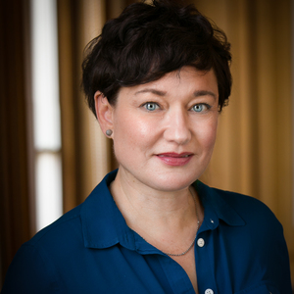
What is settler colonialism?

Slide 33
What is settler colonialism?

Slide 34
What is settler colonialism?

Slide 35
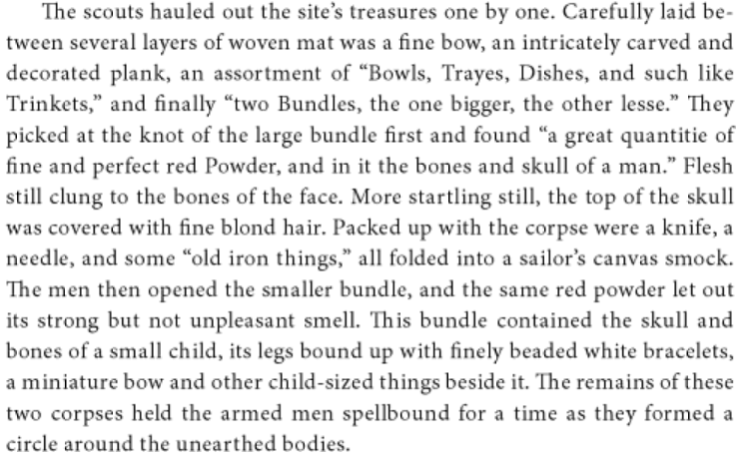
What is settler colonialism?

Slide 36
What is settler colonialism?

Slide 37
What is settler colonialism?

Slide 38
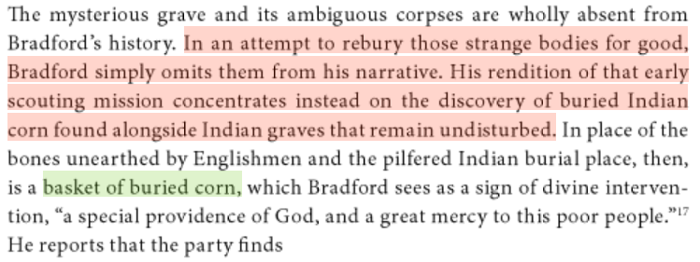
What is settler colonialism?

Slide 39
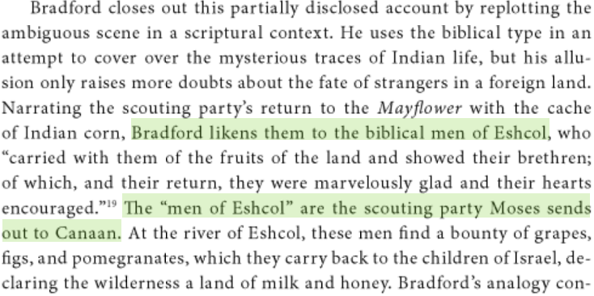
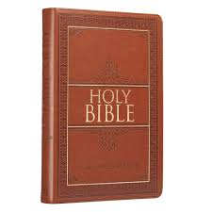
What is settler colonialism?

Slide 40
