Slide 1
Rhetorical Strategies of
Harriet Jacobs and Frederick Douglass

Slide 2
Plan for today
Peer Teaching: Harriet Jacobs and Frederick Douglass
Quiz
Activity: A day in the life
Lecture:
Christianity and slavery
Rhetorical strategies and slave narratives
Wrap-up of the semester: the danger of a single story

Slide 3
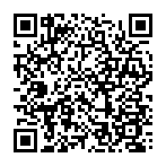
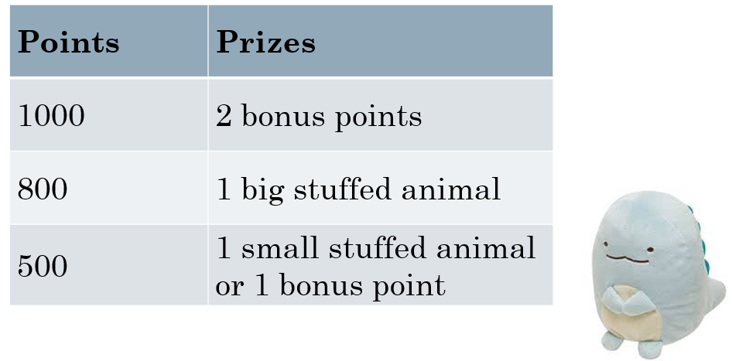
Redeem your prizes

Slide 4

Round 1
Get together with students who read the same excerpt (2-3 people in a group).
Share notes, communicate ideas, ask questions.

Slide 5
Round 2
Exchange group members.
Follow the steps:
A team starts by stating the main point of the reading and offer examples from the notes.
B team takes notes, ask questions, and tries to give a summary of A team’s presentation.
B team repeats step one.

Slide 6
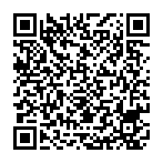
Round 3
Go to Google document to share four things:
One similarity between the two readings
One difference between the two readings
One interesting observation/fact
One question that bothers you

Slide 7


Quiz

Slide 8
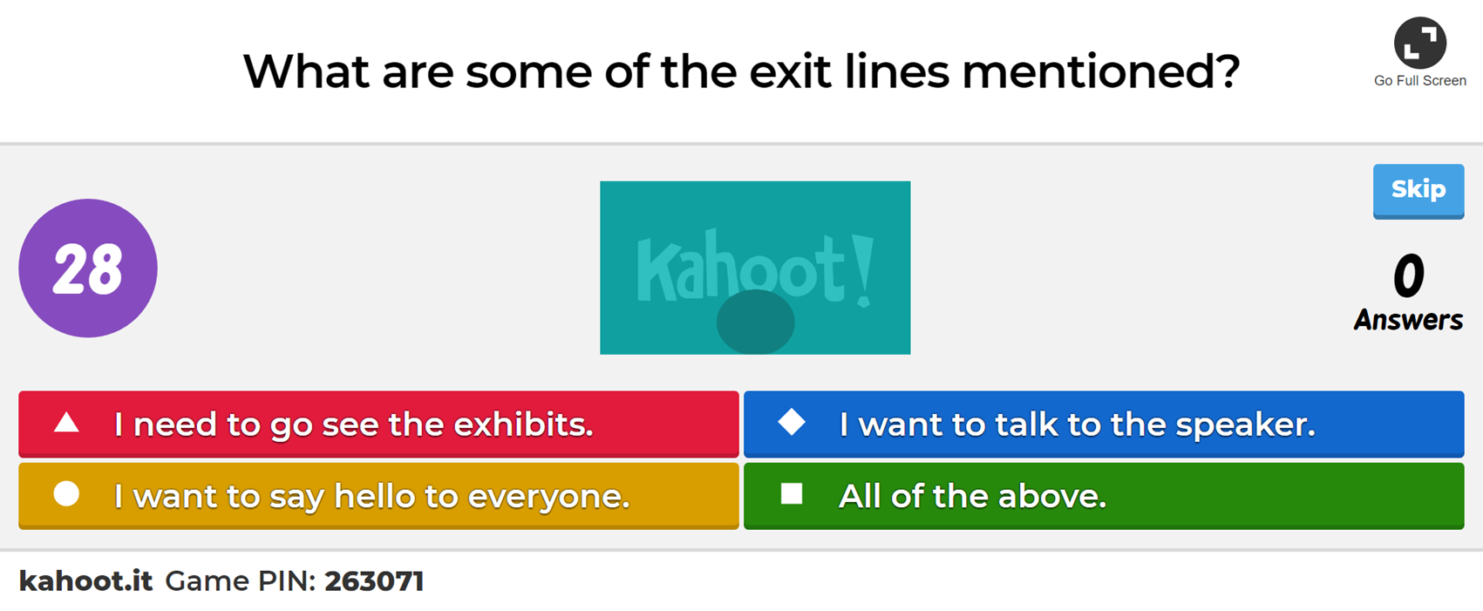

Quiz
Use your student ID number

Slide 9
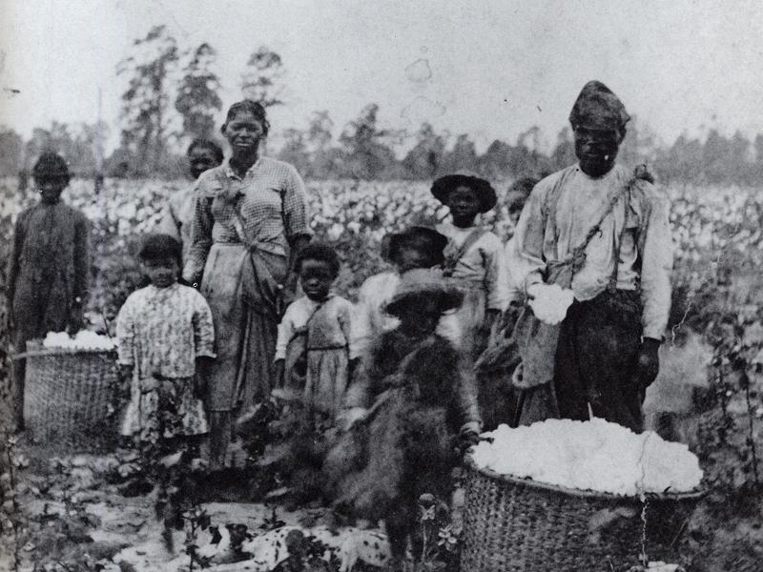
A Day in the Life

Slide 10
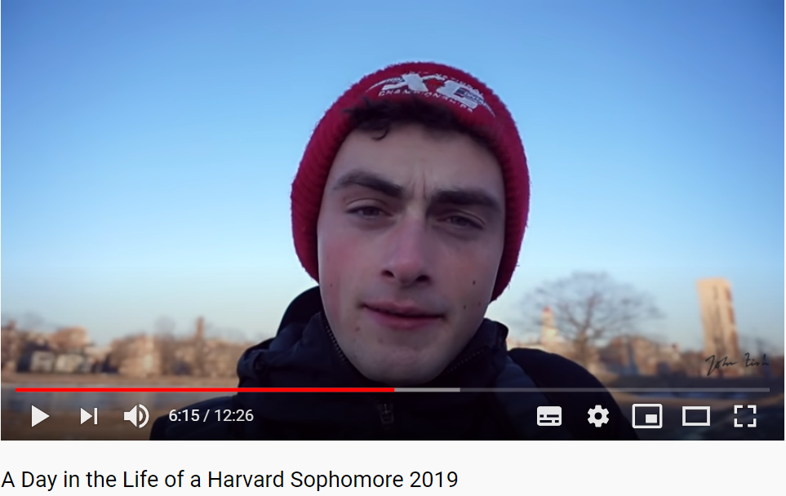

Slide 11
A Day in the Life of a Field Slave
Use your reading journal to write a daily planner of a field slave
Compare your daily planner with friends

Slide 12
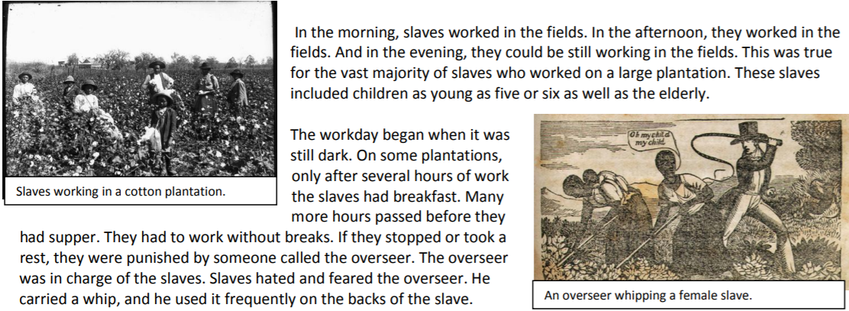
https://www.lee.k12.nc.us/cms/lib03/NC01001912/Centricity/Domain/1464/Slave%20Life%20on%20a%20Southern%20Plantation.pdf

Slide 13
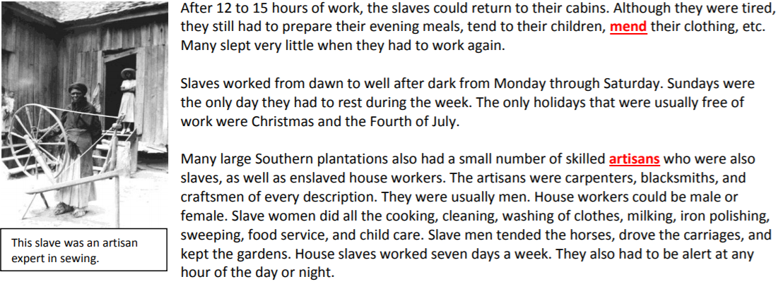
https://www.lee.k12.nc.us/cms/lib03/NC01001912/Centricity/Domain/1464/Slave%20Life%20on%20a%20Southern%20Plantation.pdf

Slide 14
Christianity and Slavery

Slide 15
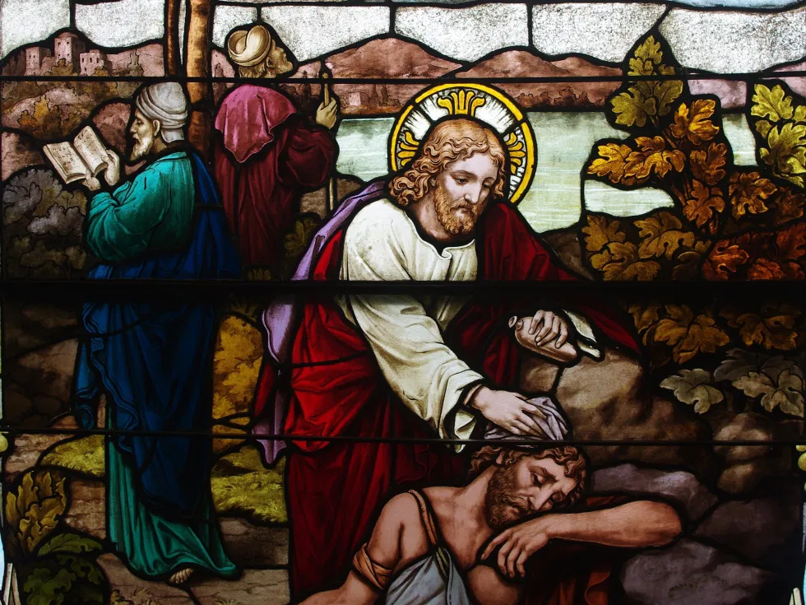
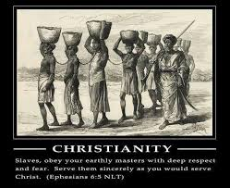
Good Christians, Bad Christians

Slide 16
In the United States, the abolition movement faced much opposition. Bertram Wyatt-Brown notes that the appearance of the Christian abolitionist movement "with its religious ideology alarmed newsmen, politicians, and ordinary citizens. They angrily predicted the endangerment of secular democracy, the mongrelization, as it was called, of white society, and the destruction of the federal union. Speakers at huge rallies and editors of conservative papers in the North denounced these newcomers to radical reform as the same old “church-and-state” zealots, who tried to shut down post offices, taverns, carriage companies, shops, and other public places on Sundays. Mob violence sometimes ensued."
https://en.wikipedia.org/wiki/Christian_abolitionism

Slide 17
Despite such determined opposition, many Methodist, Baptist, and Presbyterian members freed their slaves and sponsored black congregations, in which many black ministers encouraged slaves to believe that freedom could be gained during their lifetime. After a great revival occurred in 1801 at Cane Ridge, Kentucky, American Methodists made anti-slavery sentiments a condition of church membership. Abolitionist writings, such as "A Condensed Anti-Slavery Bible Argument" (1845) by George Bourne, and "God Against Slavery" (1857) by George B. Cheever, used the Bible, logic and reason extensively in contending against the institution of slavery, and in particular the chattel form of it as seen in the South. In Cheever's speech entitled, "The Fire and Hammer of God’s Word Against the Sin of Slavery", his desire for eliminating the crime of slaveholding is clear, as he goes so far as to address it to the President.
https://en.wikipedia.org/wiki/Christian_abolitionism

Slide 18
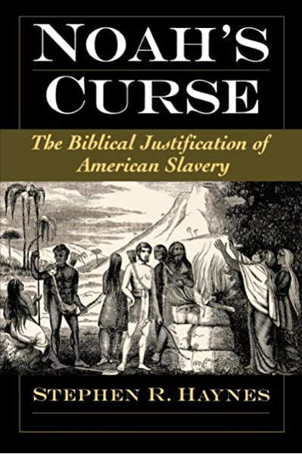
"A servant of servants shall he be unto his brethren." So reads Noah's curse on his son Ham, and all his descendants, in Genesis 9:25. Over centuries of interpretation, Ham came to be identified as the ancestor of black Africans, and Noah's curse to be seen as biblical justification for American slavery and segregation. Examining the history of the American interpretation of Noah's curse, this book begins with an overview of the prior history of the reception of this scripture and then turns to the distinctive and creative ways in which the curse was appropriated by American pro-slavery and pro-segregation interpreters.

Slide 19
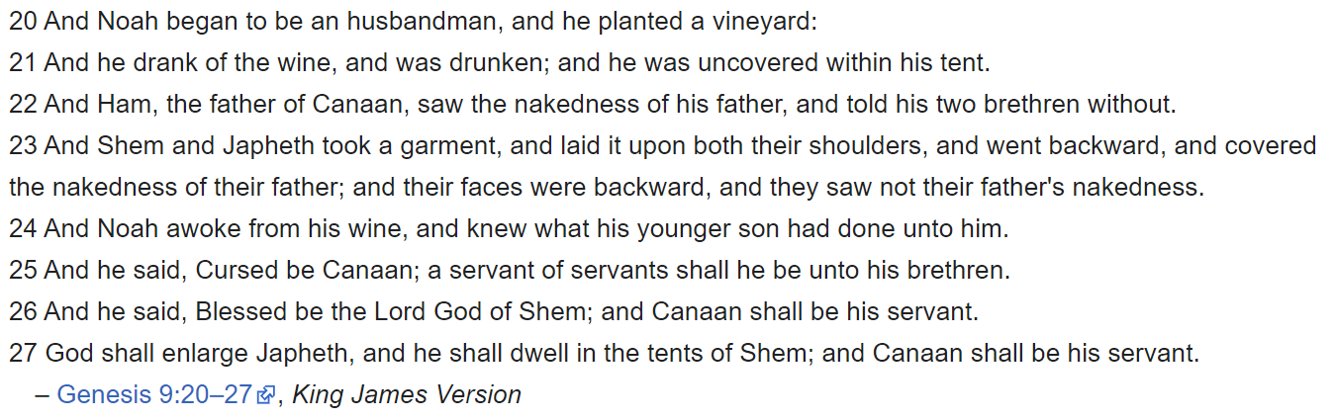

Slide 20
Rhetorical Strategies and Slave Narratives

Slide 21
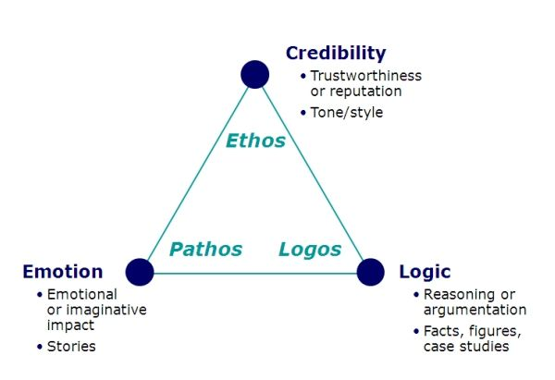

Slide 22



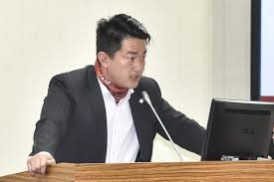

Slide 23
Rhetorical Strategies of Slave Narratives
Read closely either Harriet Jacobs or Frederick Douglass
Identify parts where logos is used
Identify parts where pathos is used

Slide 24
The Danger of a Single Story

Slide 25
