Slide 1

Did the Author’s America Include the Blacks?
Presentation Subtitle

Slide 2
Plan for today
Peer Teaching: De Crevecoeur and Jefferson
Activity: Making history come alive
Lecture:
Finishing up last week’s PPT
Using the language of slavery against the British

Slide 3


Slide 4

Round 1
Get together with students who read the same excerpt (2-3 people in a group).
Share notes, communicate ideas, ask questions.

Slide 5
Round 2
Exchange group members.
Follow the steps:
A team starts by stating the main point of the reading and offer examples from the notes.
B team takes notes, ask questions, and tries to give a summary of A team’s presentation.
B team repeats step one.

Slide 6
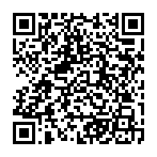
Round 3
Each group will go to Google document to share four things:
One similarity between the two readings
One difference between the two readings
One interesting observation/fact
One question that bothers you

Slide 7
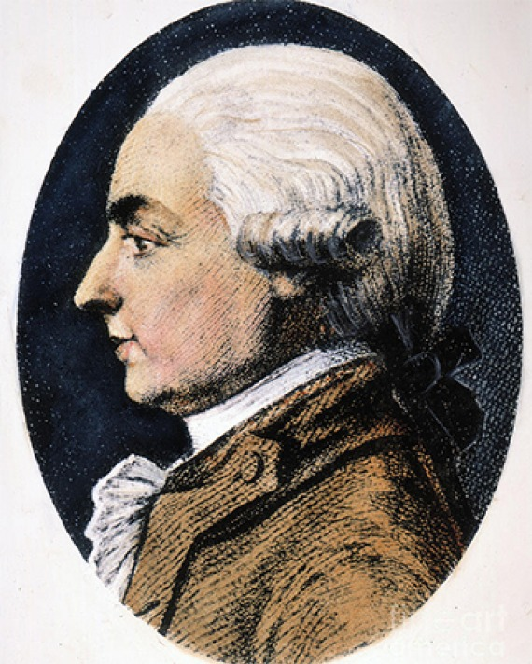
J. Hector St. John de Crevecoeur
J. Hector St. John de Crevecoeur (1735-1813)
Born a French, died an American (naturalized)
Letters from an American Farmer (1782; London)
12 letters in total from the fictional farmer James
https://www.laphamsquarterly.org/contributors/crevecoeur

Slide 8
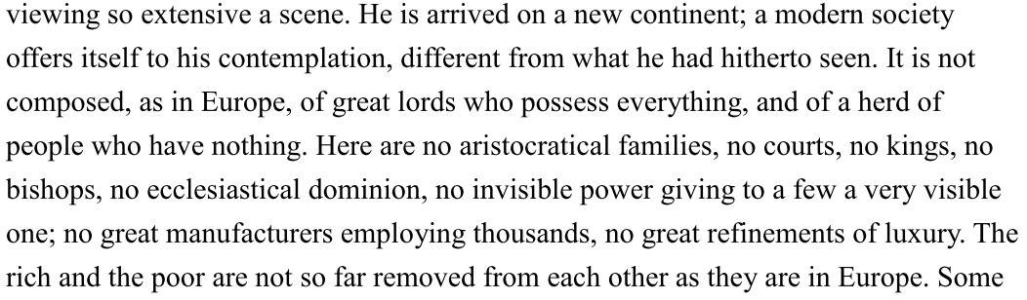
Equality vs. Slavery

Slide 9
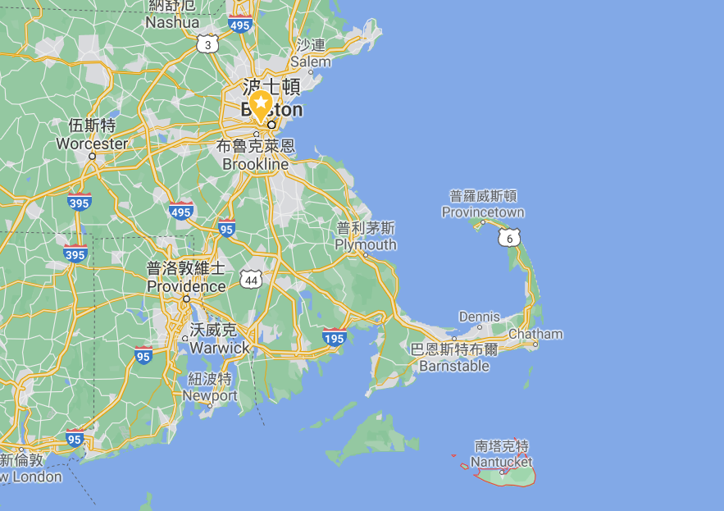

Slide 10
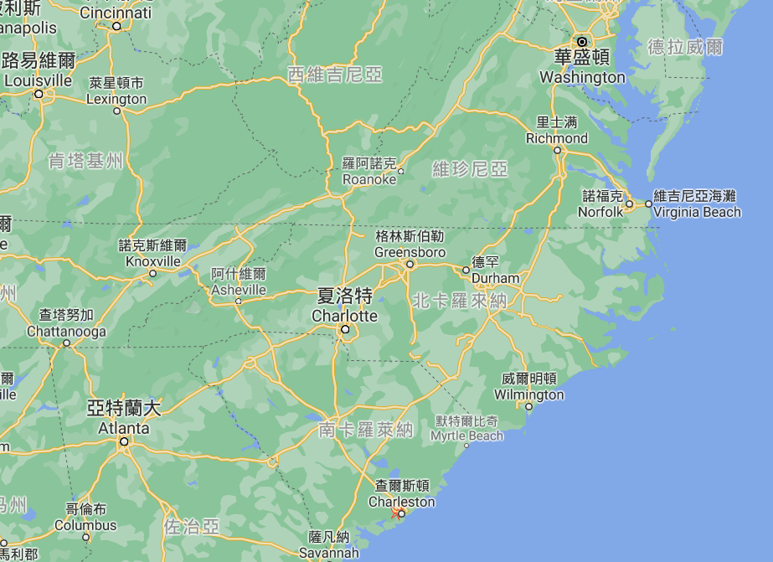

Slide 11
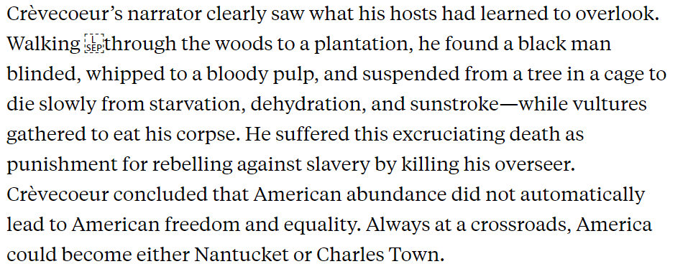
Equality vs. Slavery
https://newrepublic.com/article/113571/crevecoeurs-letters-american-farmer-dark-side

Slide 12
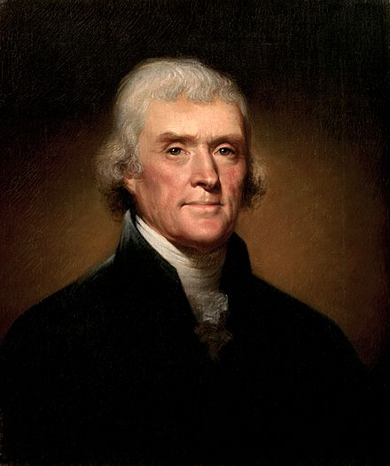
Thomas Jefferson
Thomas Jefferson (1743-1826)
The third president of the United States (1801-1809; George Washington; John Adams)
Notes on the State of Virginia (1785)
https://en.wikipedia.org/wiki/Notes_on_the_State_of_Virginia#Outline

Slide 13
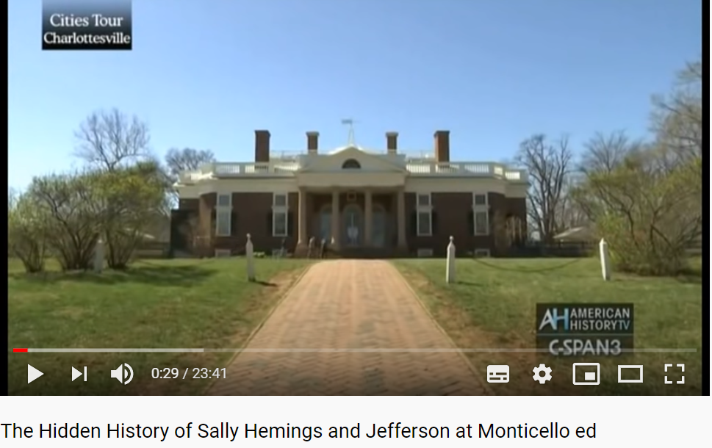
https://youtu.be/Jy2Ew7vzskc

Slide 14

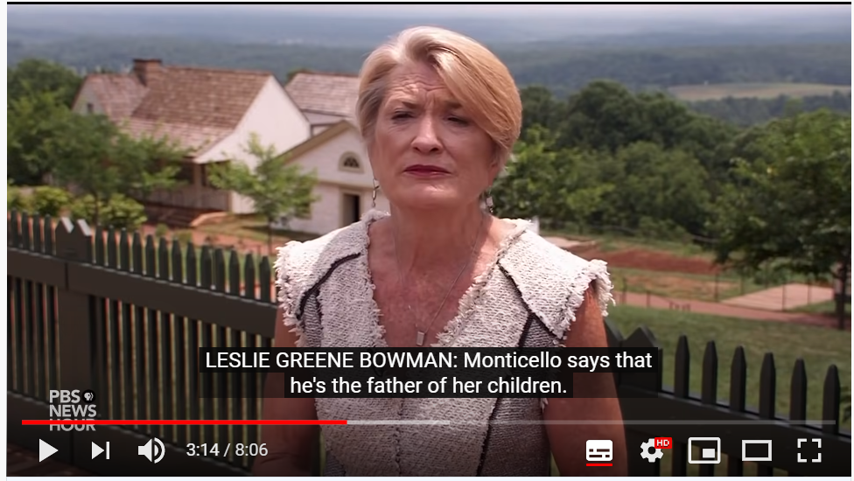
Sally Hemings
https://youtu.be/0Gm3HtijrMQ

Slide 15


Slide 16
Q & A with Farmer James or Jefferson
Work in pairs and write a short dialogue (in Q&A format) between
Farmer James and his London correspondent
Jefferson and Phillis Wheatley

Slide 17

Lecture
Finishing up last week’s PPT
Using the language of slavery against the British

Slide 18
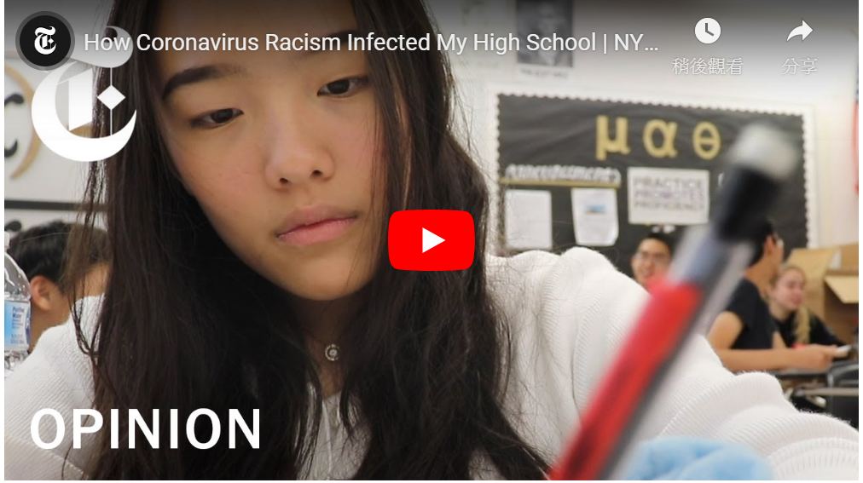
3: Understanding Racism
https://tw.voicetube.com/videos/104736

Slide 19
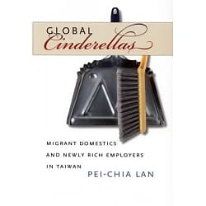

4: Racism in Taiwan?
Do you think Taiwan has racism?

Slide 20
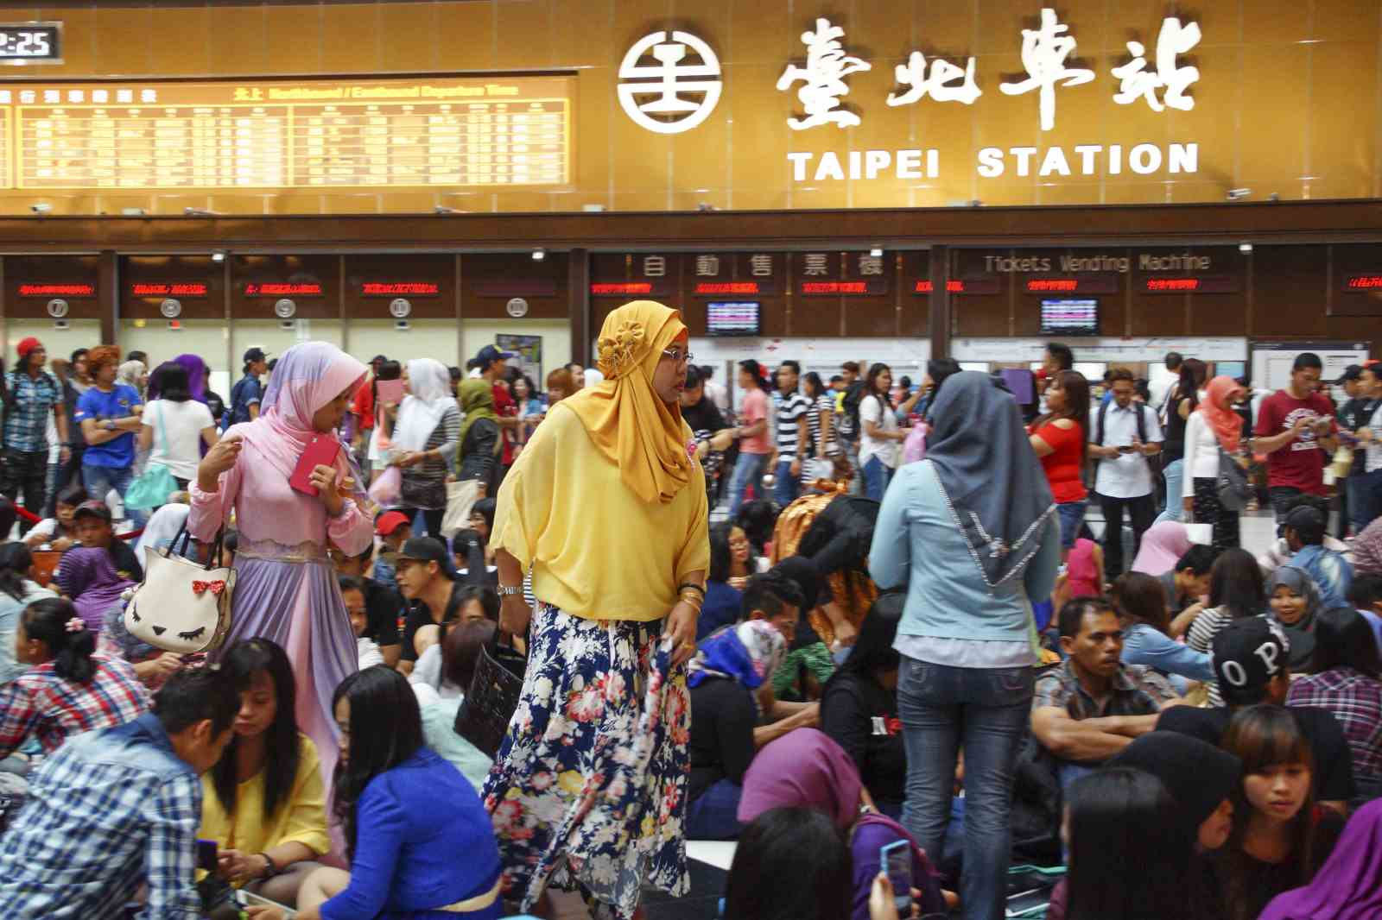
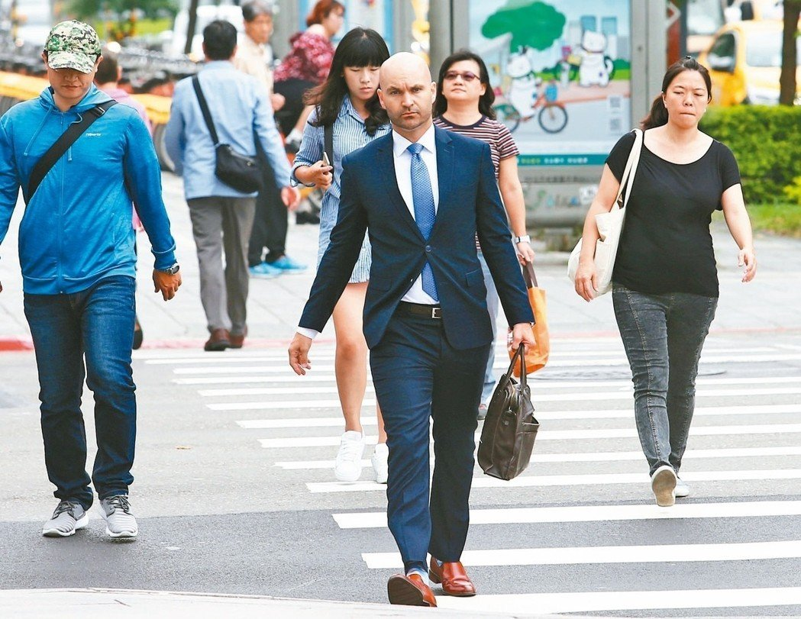
4: Racism in Taiwan
Racialization refers to “a process by which a group comes to be marked by its physical and cultural distinctiveness.” The marked distinctiveness of foreign workers is not limited to their difference from Taiwanese citizens; their subject positions are also constituted in relation to other categories of foreigners. I raise the concept “stratified otherization” to emphasize the relational construction of racialized boundaries.

Slide 21
4: Racism in Taiwan
Local newspapers and magazines often use sensational headlines to cover stories of contagious diseases carried by migrant workers, such as “Parasites: The majority of the carriers are Filipina maids” and “Two more AIDS migrant workers found.” These diseases are often associated with the living conditions in Southeast Asia, which are negatively portrayed as “backward,” “dirty,” and “uncivilized” among the Taiwanese public.

Slide 22
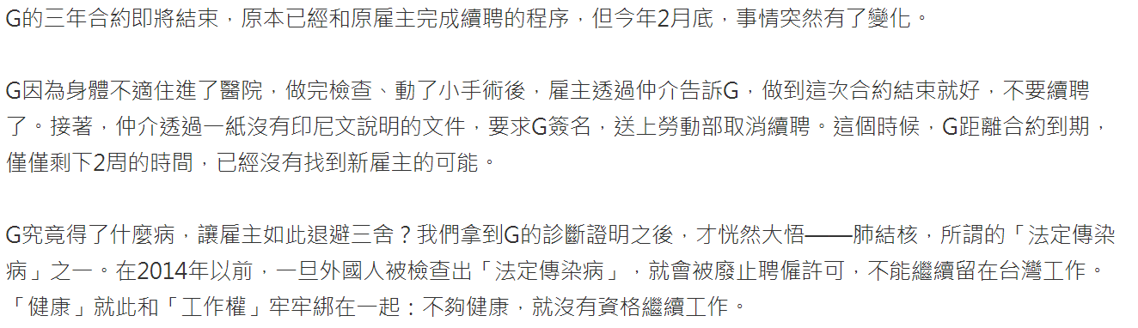
4: Racism in Taiwan

Slide 23
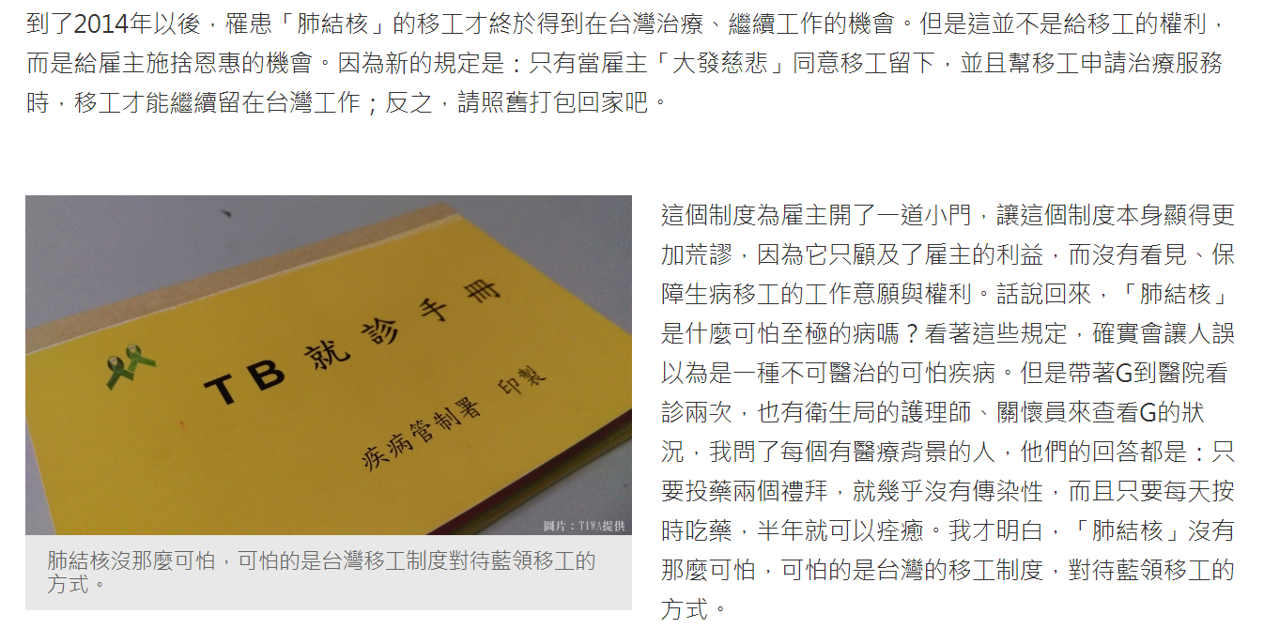
4: Racism in Taiwan

Slide 24
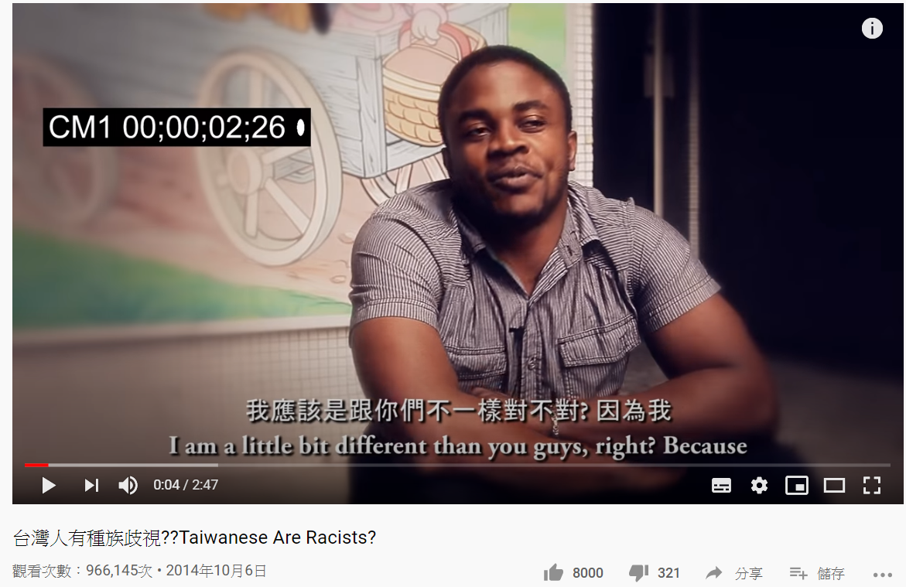
4: Racism in Taiwan
https://youtu.be/X-pHPHG60iM

Slide 25
Using the Language of Slavery Against the British

Slide 26

Revolutionary leaders borrowed the language of slavery
to talk about something else

Slide 27
Strategy 1: Slavery is an “European” invention
Shortly after the American Revolution, South Carolina historian Alexander Hewatt wrote that “upon the slightest reflection all men must confess that those Africans, whom the powers of Europe have conspired to enslave, are by nature equally free and independent . . . as Europeans themselves” (qtd. in Hoffer, Cry Liberty 134).

Slide 28
Strategy 1: Slavery is an “European” invention
Shortly after the American Revolution, South Carolina historian Alexander Hewatt wrote that “upon the slightest reflection all men must confess that those Africans, whom the powers of Europe have conspired to enslave, are by nature equally free and independent . . . as Europeans themselves” (qtd. in Hoffer, Cry Liberty 134).

Slide 29
Strategy 2: White Americans are slaves, too
Single acts of tyranny may be ascribed to the accidental opinion of a day; but a series of oppressions, begun at a distinguished period, and pursued unalterably through every change of ministers, too plainly prove a deliberate and systematical plan of reducing us to slavery. (Jefferson, “A Summary View of the Rights of British America”)
https://avalon.law.yale.edu/18th_century/jeffsumm.asp

Slide 30
Strategy 2: White Americans are slaves, too
Single acts of tyranny may be ascribed to the accidental opinion of a day; but a series of oppressions, begun at a distinguished period, and pursued unalterably through every change of ministers, too plainly prove a deliberate and systematical plan of reducing us to slavery. (Jefferson, “A Summary View of the Rights of British America”)
https://avalon.law.yale.edu/18th_century/jeffsumm.asp

Slide 31
Result: Slaves’ sufferings disappear
In the midst of the American Revolution, Thomas Paine fervidly called upon the people of the colonies to fight for their independence, claiming that Britain was in fact treating them as slaves: “Britain, with an army to enforce her tyranny, has declared, that she has a right (not only to TAX) but ‘to BIND us in ALL CASES WHATSOEVER,’ and if being bound in that manner is not slavery, then is there not such a thing as slavery upon earth” (“The American Crisis, Number I” 91)

Slide 32
Result: Slaves’ sufferings disappear
In the midst of the American Revolution, Thomas Paine fervidly called upon the people of the colonies to fight for their independence, claiming that Britain was in fact treating them as slaves: “Britain, with an army to enforce her tyranny, has declared, that she has a right (not only to TAX) but ‘to BIND us in ALL CASES WHATSOEVER,’ and if being bound in that manner is not slavery, then is there not such a thing as slavery upon earth” (“The American Crisis, Number I” 91)

Slide 33
