Slide 1
How to Learn English on YouTube
Everything
Roger Liu

Slide 2
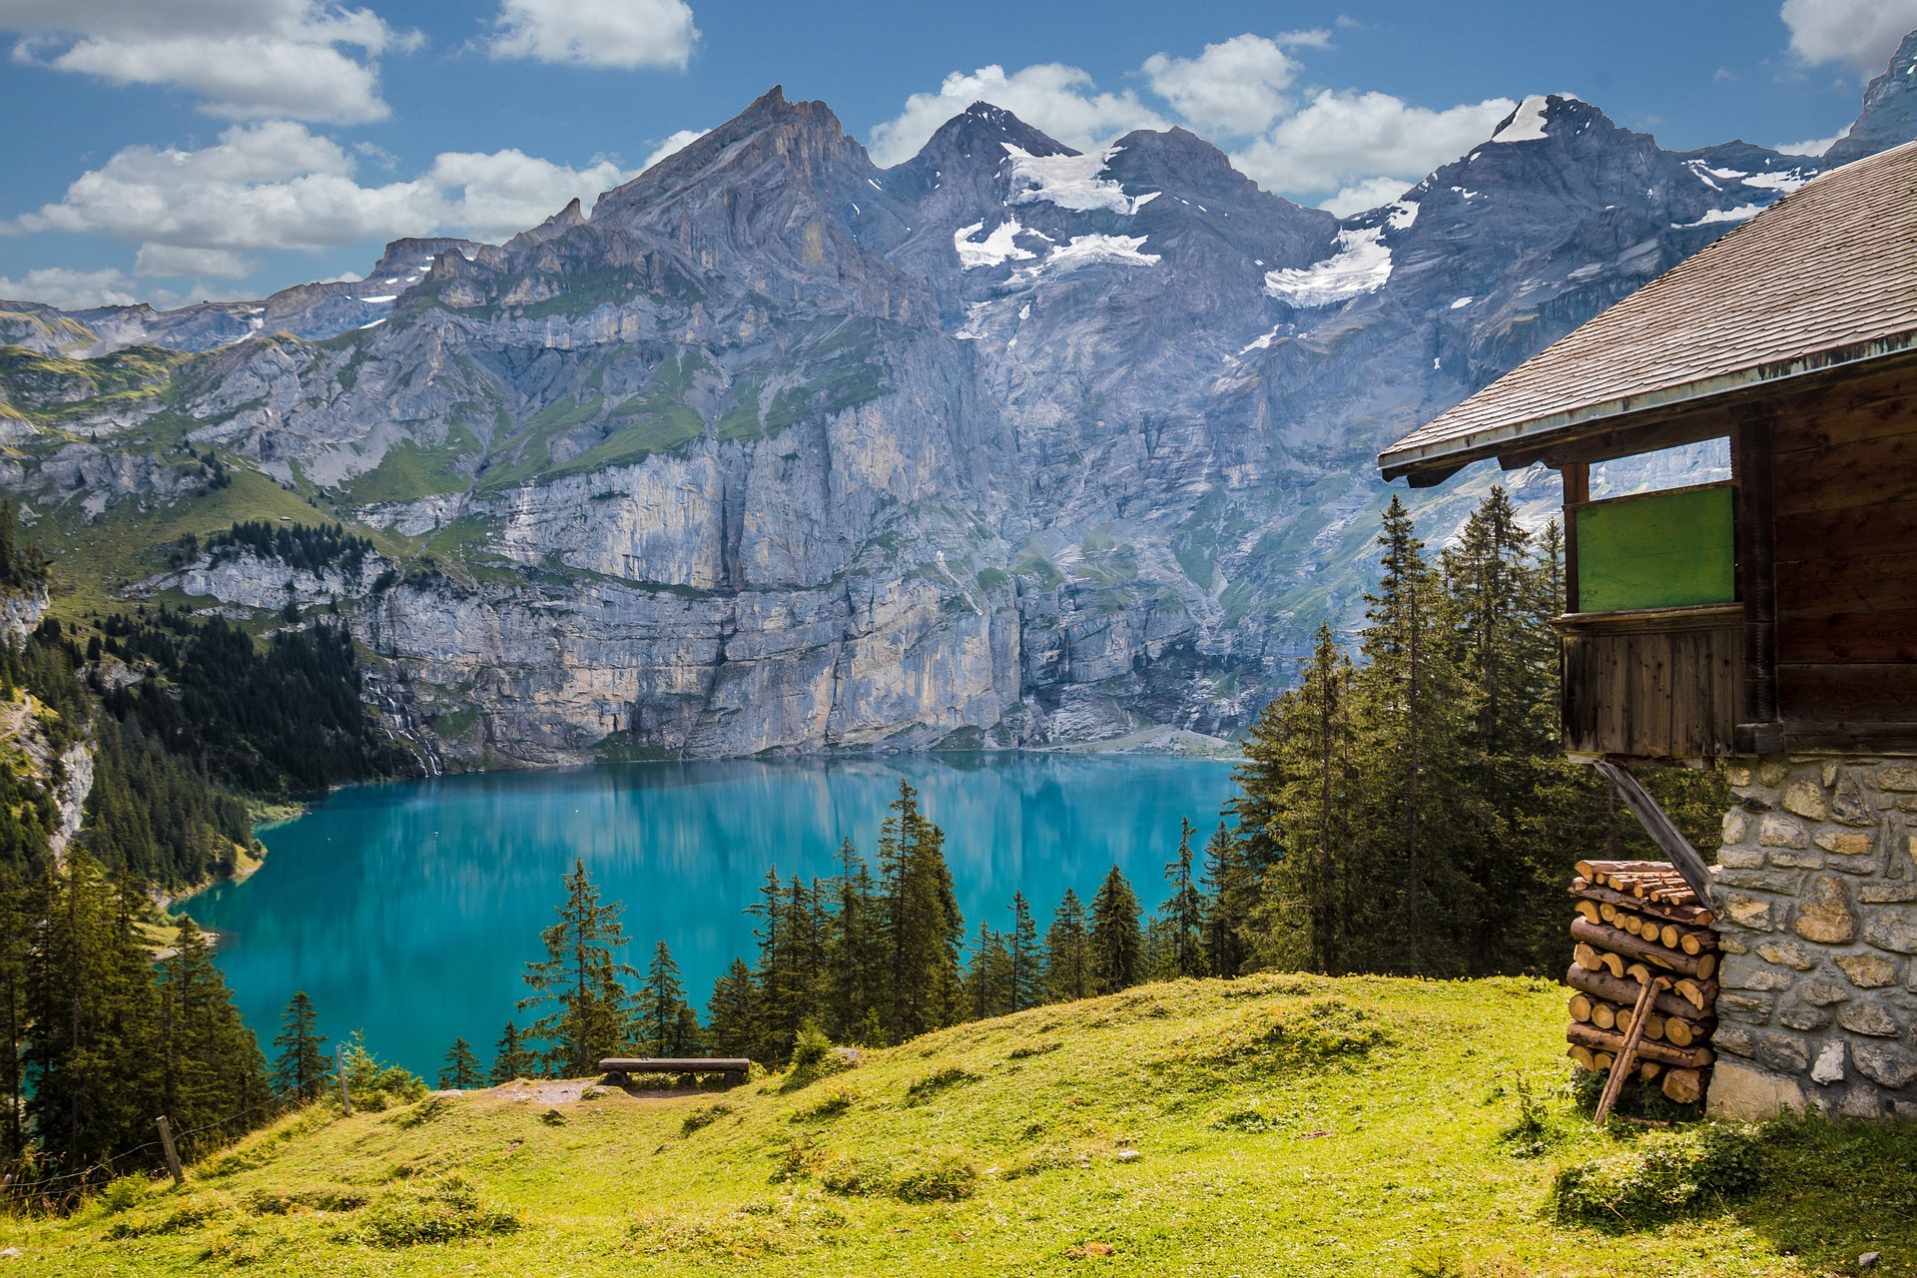
Why are mountains funny?
Because they are hill areas.
https://pixabay.com/images/id-1681485/

Slide 3
Plan for today
Use YouTube like you use a recipe: three cases
Make YouTube your gateway to the world

Slide 4
Fun is the key
when it comes to YouTube videos .

Slide 5
1
Use YouTube Like You Would Use a Recipe Book
https://pixabay.com/images/id-4660847/

Slide 6
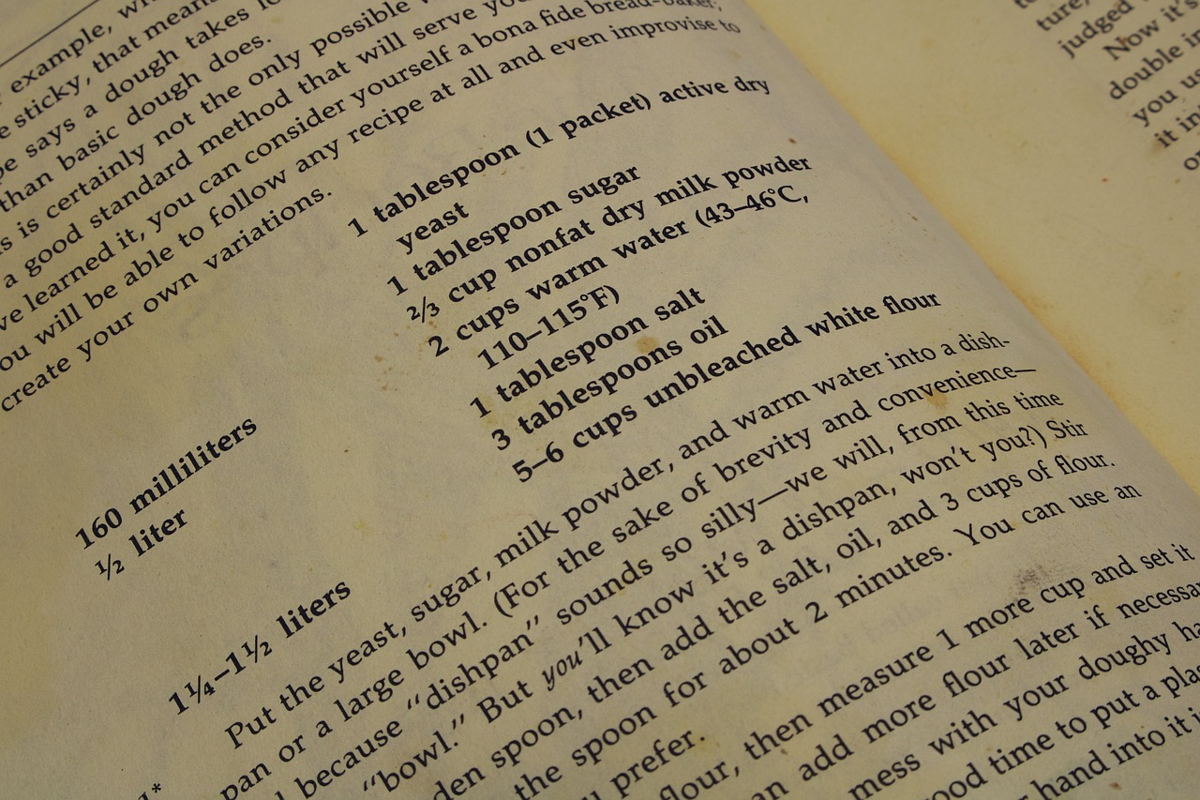
So, how do you use a recipe book?
Learn by following the instructions
https://pixabay.com/images/id-5155874/

Slide 7
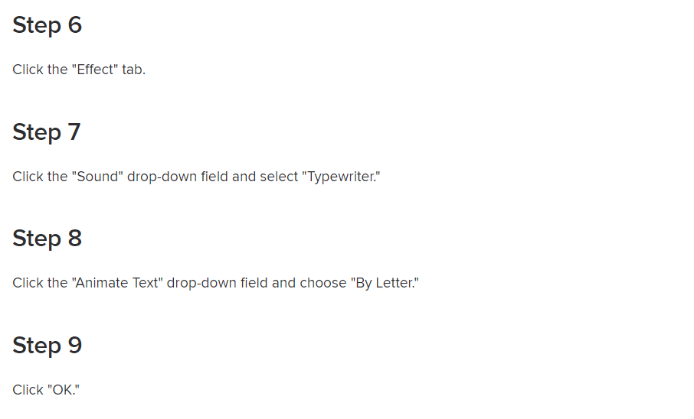
Example: Typewriter Animation

Slide 8
Example: Typewriter Animation
https://youtu.be/Fn_sYJL3P8k

Slide 9
So, what’s the “correct” way to use YouTube?
Use YouTube when you encounter a problem.

Slide 10
Case 1
Cooking
Case 2
Pain relief
Case 3
Travelling

Slide 11
Don’t know how to cook chicken?
Use YouTube!
https://pixabay.com/vectors/meeting-conference-people-table-152506/

Slide 12
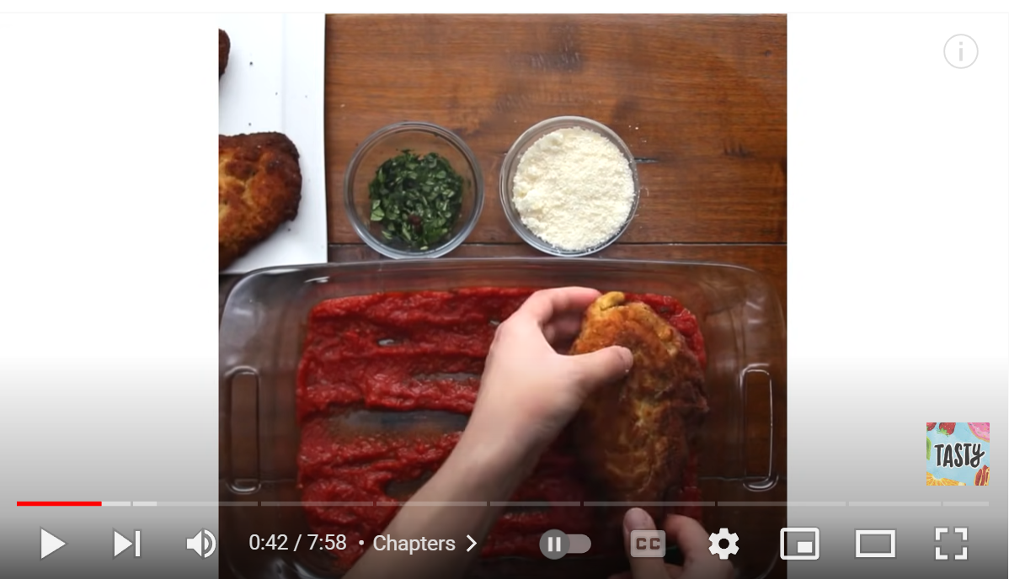
https://youtu.be/mvSNjWDQCAE

Slide 13
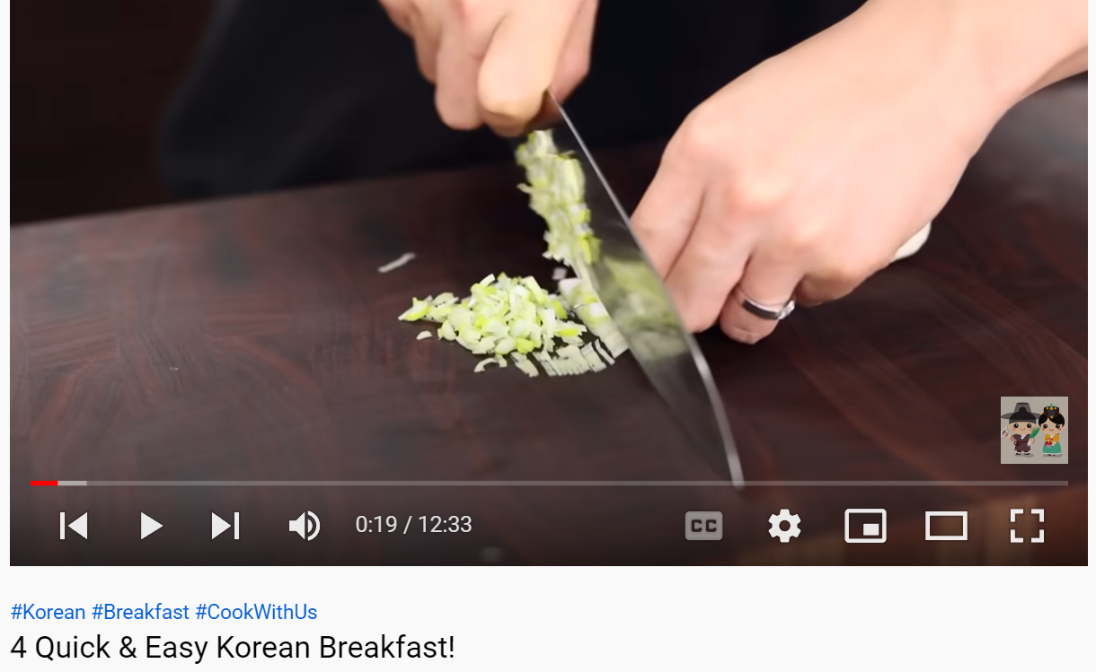
Your Turn
Beef
Sea Bass
Vegetarian
Your own choice
https://youtu.be/fvuHXumNbus

Slide 14
Having a headache?
Use YouTube!
https://pixabay.com/vectors/meeting-conference-people-table-152506/

Slide 15
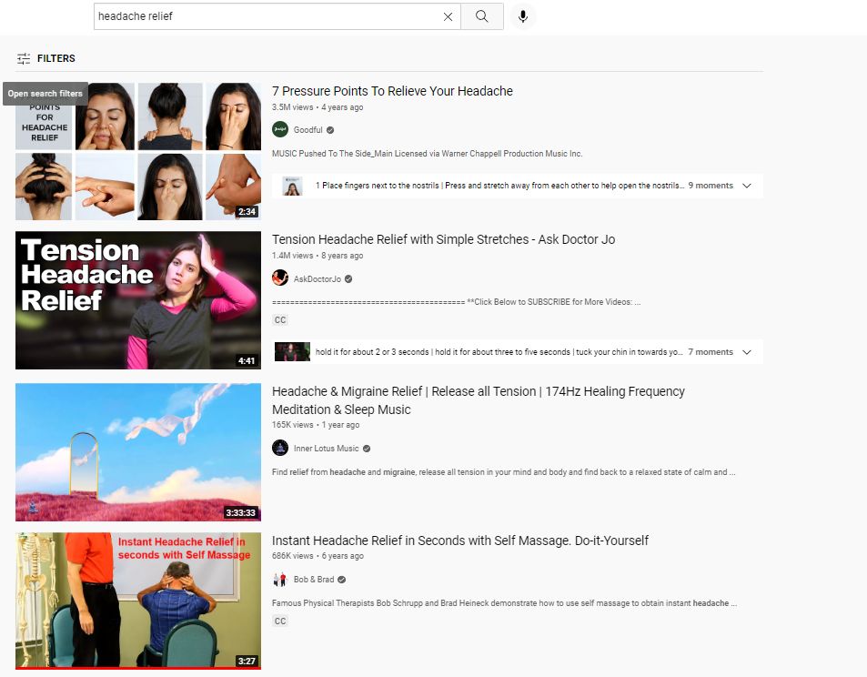
Be careful!
Be careful!
Select your videos wisely (seek expert opinions only)

Slide 17
Travelling to Japan?
Use YouTube!
https://pixabay.com/vectors/meeting-conference-people-table-152506/

Slide 18
https://youtu.be/IuTDuvYr7f0

Slide 19
Your Turn
The good thing about YouTube:
If you don’t like the video you are watching, choose another video!
Taipei
Seoul
Bangkok
Your own choice

Slide 20
2
Make YouTube your gateway
to the world
https://pixabay.com/images/id-4660847/

Slide 21
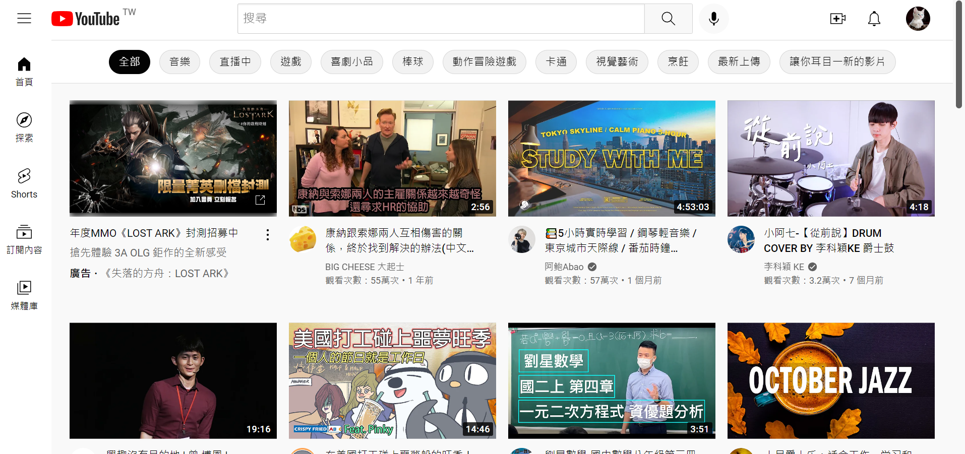
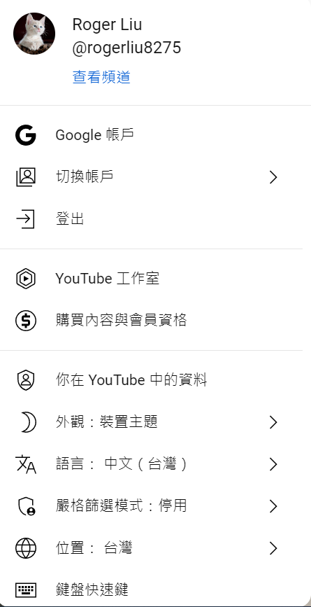

Slide 22
