Slide 1
Is Whitman’s Poetry Homoerotic?

Slide 2
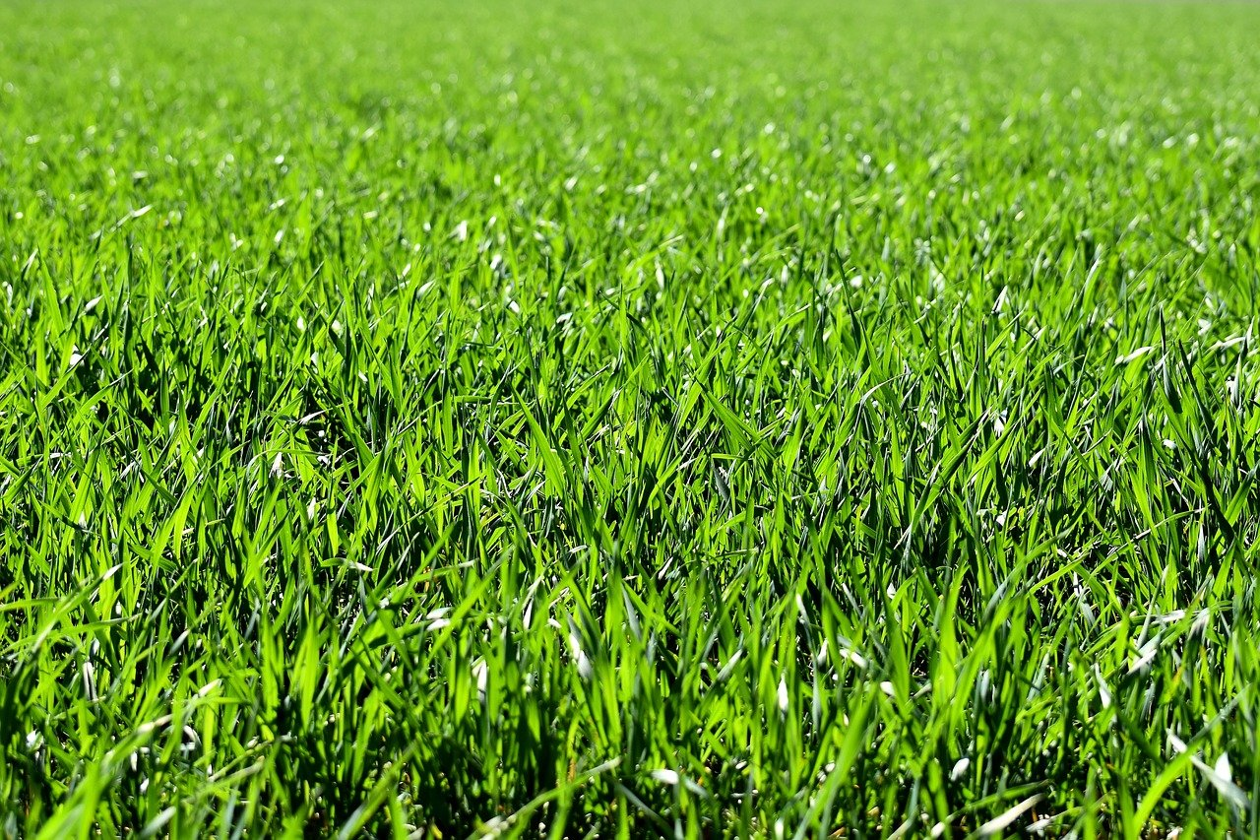
Whitman’s life
Whitman vs. Emerson
Whitman and sex
Whitman and slavery
Whitman and democracy
Whitman’s impossible homecoming

Slide 3

Whitman’s Life
Born in 1819 in West Hills, New York
Moved to Brooklyn at 4
Dropped out of school at 11
Taught school when he was about 20
Published “The punishment of Pride” (poem) and “Death in the School-Room” (story; against corporeal punishment) at 22
At 36, published the first edition of Leaves of Grass
Tended the injured and the sick during the Civil War
Visited by Oscar Wilde at 63
Died in 1892 in New Jersey

Slide 4
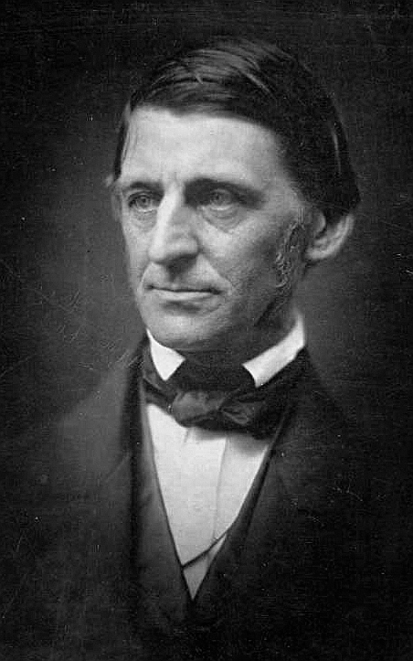
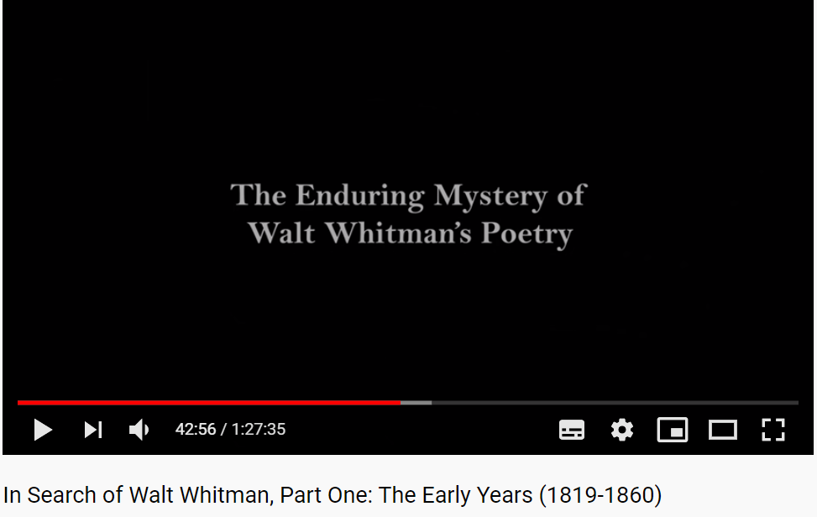
Behind Whitman’s poetry
“Cosmic consciousness”
https://youtu.be/RHgfTd9zbJ8?t=2576
https://en.wikipedia.org/wiki/Ralph_Waldo_Emerson

Slide 5
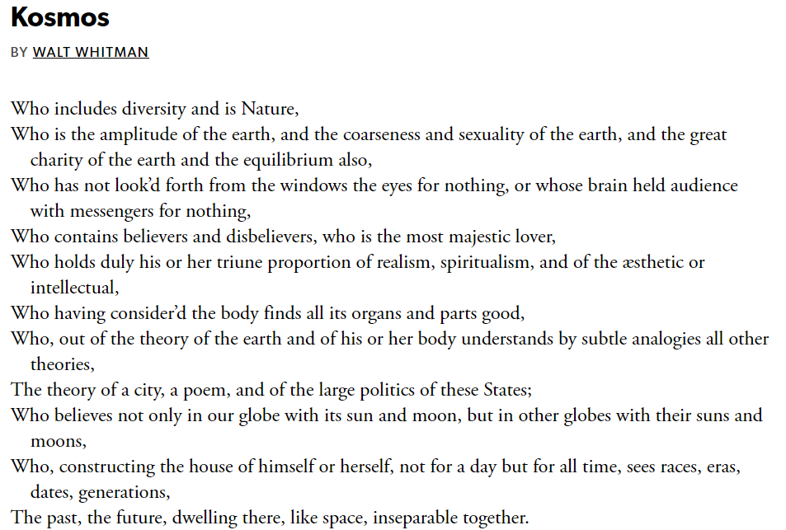

Slide 6

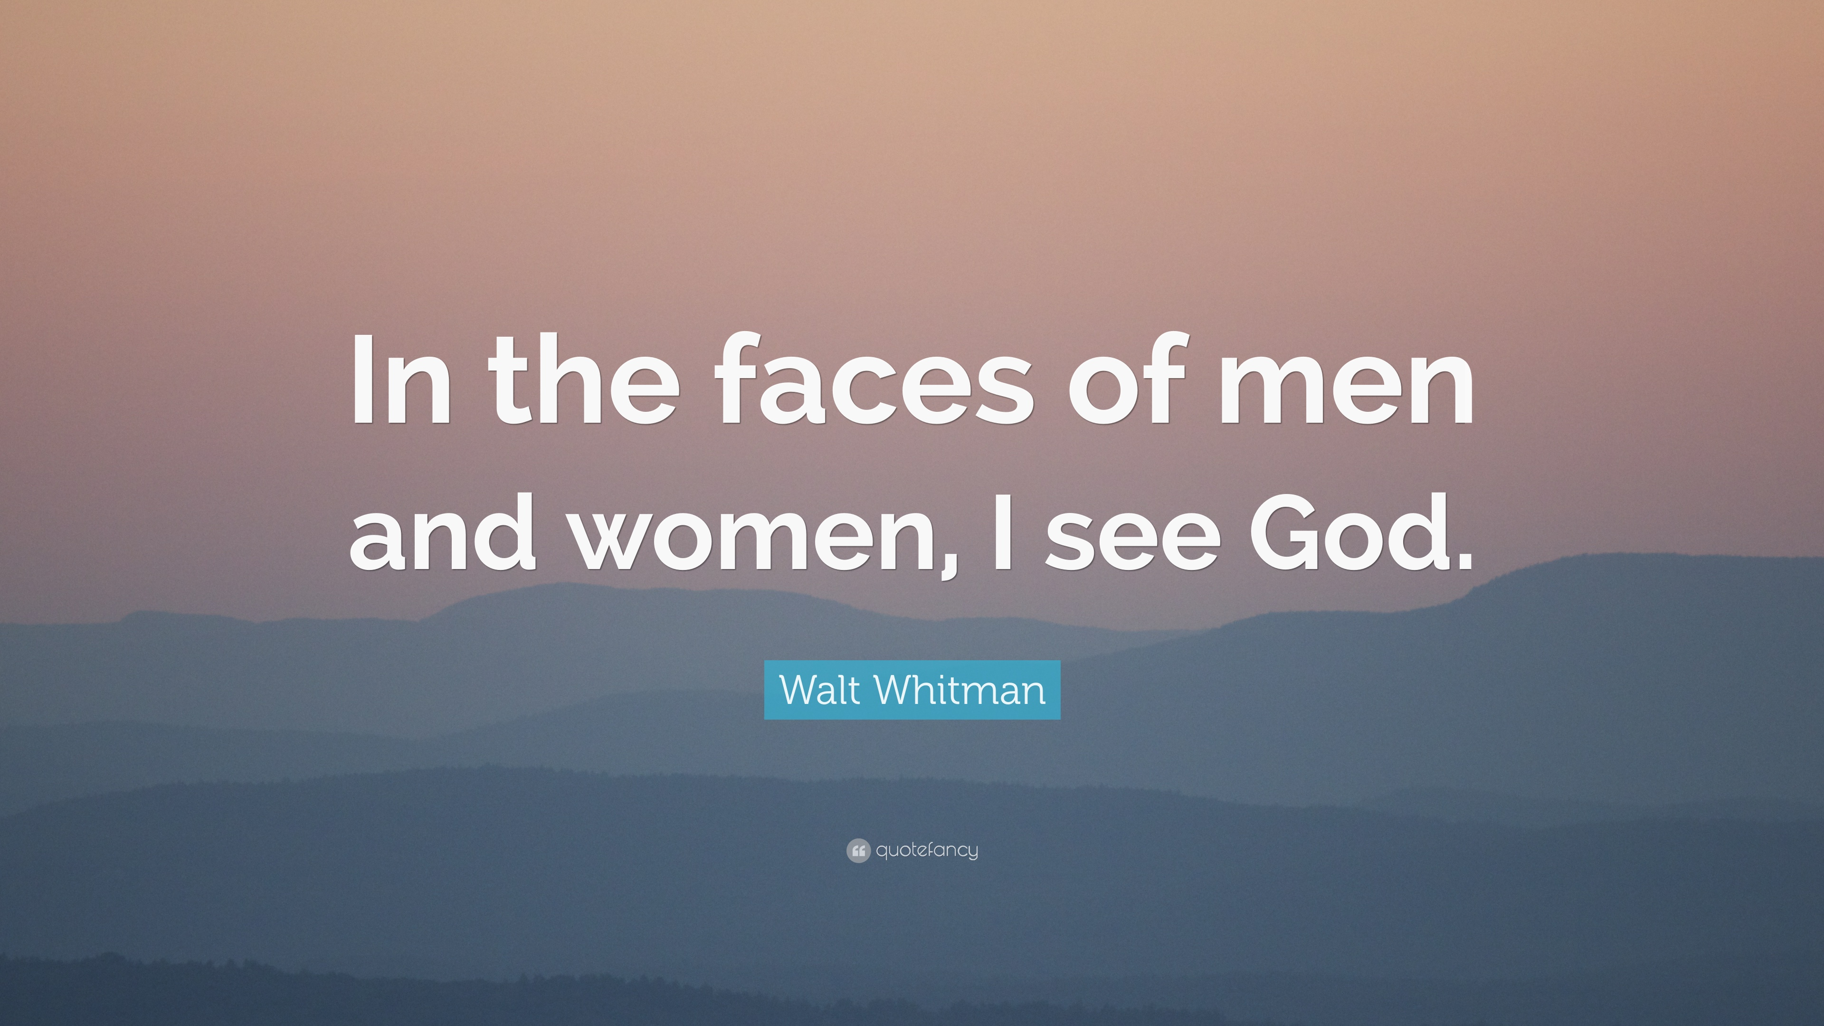
Emerson vs. Whitman
Emerson: experience God in nature
Whitman: God = source of life = love/sex
https://www.brainyquote.com/quotes/ralph_waldo_emerson_385779
https://quotefancy.com/quote/930557/Walt-Whitman-In-the-faces-of-men-and-women-I-see-God

Slide 7
Whitman on Sex
In one of his anonymous reviews of his book ("Walt Whitman and His Poems," 1855) he wrote of himself and the 1855 Leaves : "The body, he teaches, is beautiful. Sex is also beautiful. . . . Sex will not be put aside; it is a great ordination of the universe. He works the muscle of the male and the teeming fibre of the female throughout his writings, as wholesome realities, impure only by deliberate intention and effort"
https://whitmanarchive.org/criticism/current/encyclopedia/entry_49.html

Slide 8
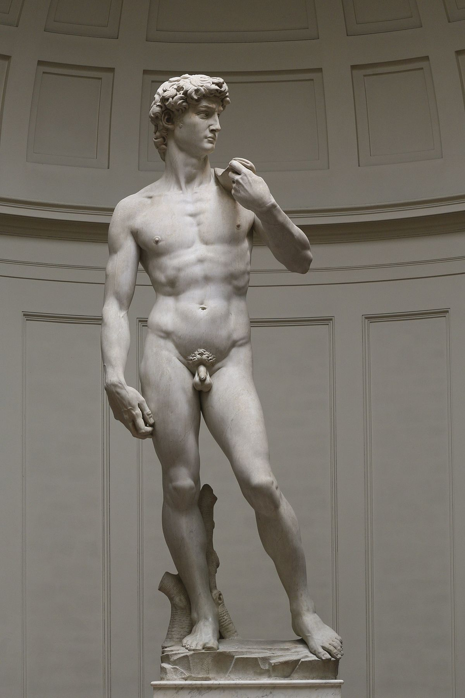
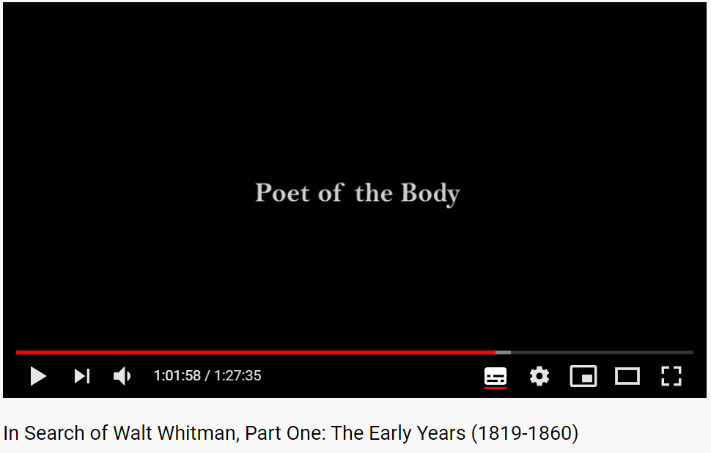
Attitude towards the body
Not as inferior to soul, but as beautiful and sacred throughout
https://youtu.be/RHgfTd9zbJ8?t=3718
https://en.wikipedia.org/wiki/David_(Michelangelo)

Slide 9
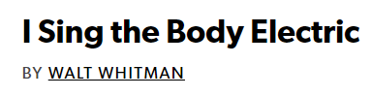
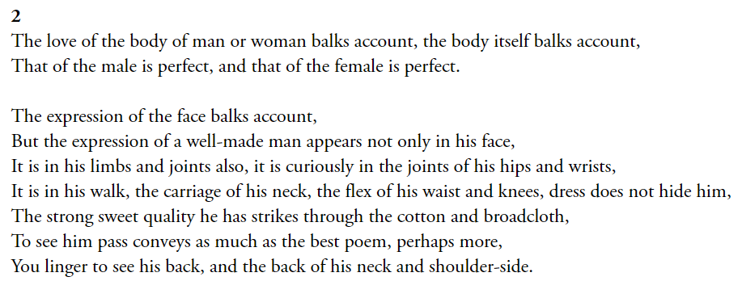

Slide 10


Slide 11
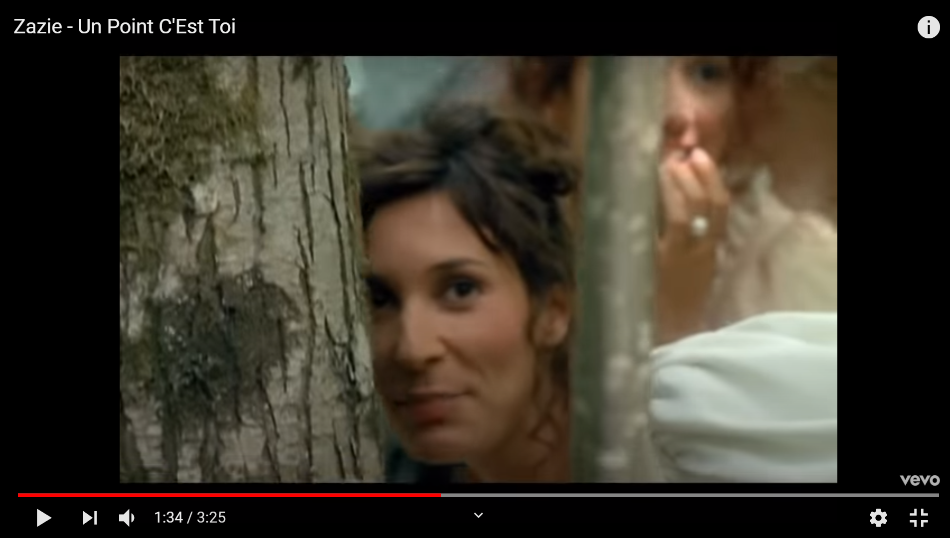
https://youtu.be/yMEj1qgHADc

Slide 12
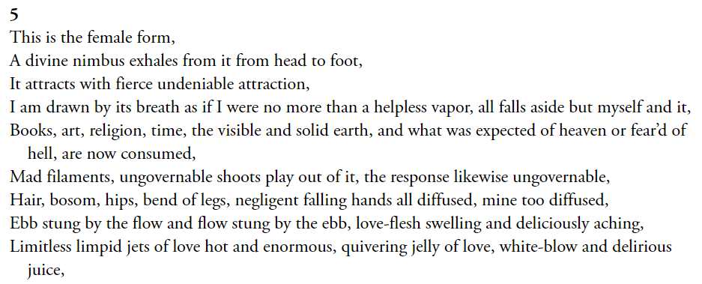

Slide 13
Whitman on Sex
In one of his anonymous reviews of his book ("Walt Whitman and His Poems," 1855) he wrote of himself and the 1855 Leaves : "The body, he teaches, is beautiful. Sex is also beautiful. . . . Sex will not be put aside; it is a great ordination of the universe. He works the muscle of the male and the teeming fibre of the female throughout his writings, as wholesome realities, impure only by deliberate intention and effort"
https://whitmanarchive.org/criticism/current/encyclopedia/entry_49.html

Slide 14
Do you think Whitman is attracted more by the male body or the female body?

Slide 15
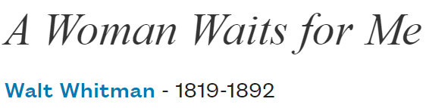
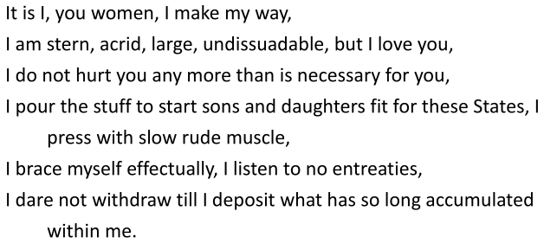

Slide 16
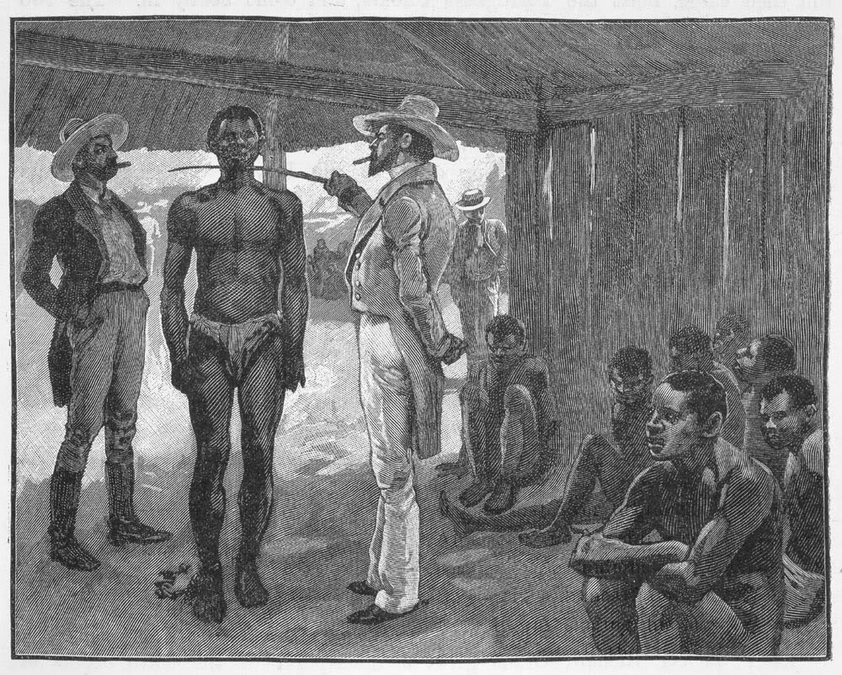
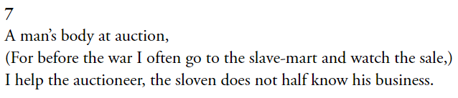
Whitman and slavery
http://justcommonsense-lostinamerica.blogspot.com/2015/04/nfl-slave-auction.html

Slide 17
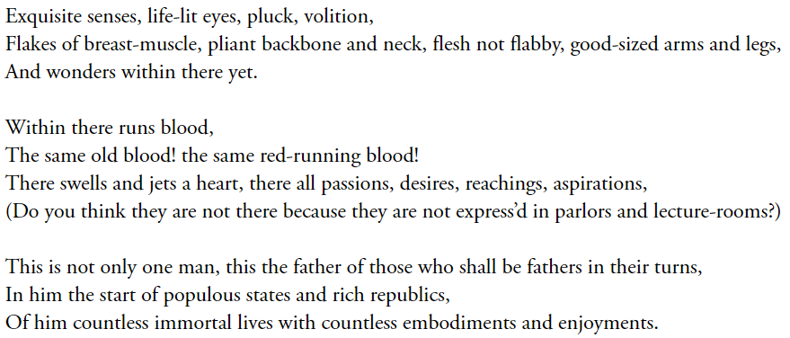
Whitman and slavery

Slide 18


Whitman and democracy

Slide 19
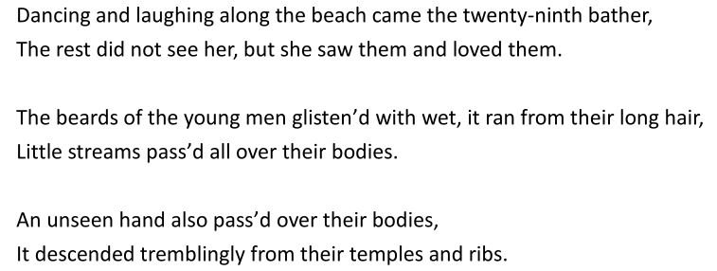
Democracy through the invisible hand that touches

Slide 20
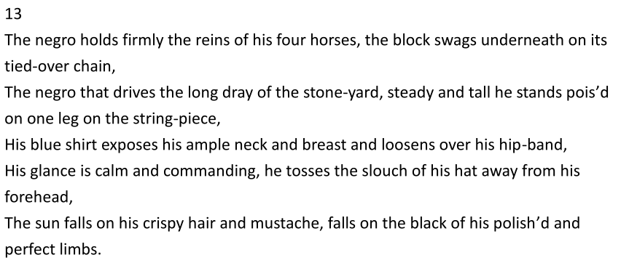
Democracy through the invisible hand that touches

Slide 21
Democracy through the invisible hand that touches
the finite mortal individual, democratic citizen, equal to and among others, who contains the world within himself by virtue of his resourceful imagination and his sympathetic love. “I am he attesting sympathy,” the poet announces. [. . .] The defects in earthly love are to be overcome not by any established system of belief [. . .] but by the capacity of the individual to extend the circles of sympathy outward to embrace everything in the world with equal love. (“Democratic Desire” 107)

Slide 22
Critics like to emphasize how Whitman can embrace everyone, but I think there’s a barrier between him and his father

Slide 23
“Wild Frank’s Return”
Wild Frank left home as a gesture of protest against his father’s favoritism. Two years later, he “appear’d to have lost his angry feeling” toward his father and decided to go home (63). On his way, he decided to take a nap and tied his mare over his wrist. A thunderstorm came and frightened the mare. She started to dash, dragging behind her the poor Wild Frank. The family heard the clatter and went out to greet the son, only to see “the rough semblance of a human form—all batter’d and cut, and bloody” (67).

Slide 24
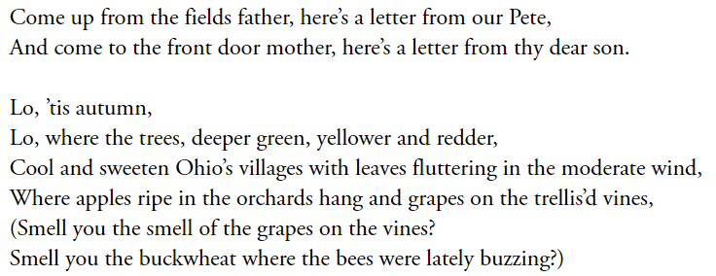
“Come up from the fields, father”

Slide 25
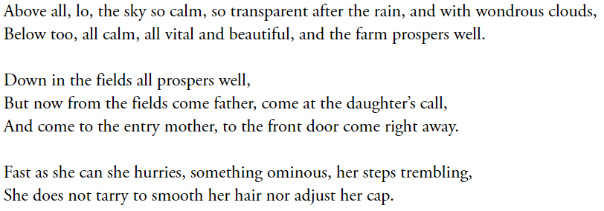
“Come up from the fields, father”

Slide 26
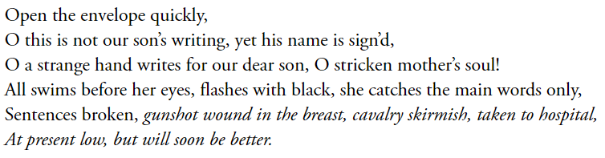
“Come up from the fields, father”

Slide 27
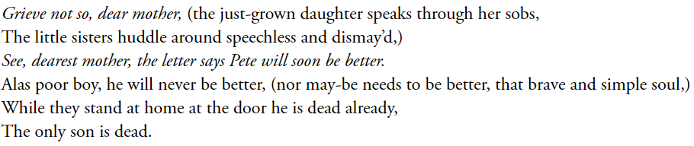
“Come up from the fields, father”

Slide 28
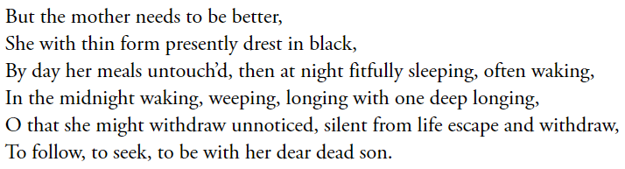
“Come up from the fields, father”

