Slide 1
How were the Indians Portrayed?
Roger Liu

Slide 2
Plan for today
Announcement: Reward cards
Peer Teaching: Samuel de Champlain
Robert Juet
Lecture: How were the Indians portrayed
Activity: Analyze the strategy of Samson Occom
Group Work: Discuss the culture fair
Self-reflection: Answer the guide question in your reading journal

Slide 3
Announcement: Reward cards
Points | Prizes
1000 | 2 bonus points
800 | 1 big stuffed animal
500 | 1 small stuffed animal or 1 bonus point

Slide 4
Peer Teaching: Round One
Get together with students who read the same excerpt (2-3 people in a group).
Share notes, communicate ideas, ask questions.

Slide 5
Peer Teaching: Round Two
Exchange group members.
Follow the steps:
Team A starts by stating the main point of the reading and offer examples from the notes.
Team B takes notes, ask questions, and tries to give a summary of Team A’s presentation.
Team B repeats step one.

Slide 6
Peer Teaching: Round Three
Each group will go to Google document to share four things:
One similarity between the two readings
One difference between the two readings
One interesting observation/fact
One question that bothers you

Slide 7
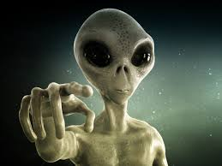
Lecture: The Portrayal of the Indians
https://www.ox.ac.uk/news/2017-10-31-aliens-may-be-more-us-we-think
https://www.deviantart.com/bluebottleflyer/art/Scared-Aliens-566220019

Slide 8
Lecture: The Portrayal of the Indians
Side A | Side B
hospitality | hostility
reciprocity | self-interest
open-mindedness | stereotypes
communication | misunderstanding

Slide 9
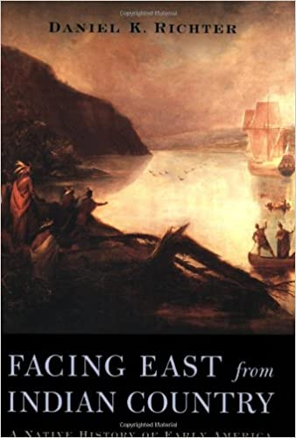
Lecture: The Portrayal of the Indians
Words like “invasion” and “conquest” may now trip more easily from our tongues than quaint phrases like “the transit of civilization,” yet the “master narrative” of early America remains essentially European-focused (8).

Slide 10
Lecture: The Portrayal of the Indians
Yet if we shift out perspective to try to view the past in a way that faces the east from Indian country, history takes on a very different appearance. Native Americans appear in the foreground, and European enter from distant shores.

Slide 11
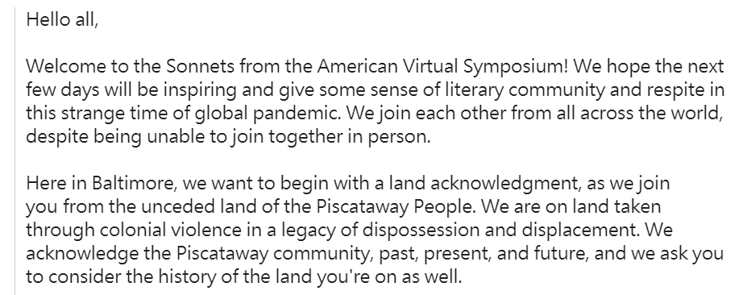
Lecture: The Portrayal of the Indians

Slide 12
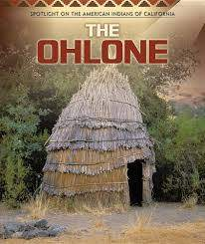
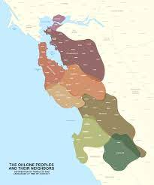
Lecture: The Portrayal of the Indians
https://youtu.be/S0nkhf6YPeg

Slide 13
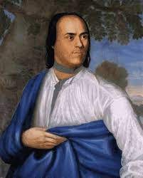
Activity: Samson Occom’s Strategy
Mohegan leader Samson Occum, who in 1759, became the first formally trained and ordained Christian Indian minister. He was known as “minister to all the tribes of New England” and “the great Indian man who takes care of Indians.”
https://jeremynative.com/onthissite/wiki/samson-occom/

Slide 14
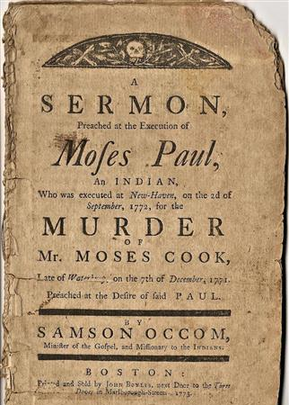
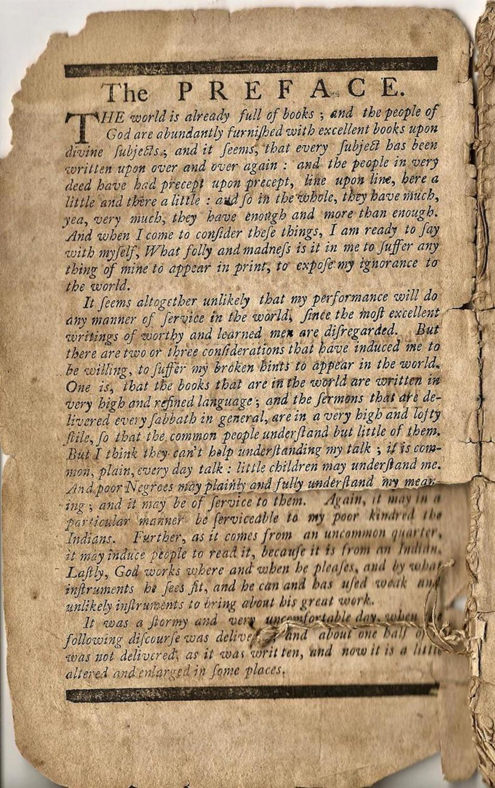
https://findit.library.yale.edu/yipp/catalog/digcoll:1018719

Slide 15
Activity: Samson Occom’s Strategy
On 2 September 1772, in New Haven, Connecticut, Moses Paul was hanged for murdering Moses Cook at David Clark's tavern in Bethany. Murders were not common in eighteenth-century Connecticut, but this crime seemed common enough. Paul was just the sort of person colonists expected to commit murder, and the circumstances were ripe for him to do so.

Slide 16
Activity: Samson Occom’s Strategy
For generations, Congregational ministers had proclaimed from their pulpits that drunks were dangerous and that excessive alcohol consumption was the root of much graver sins, especially violent crimes like rape and assault. And this drunk was an Indian. Everyone knew that Indians were prone by nature both to drink excessively and to become violent when drunk. Not surprisingly, the story of Paul's crime as reported in the colonial newspapers conformed in every particular to the behavior considered typical of the colony's Native inhabitants.

Slide 17
Activity: Samson Occom’s Strategy
Read the excerpt from Samson Occom’s sermon for Moses Paul.
Identify Occom’s strategy: How did he challenge the stereotype that Indians were all drunkards and, when drunk, violent criminals?

Slide 18
Activity: Samson Occom’s Strategy
Alas! poor Moses, now you know, by sad, by woful ex|perience, the living truth of our text, that the wages of sin is death. You have been already dead; yea twice dead.
Sirs, We may plainly see, from what we have heard, and from the miserable object before us, into what a doleful condition sin has brought mankind, even into a state of death and misery. We are by nature as certainly under sentence of death from God, as this miserable man is.
http://icarusfilms.com/if-taw

Slide 19
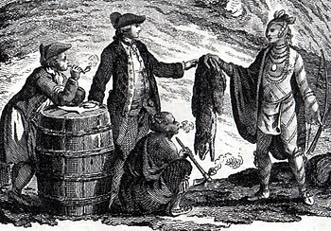
Activity: Samson Occom’s Strategy
And death, which is the wages of sin, is standing even on this side of your grave ready to put a final period to your mortal life.
the gift of God is eternal life, thro' Jesus Christ our Lord. It is a free gift, and of|fered to the greatest sinners, and upon their true repentance towards God
https://givingcompass.org/article/are-wages-changing/
https://en.wikipedia.org/wiki/Alcohol_and_Native_Americans

Slide 20
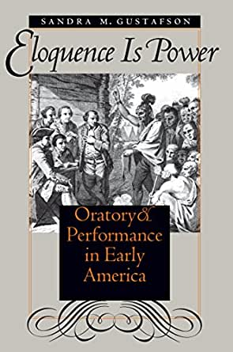
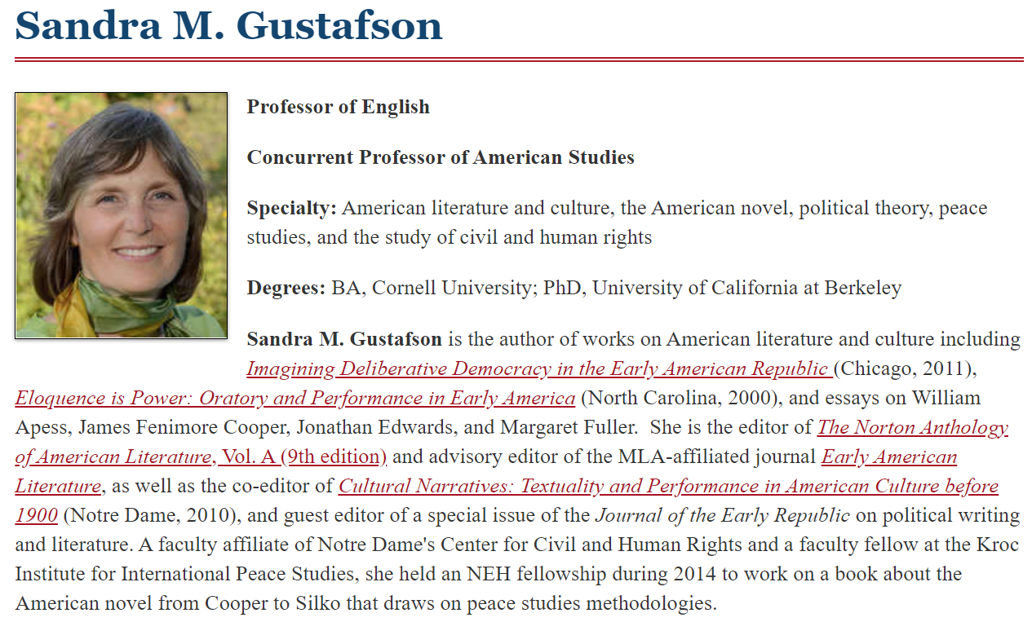
Activity: Samsom Occom’s Strategy

Slide 21
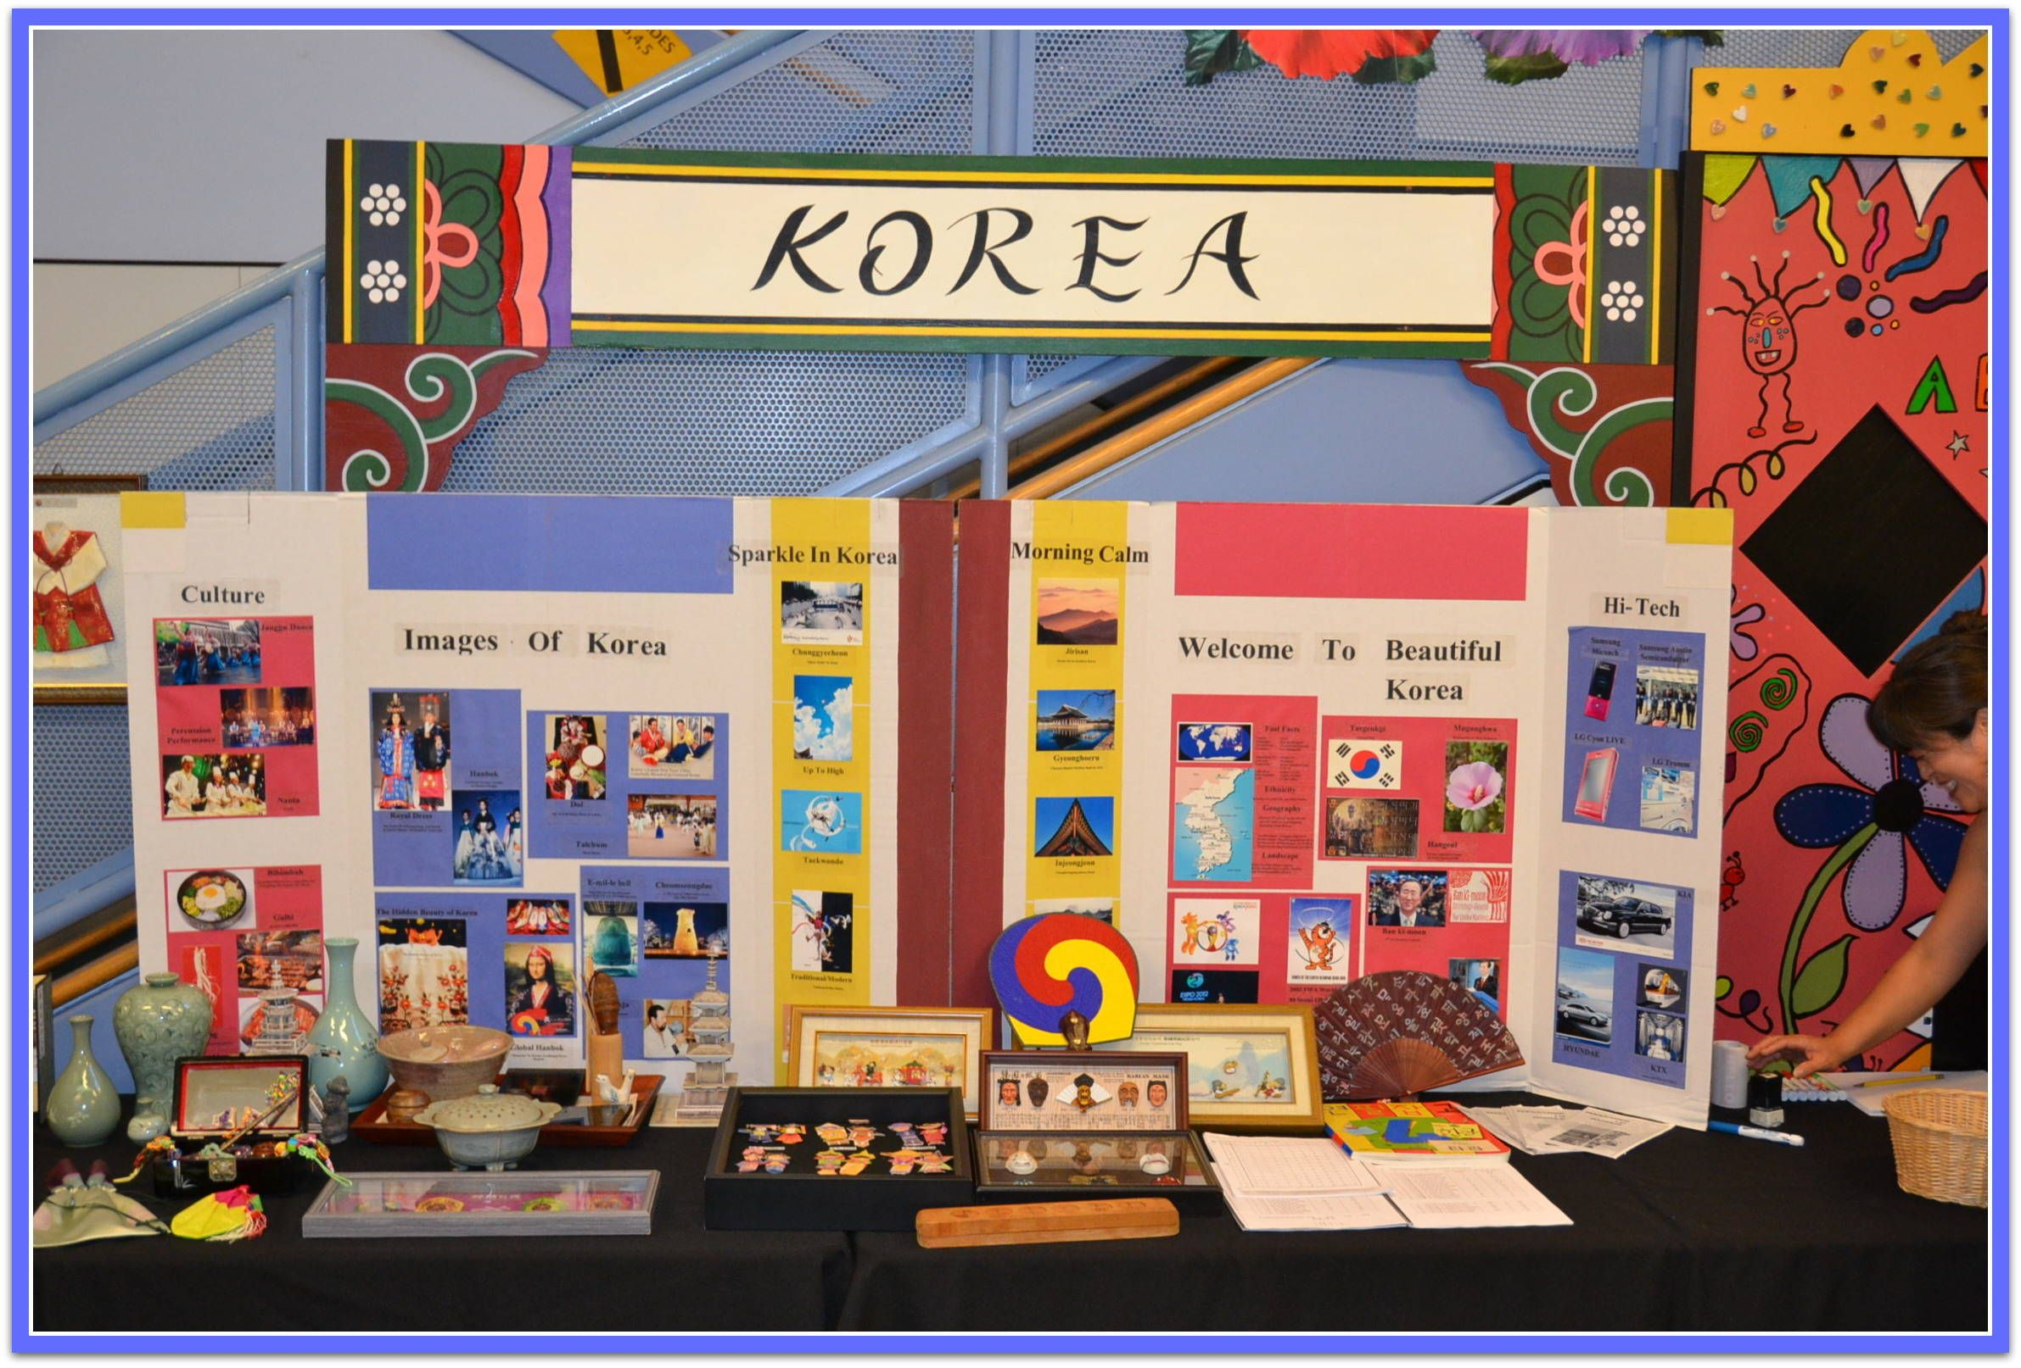
Group work: discuss the culture fair
Get together with your group members (2-3 people per group)
Decide your presentation theme
Discuss how to prepare for the presentation
Discuss how to divide the work
https://www.pinterest.com/pin/196680708708112952/

