Slide 1
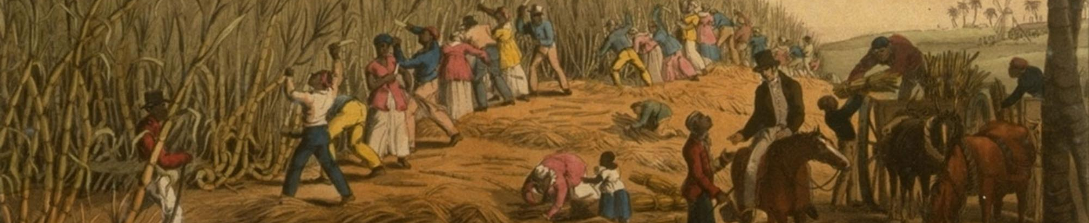
What does it mean to be democratic and slave-holding?

Slide 2
Plan for today
Peer Teaching:
The Dred Scott Decision and
The Lincoln-Douglas debates
Activity: The Story of Tony
Lecture: Slavery and racism, the U.S. and Taiwan

Slide 3
Peer Teaching

Slide 4

Peer Teaching: Round One
Get together with students who researched the same topic (2-3 people in a group).
Share notes, communicate ideas, ask questions.

Slide 5
Peer Teaching: Round Two
Exchange group members.
Follow the steps:
Team A starts by stating the main point of the reading and offer examples from the notes.
Team B takes notes, ask questions, and tries to give a summary of Team A’s presentation.
Team B repeats step one.

Slide 6
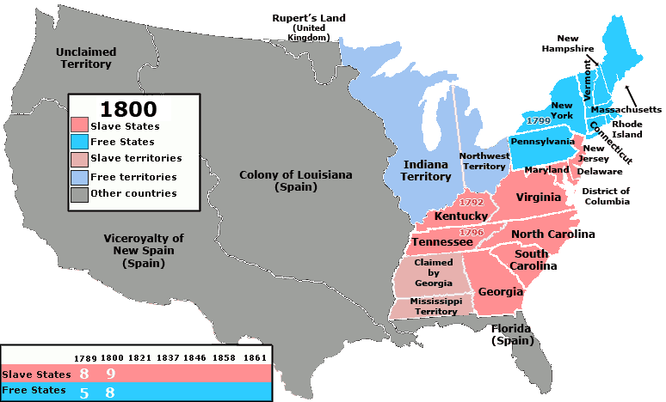
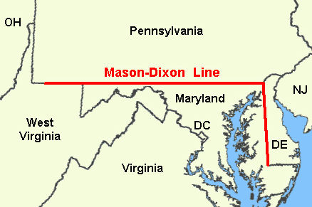
1803 Louisiana Purchase
https://en.wikipedia.org/wiki/Slave_states_and_free_states

Slide 7
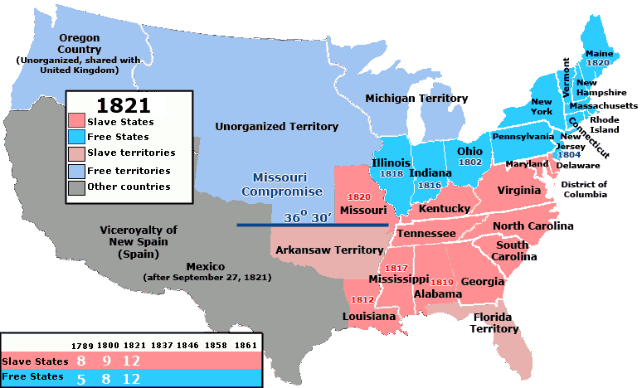
1820 Missouri Compromise
1820
House of Representatives
https://en.wikipedia.org/wiki/Slave_states_and_free_states

Slide 8
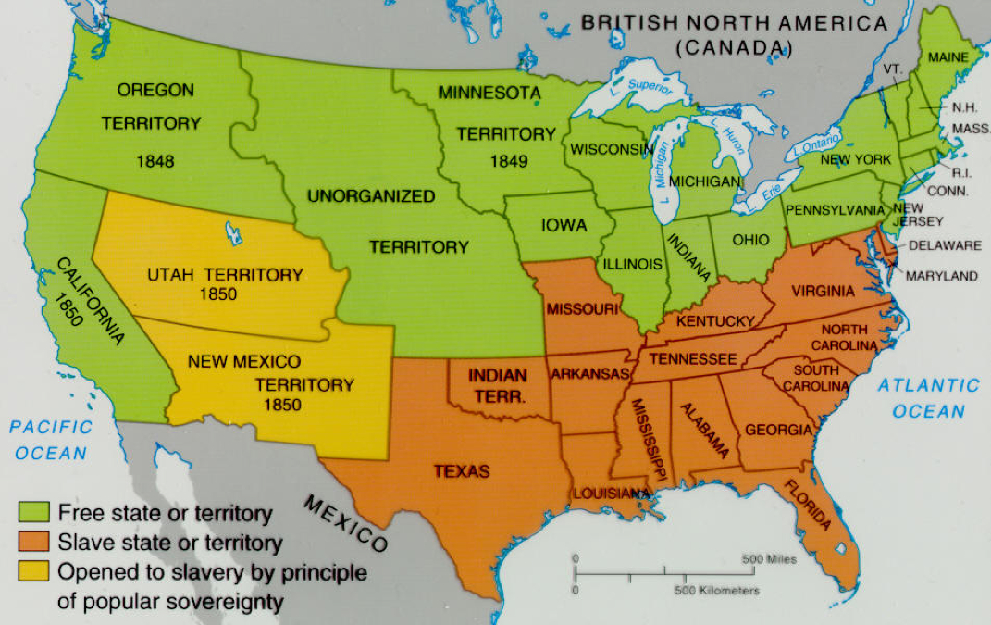
Compromise of 1850/ Fugitive Slave Act
Hawthorne lost his job
Free!
Let people decide!

Slide 9
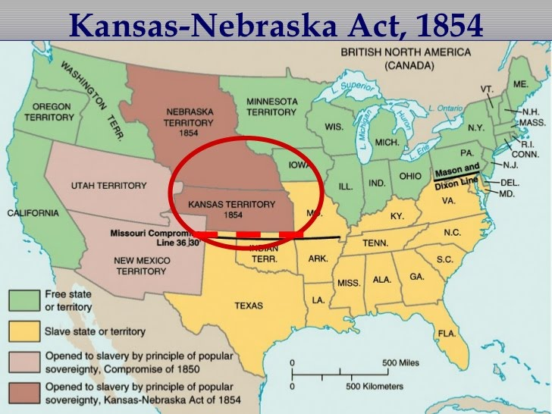
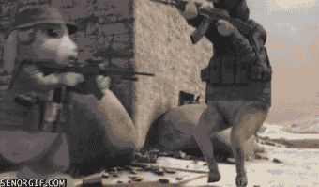
Kansas-Nebraska Act, 1854
Let people decide!
https://sites.google.com/a/student.ucps.k12.nc.us/the-antebellum-period/congress/kansas-nebraska-act

Slide 10
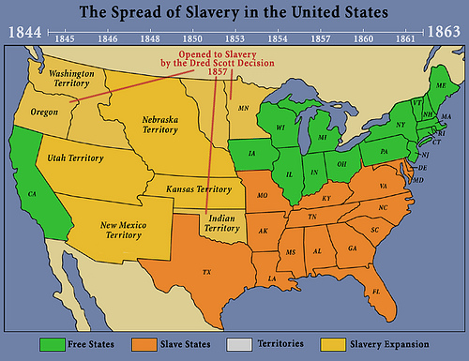
The Dred Scott Decision of 1857
http://apushcanvas.pbworks.com/w/page/71250320/The%20Dred%20Scott%20Decision

Slide 11
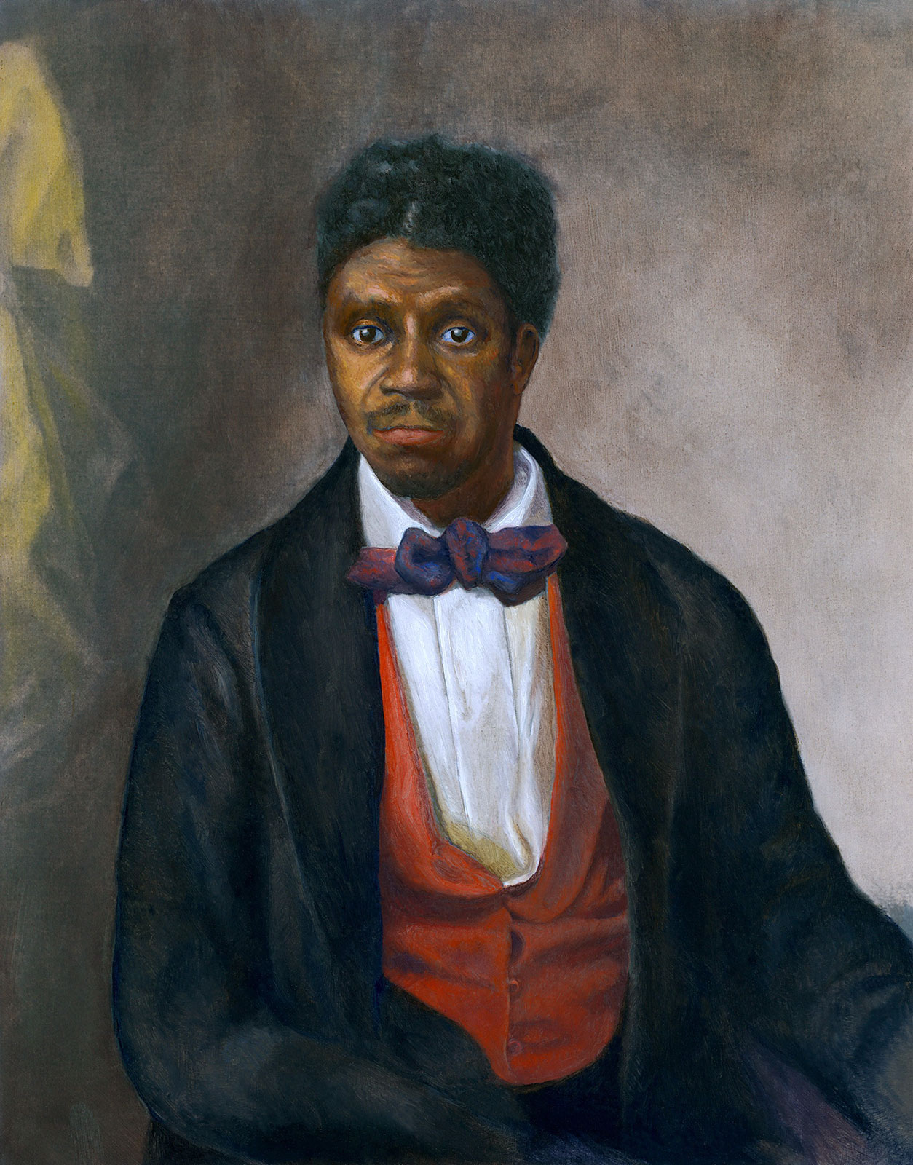
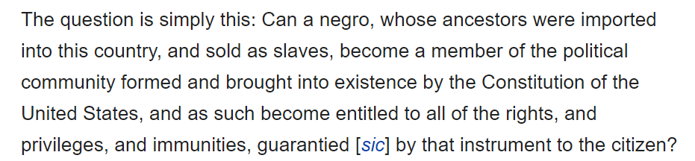
The Dred Scott Decision
Time: 1857
Controversies:
Blacks are not American citizens
The Congress cannot make a law that violates citizens’ property rights
https://www.britannica.com/biography/Dred-Scott

Slide 12
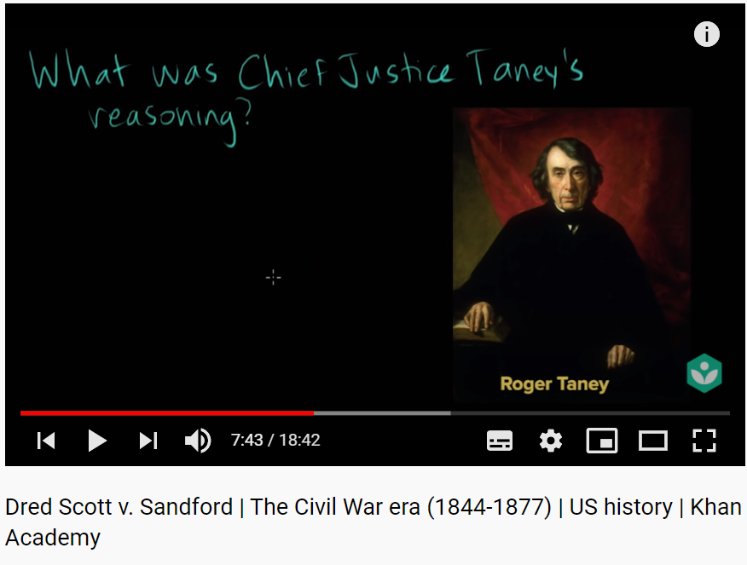
https://youtu.be/sWuXMjrv4aA?t=463

Slide 13
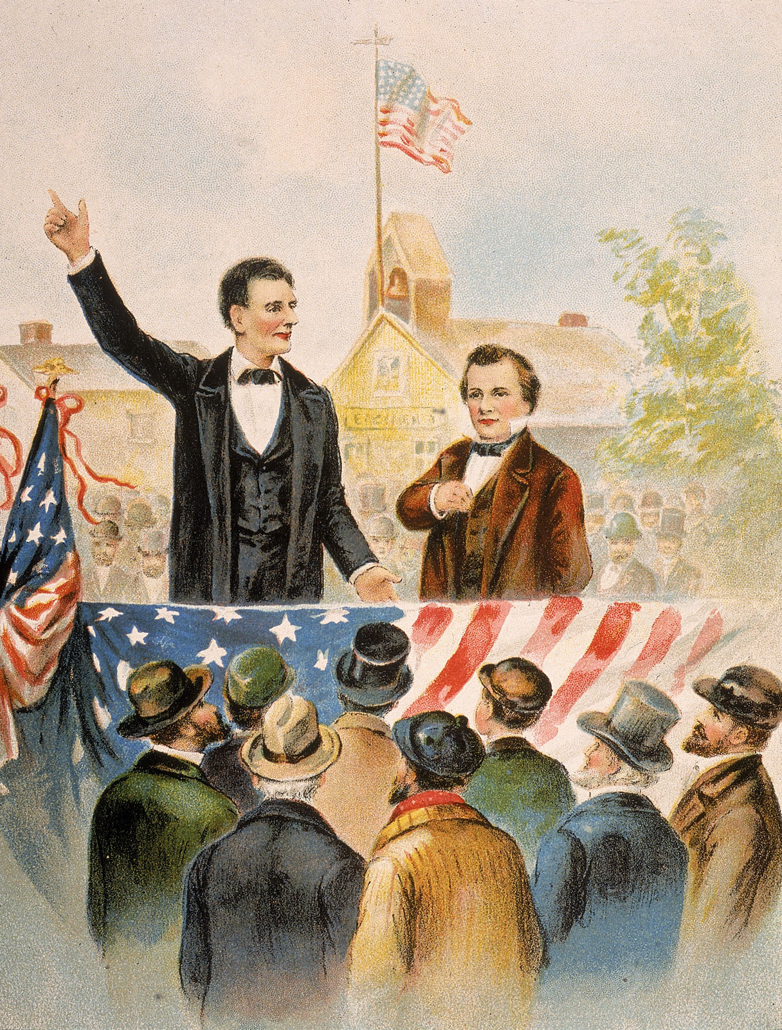
The Lincoln-Douglas Debates
Time: 1858
Issues:
popular sovereignty = democracy
the Dred Scott decision does not fit in the model of popular sovereignty (It violates the will of the people in free states; The free states can make laws to discourage slave owners from bringing slaves)
What’s wrong with voting to become a slaveholding state?
https://www.britannica.com/event/Lincoln-Douglas-debates

Slide 14
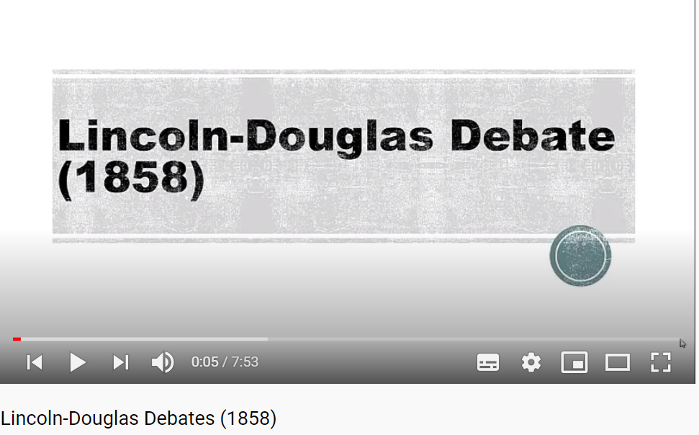
https://youtu.be/NKjihHjgG94

Slide 15
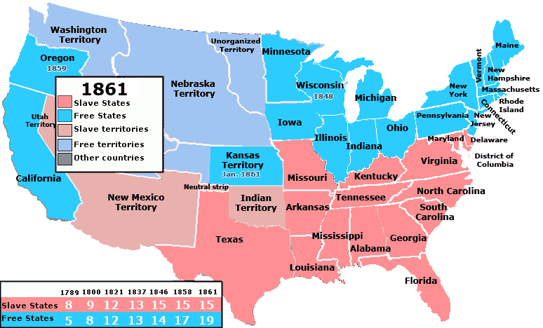
Before the Civil War
https://en.wikipedia.org/wiki/Slave_states_and_free_states

Slide 16
The Story of Tony
Activity

Slide 17
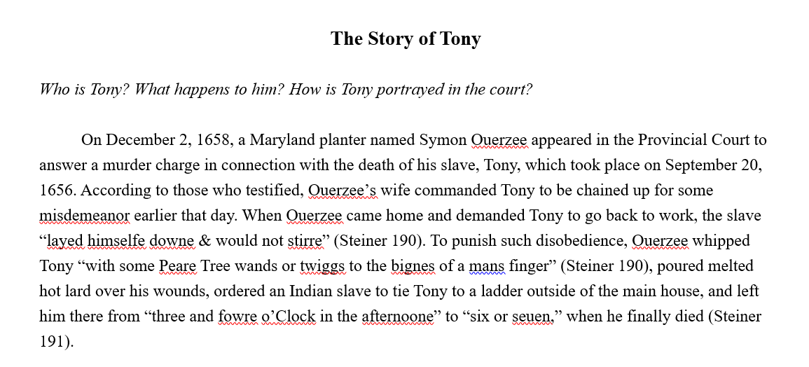
Activity: The Story of Tony

Slide 18
Slavery and Racism
The U.S. and Taiwan

Slide 19
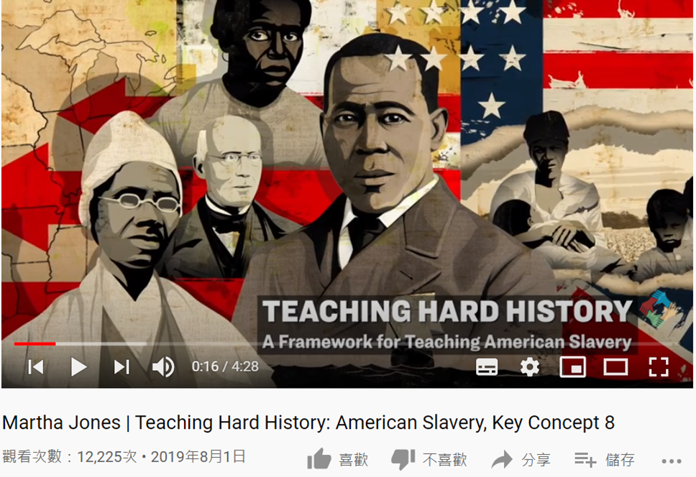
1. Slavery and Racism
What does Professor Martha Jones say about the relationship between slavery and racism (white supremacy = white people are better than black people)?
https://youtu.be/5t-4HaJ_ERY

Slide 20
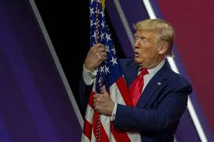
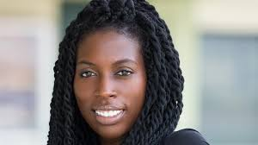
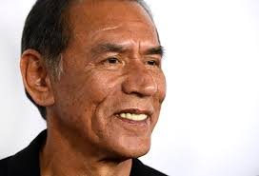
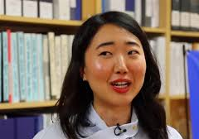
1: American?

Slide 21
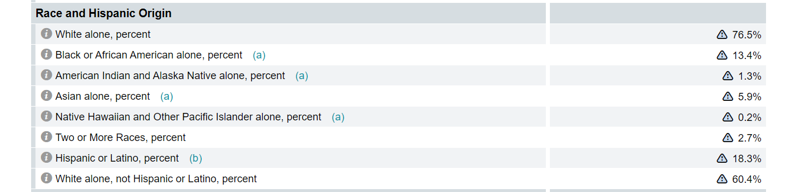
1: US CENSUS

Slide 22
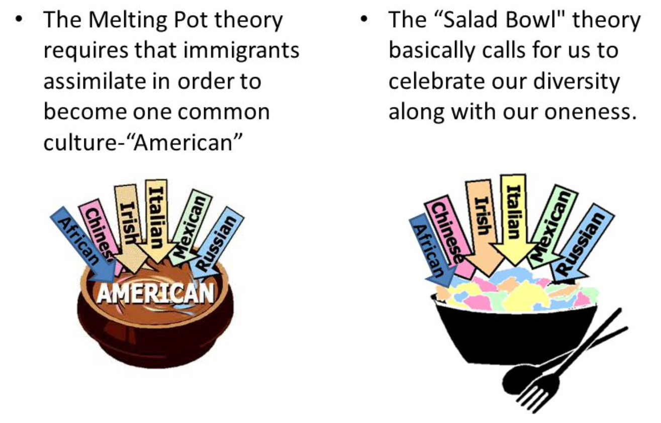
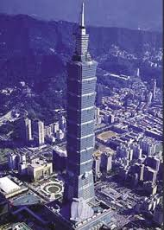
1: Melting pot or salad bowl
Is Taiwan a melting pot or a salad bowl?
What are the problems of the melting pot?

Slide 23
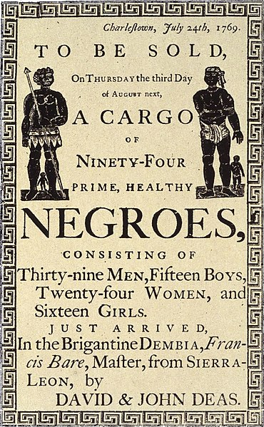
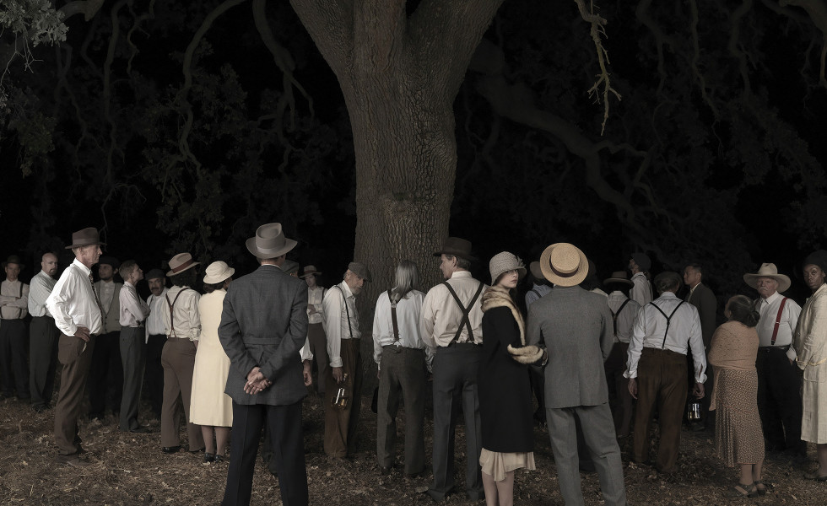
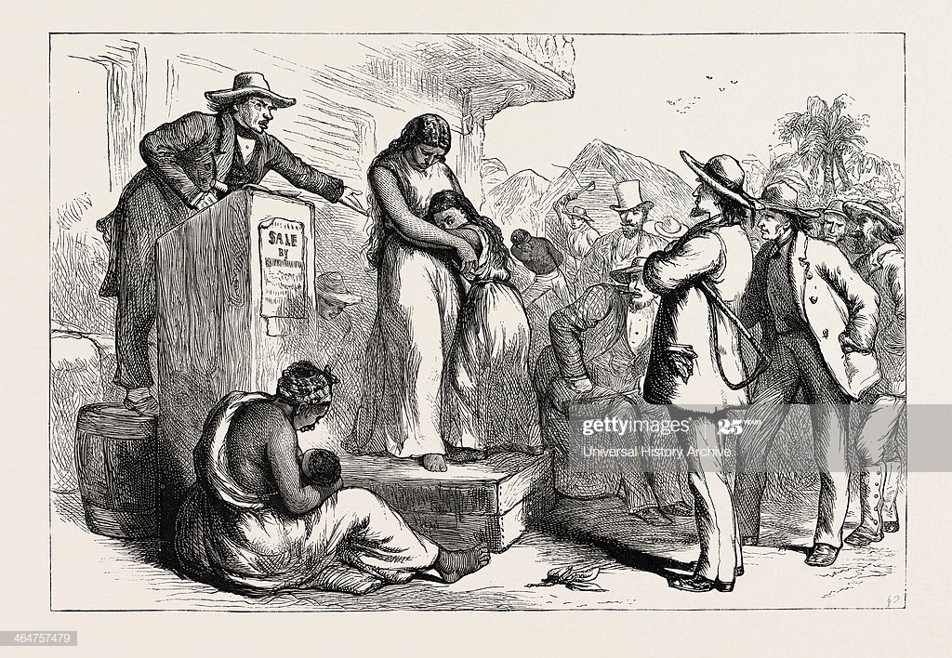
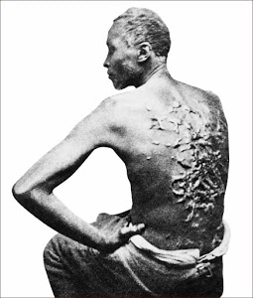
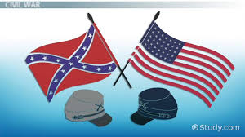
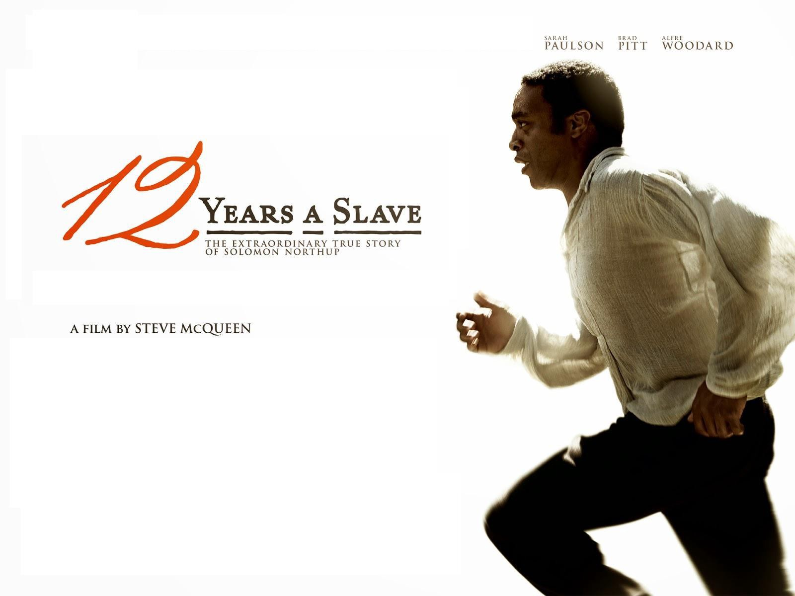
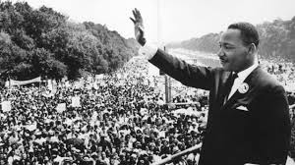
2: Slavery in America
Plantation
Slave auction
Flogging
3/5 Compromise
American Civil War
Lynching
Civil Rights Movement
https://youtu.be/usvSvsIMvmo

Slide 24
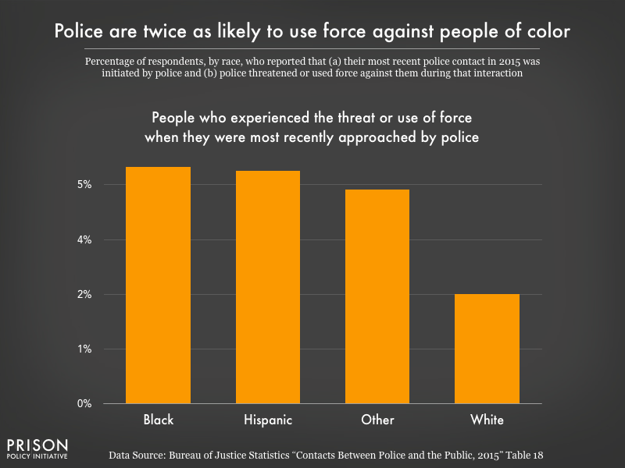
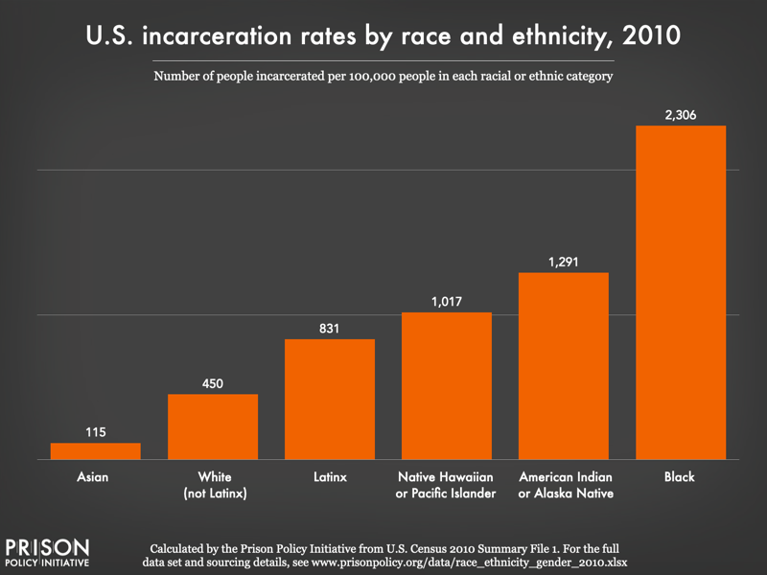
3: Understanding Racism

Slide 25
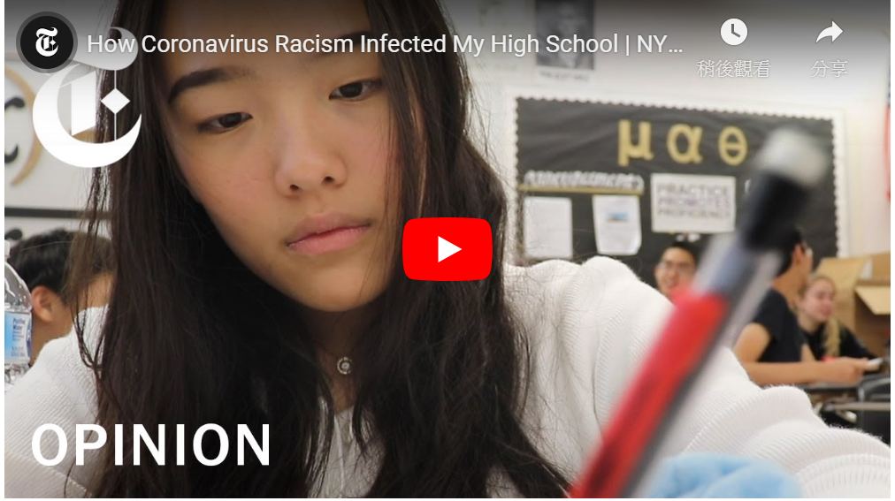
3: Understanding Racism
https://tw.voicetube.com/videos/104736

Slide 26
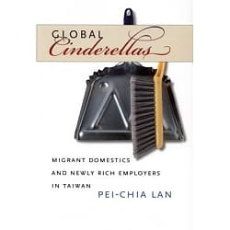

4: Racism in Taiwan?
Do you think Taiwan has racism?

Slide 27
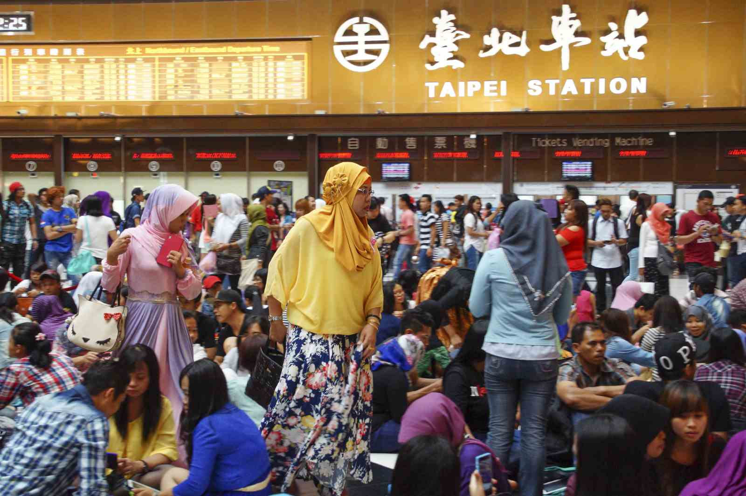
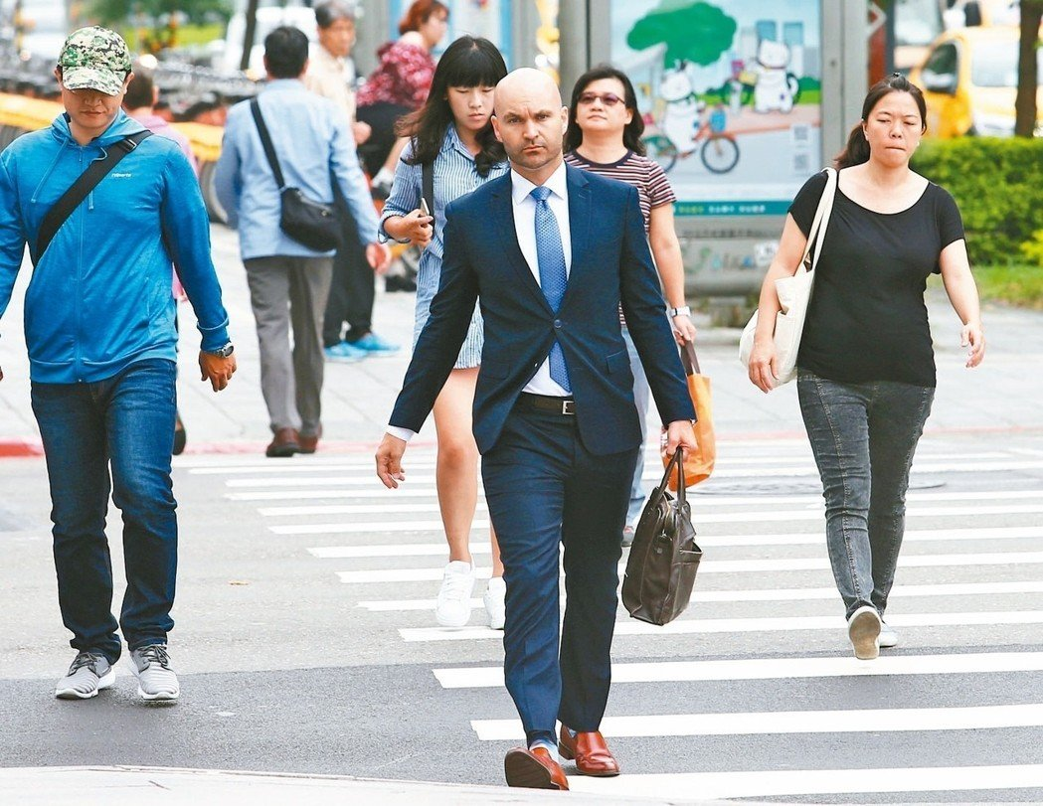
4: Racism in Taiwan
Racialization refers to “a process by which a group comes to be marked by its physical and cultural distinctiveness.” The marked distinctiveness of foreign workers is not limited to their difference from Taiwanese citizens; their subject positions are also constituted in relation to other categories of foreigners. I raise the concept “stratified otherization” to emphasize the relational construction of racialized boundaries.

Slide 28
4: Racism in Taiwan
Local newspapers and magazines often use sensational headlines to cover stories of contagious diseases carried by migrant workers, such as “Parasites: The majority of the carriers are Filipina maids” and “Two more AIDS migrant workers found.” These diseases are often associated with the living conditions in Southeast Asia, which are negatively portrayed as “backward,” “dirty,” and “uncivilized” among the Taiwanese public.

Slide 29
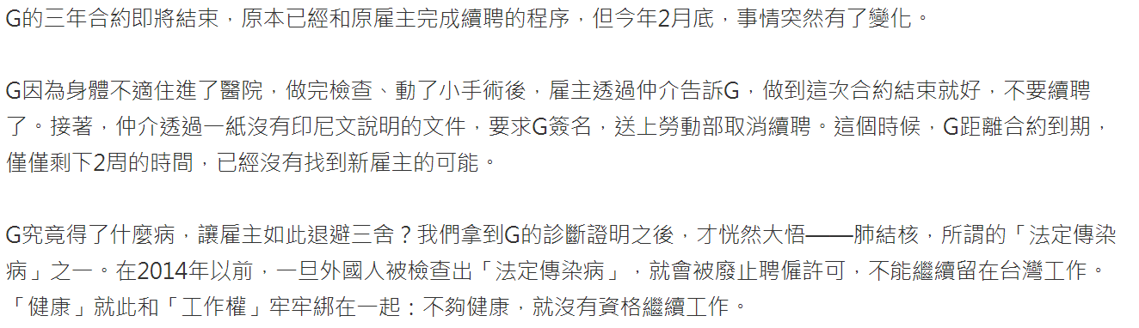
4: Racism in Taiwan

Slide 30
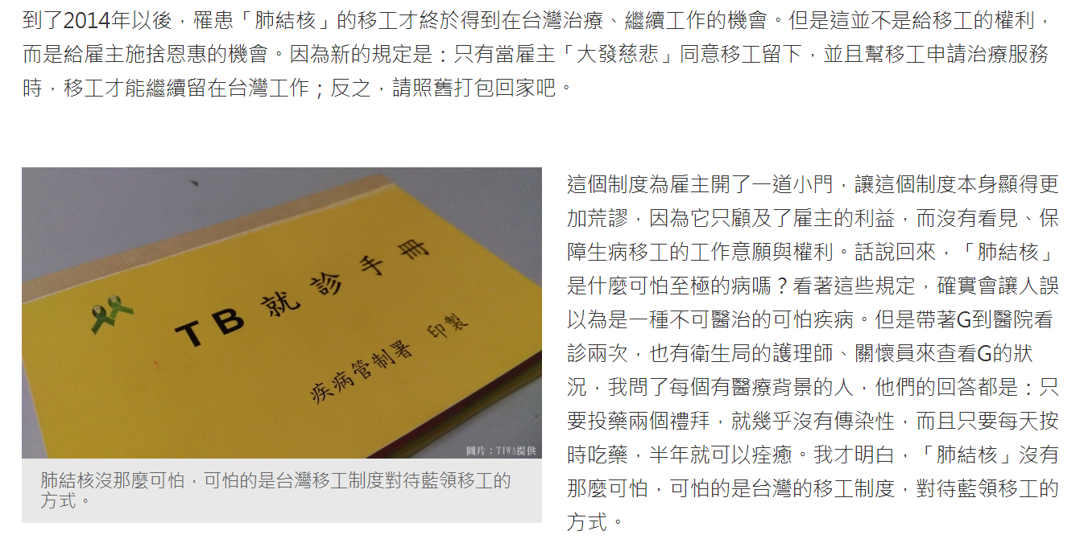
4: Racism in Taiwan

Slide 31
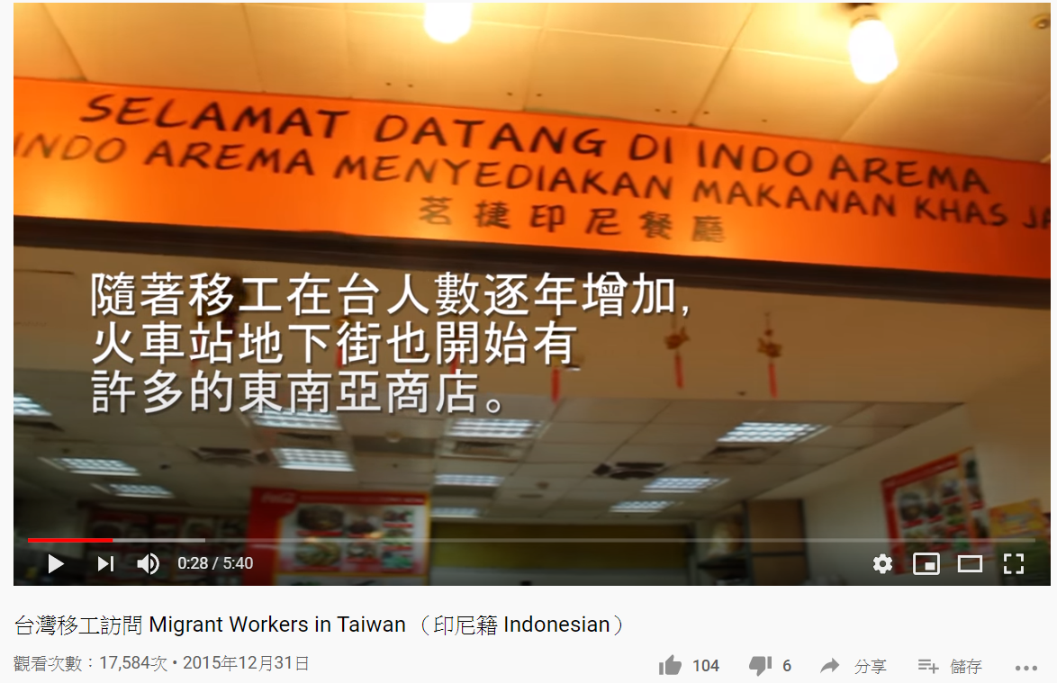
4: Racism in Taiwan
https://youtu.be/3ma7dWZpYp0

Slide 32
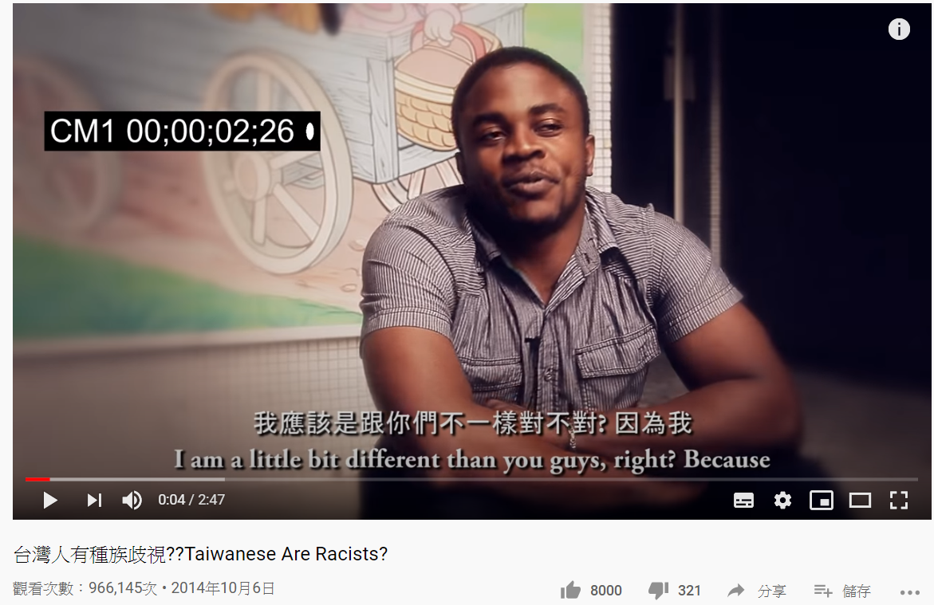
4: Racism in Taiwan
https://youtu.be/X-pHPHG60iM

