Slide 1
Do you like Emerson's God?

Slide 2
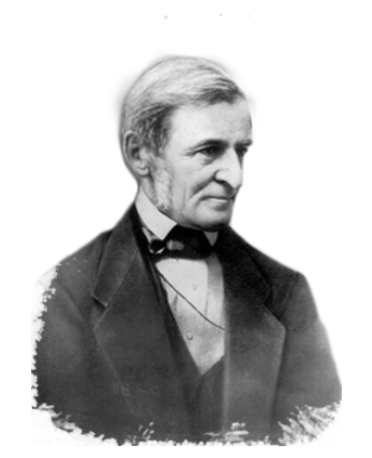
Plan for today
Peer Teaching: Emerson’s “Divinity School Address” and “Nature”
Activity: writing the five senses
Lecture: Emerson and Oriental Thoughts
https://kr.usembassy.gov/education-culture/infopedia-usa/living-documents-american-history-democracy/ralph-waldo-emerson-self-reliance-1841/

Slide 3
Peer Teaching: “Divinity School Address” and “Nature”

Slide 4
Round 1
Get together with students who read the same excerpt (2-3 people in a group).
Share notes, communicate ideas, ask questions.

Slide 5
Round 2
Exchange group members.
Follow the steps:
Team A starts by stating the main point of the reading and offer examples from the notes.
Team B takes notes, ask questions, and tries to give a summary of Team A’s presentation.
Team B repeats step one.

Slide 6
Round 3
Each group will go to Google document to share four things:
One similarity between the two readings
One difference between the two readings
One interesting observation/fact
One paragraph that bothers you

Slide 7
Activity: Writing the five senses

Slide 8
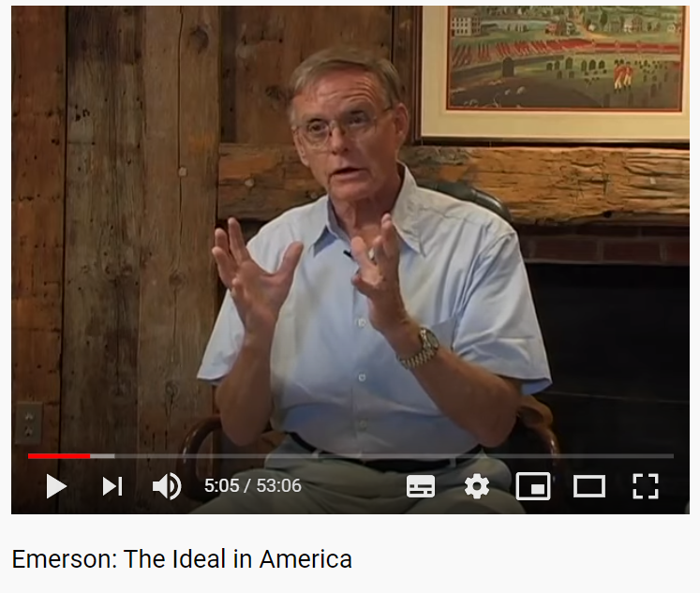
Introduction to Emerson’s Life
https://youtu.be/daRaMqFBjzQ

Slide 9
Writing practice
For the next 15 minutes, go outside of the classroom and find a place that’s calming. (bring only your journal and a pen)
Explore your five senses and record what comes through them.
Come back to the classroom in 15 minutes and share.

Slide 10
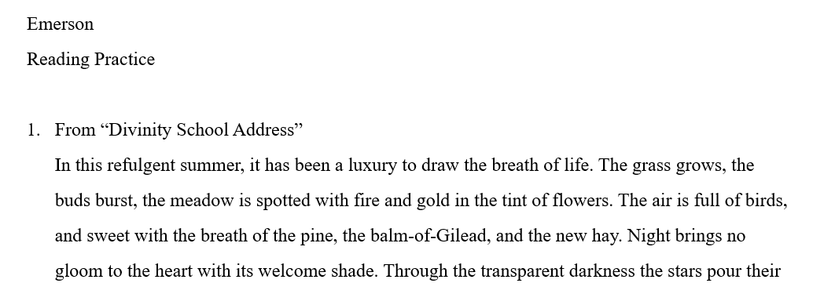
Reading Practice
Read the two passage on the handout and underline where Emerson used his five senses
Paine or Franklin (Enlightenment)
vs.
Emerson
(Transcendentalism)

Slide 11
Lecture: Emerson and Oriental Thoughts

Slide 12
Emerson and Daoism: Abandonment of SELF
Zuowang (Chinese: 坐忘; pinyin: zuòwàng) is a classic Daoist meditation technique, described as "a state of deep trance or intense absorption, during which no trace of ego-identity is felt and only the underlying cosmic current of the Dao is perceived as real."
Ending of Emerson’s poem “Each and All”

Slide 13
Zuowang 坐忘 "sitting in oblivion," signifies a state of deep meditative absorption and mystical oneness, during which all sensory and conscious faculties are overcome and which is the base point for attaining Dao. I translate wang as "oblivion" and "oblivious" rather than "forgetting" or "forgetful" because the connotation of "forget" in English is that one should remember but doesn't do so, or—if used intentionally—that one actively and intentionally does something in the mind. None of these holds true for what ancient and medieval Daoists were about. This is borne out both by the language and the writings: the word wang in Chinese consists of the character xin for "mind-heart," usually associated with conscious and emotional reactions to reality and the word wang for "obliterate" or "perish." The implication is – as indeed described in the sources – that one lets go of all kinds of intentional and reactive patterns and comes to rest in oneness with spirit and is ready to merge completely with Dao. (Kohn 2010:1)

Slide 14
Emerson and Daoism: Principle of universe
These facts have always suggested to man the sublime creed, that the world is not the product of manifold power, but of one will, of one mind; and that one mind is everywhere active, in each ray of the star, in each wavelet of the pool; and whatever opposes that will, is everywhere balked and baffled, because things are made so, and not otherwise. […] For all things proceed out of this same spirit, which is differently named love, justice, temperance, in its different applications, just as the ocean receives different names on the several shores which it washes. All things proceed out of the same spirit, and all things conspire with it. -- “Divinity School Address” (p.3)
有物混成，先天地生。寂兮寥兮，獨立不改，周行而不殆，可以為天下母。吾不知其名，字之曰道，強為之名曰大。大曰逝，逝曰遠，遠曰反。故道大，天大，地大，王亦大。域中有四大，而王居其一焉。人法地，地法天，天法道，道法自然。

Slide 15
Emerson and Buddhism: Corrupted Language
Thus is nature an interpreter, by whose means man converses with his fellow men. A man's power to connect his thought with its proper symbol, and so to utter it, depends on the simplicity of his character, that is, upon his love of truth, and his desire to communicate it without loss. The corruption of man is followed by the corruption of language. When simplicity of character and the sovereignty of ideas is broken up by the prevalence of secondary desires, the desire of riches, of pleasure, of power, and of praise, -- and duplicity and falsehood take place of simplicity and truth, the power over nature as an interpreter of the will, is in a degree lost. –“Language”
「須菩提！於意云何？菩薩莊嚴佛土不？」「不也，世尊！何以故？莊嚴佛土者，則非莊嚴，是名莊嚴。」

Slide 16
