Slide 1
What is Franklin’s/Paine’s attitude towards religion?

Slide 2
Plan for today
Quiz: Taylor and Edwards
Peer Teaching: Franklin and Paine
Activity: Five dollar for your dream
Lecture: Divinity School 101

Slide 3
Quiz

Slide 4
Quiz
Put your student ID number here

Slide 5
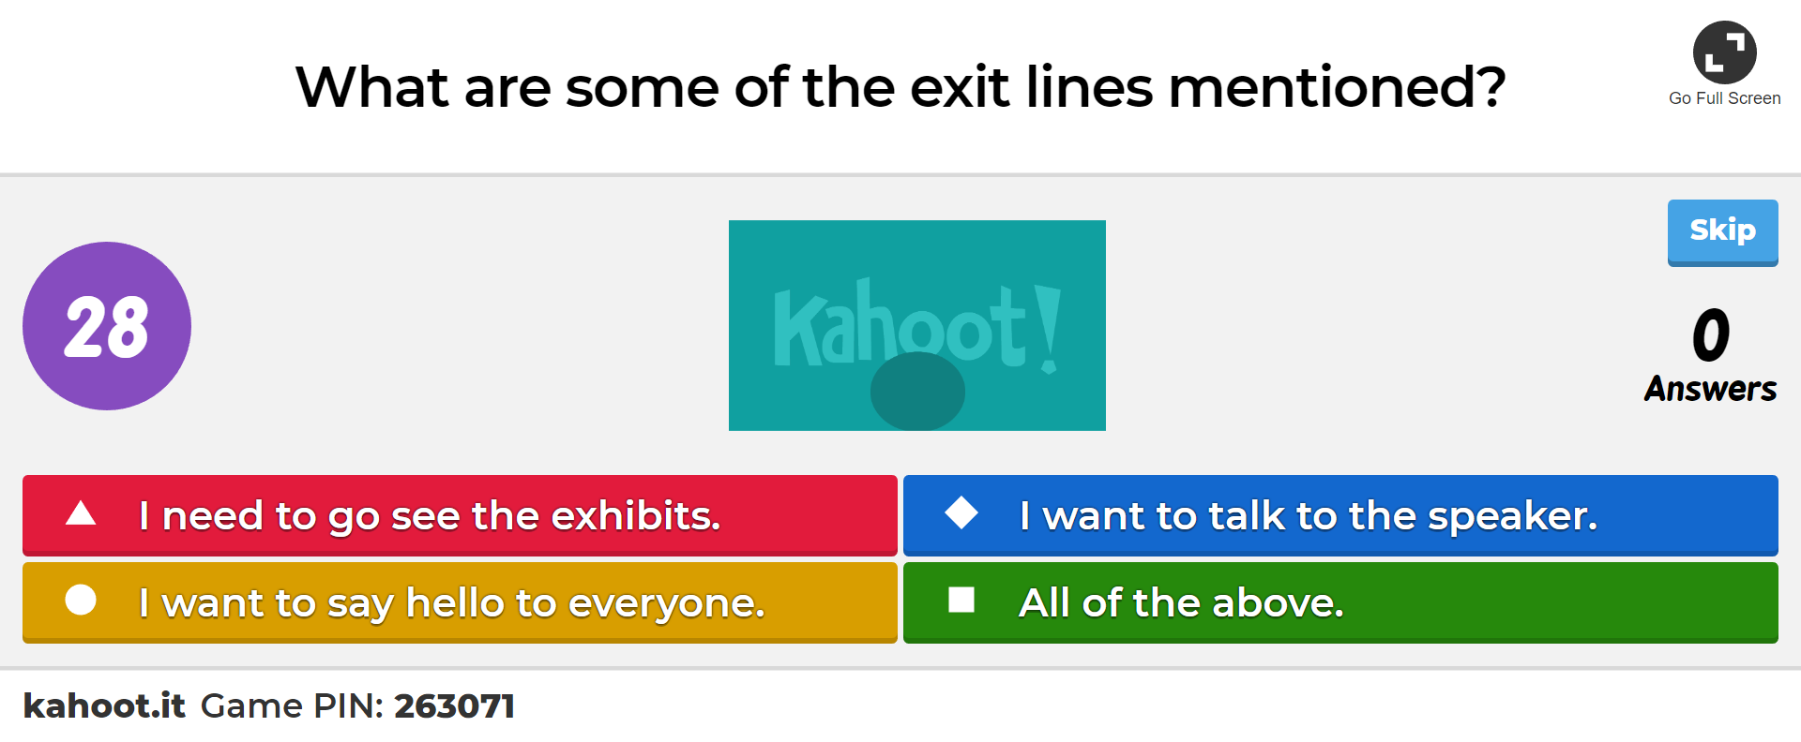
Quiz

Slide 6
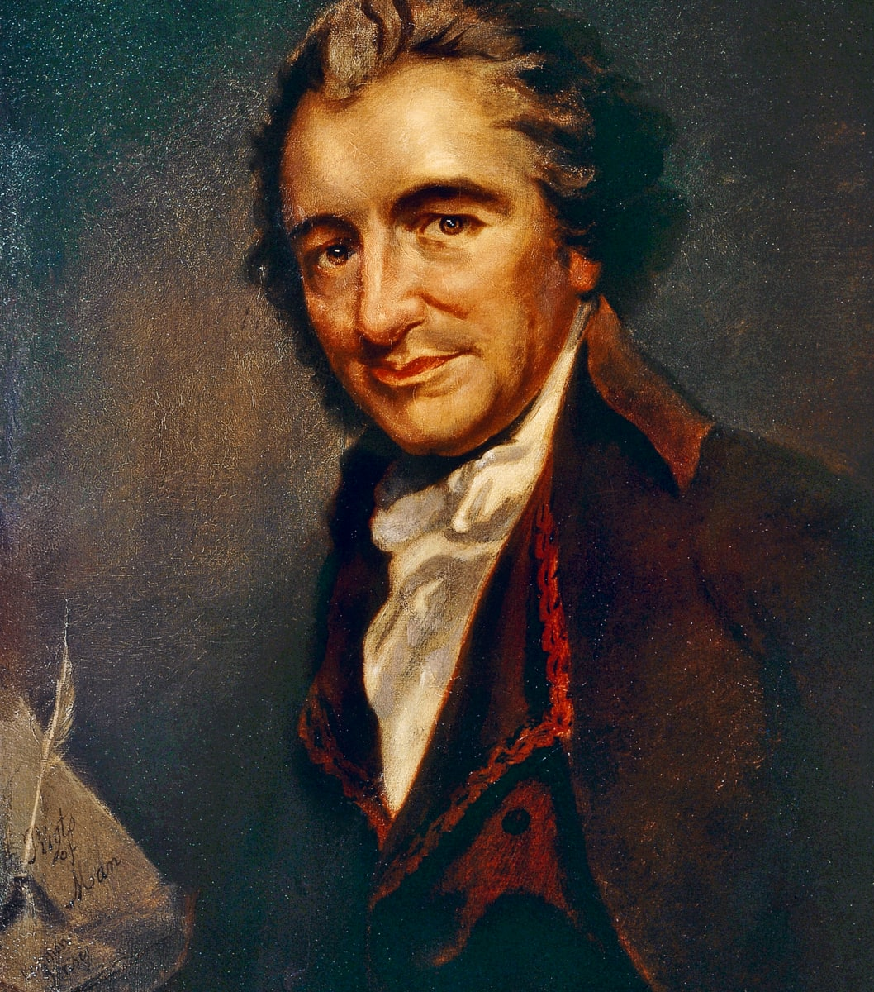
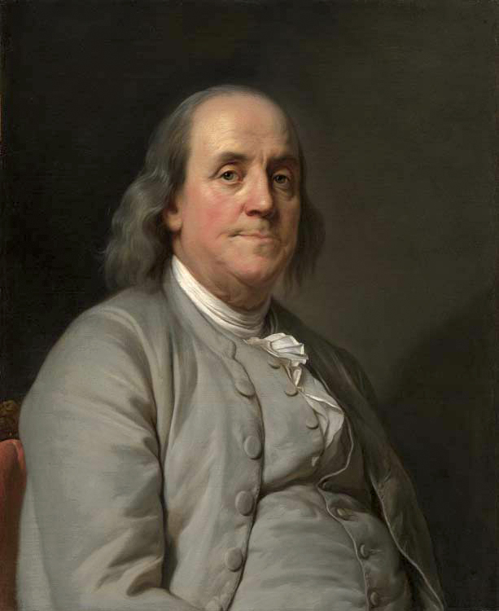
Peer teaching: Franklin and Paine

Slide 7
Round 1
Get together with students who read the same excerpt (2-3 people in a group).
Share notes, communicate ideas, ask questions.

Slide 8
Round 2
Exchange group members.
Follow the steps:
Team A starts by stating the main point of the reading and offer examples from the notes.
Team B takes notes, ask questions, and tries to give a summary of Team A’s presentation.
Team B repeats step one.

Slide 9
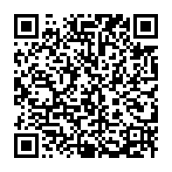
Round 3
Each group will go to Google document to share four things:
One similarity between the two readings
One difference between the two readings
One interesting observation/fact
One question that bothers you

Slide 10
Benjamin Franklin’s AUTOBIOGRAPHY
Has 4 parts
Part one written to his son
A “rags to riches” manual
Errata and self-improvement

Slide 11
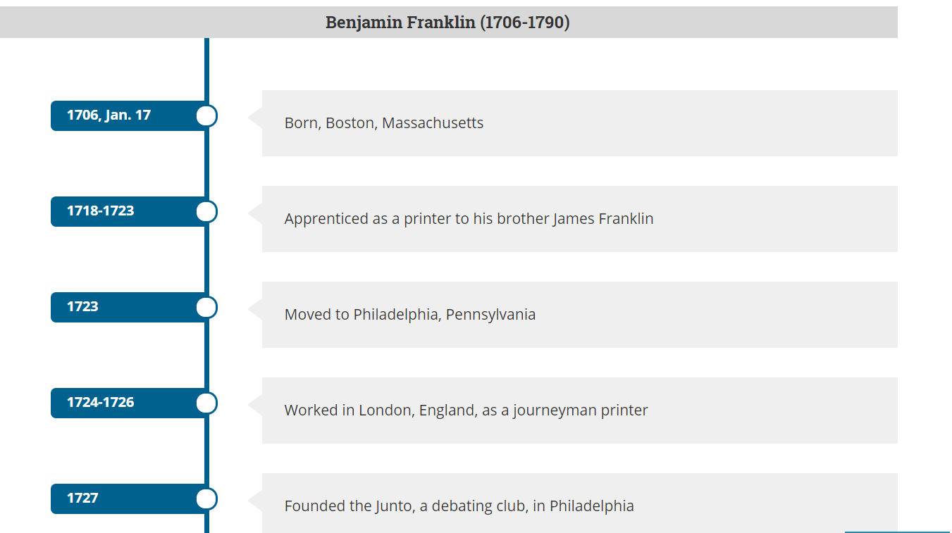
Benjamin Franklin’s Life
https://www.loc.gov/collections/benjamin-franklin-papers/articles-and-essays/timeline/

Slide 12
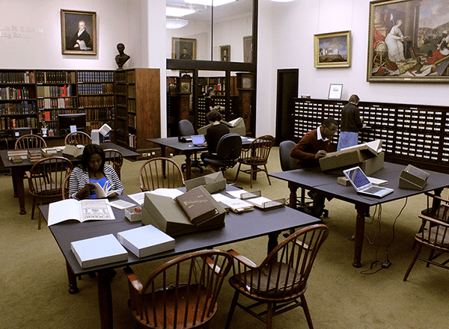
The Library company of Philadelphia

Slide 13
Thomas Paine’s Age of Reason
Common Sense (1775-1776): Advocating independence of the 13 colonies
The American Crisis (1776-1783): Encouraging the cause
Rights of Man (1791): Defending revolution against tyrannical rule
Age of Reason (1794-1807): Attacking organized religion

Slide 14
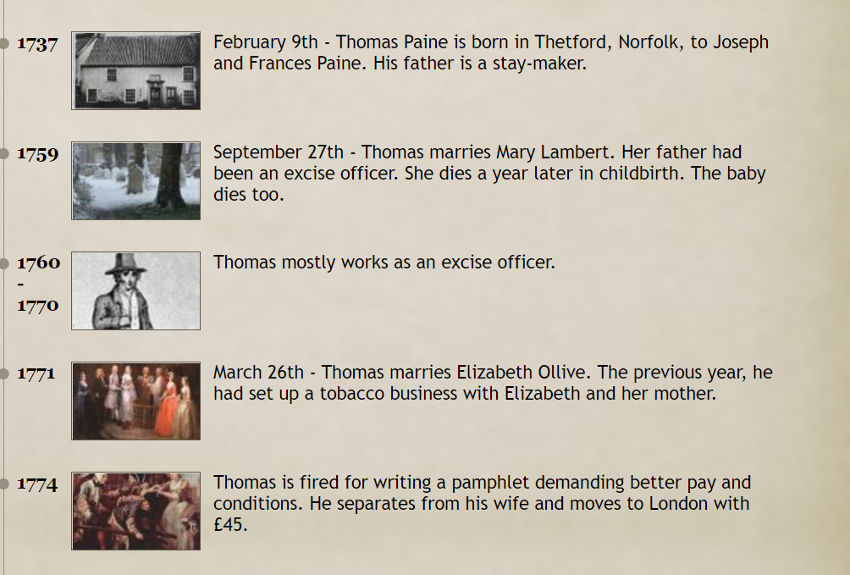
Thomas Paine’s Life
http://historysheroes.e2bn.org/hero/minitimeline/81

Slide 15
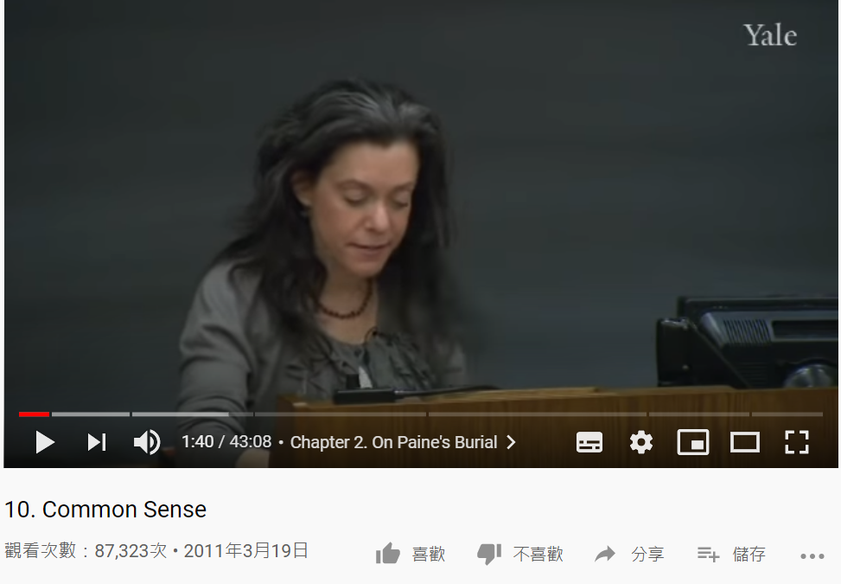
More About Paine
https://youtu.be/Dxdqdax4VbQ?t=100

Slide 16
Activity: Five dollars for your dream

Slide 17
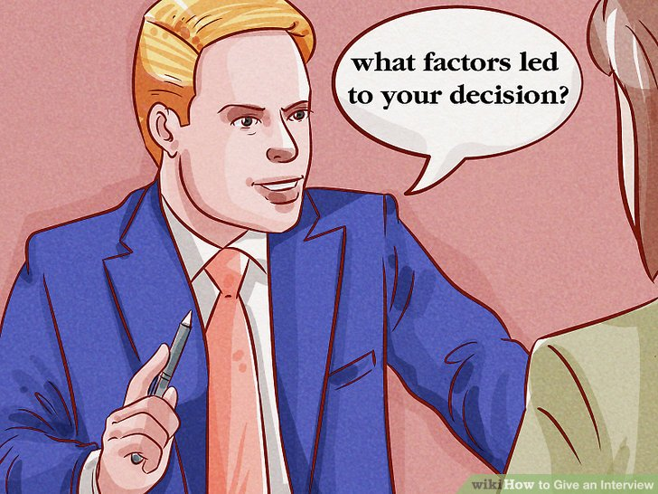
Set up
The first person of each team will be the interviewer.
The last person of each team will be the cameraman.
The other persons of the team will be the interviewees.

Slide 18
Rules
Each group will get a set of 9 cards.
Each interviewee has 5 dollars to buy a combination of goals for your life.

Slide 19
How to play
The interviewer should know why the interviewee chooses one goal instead of another.
The cameraman should film or take a photo of the choices.
After the two interviews, add up the points of your group.

Slide 20
Dreams | Worth | Total in Your Group
MONEY | 3
HEALTH | 3
FAMILY | 2
FRIENDS | 2
JOB | 2
RESPECT | 1
FUN | 1
LOVE | 1
LEARNING | 1

Slide 21
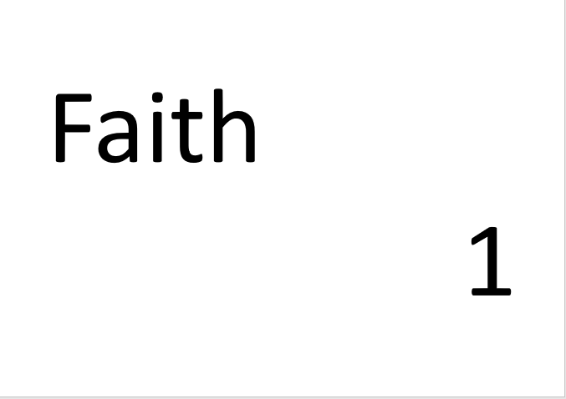
Where is faith?
This time, we add a new goal in life: “Faith,” which is worth 1 dollar
The interviewees will now consider whether to choose “Faith” as a goal
The interviewers should know why “Faith” plays a part or no part.

Slide 22
Lecture: Divinity School 101

Slide 23
Warming up
1. Biblical Inerrancy

Slide 24
Warming up
2. Immaculate Conception
When also I am told that a woman, called the Virgin Mary, said, or gave out, that she was with child without any cohabitation with a man, and that her betrothed husband, Joseph, said that an angel told him so, I have a right to believe them or not: such a circumstance required a much stronger evidence than their bare word for it: but we have not even this; for neither Joseph nor Mary wrote any such matter themselves. It is only reported by others that they said so. It is hearsay upon hearsay, and I do not chose to rest my belief upon such evidence.

Slide 25
Exercise
Read the Bible like Thomas Paine (and Franklin)
You will be divided into 2 groups
Group One will read Genesis 1
Group Two will read Genesis 2
Make a chart of what happens on each day and compare with the other group

Slide 26
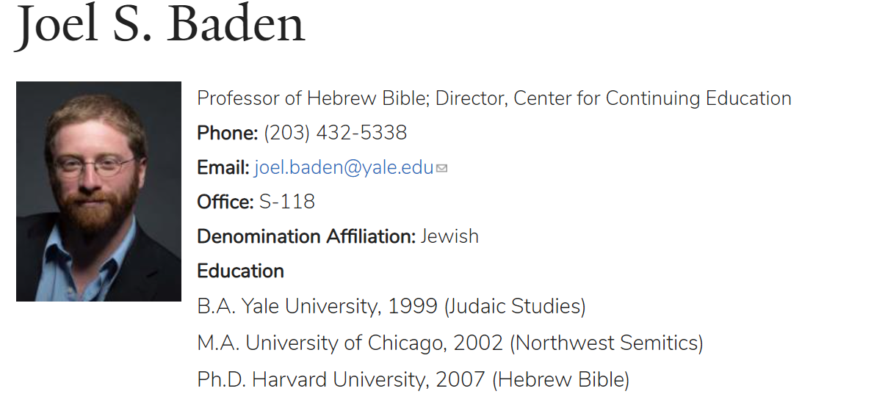
Learn from the scholar
https://divinity.yale.edu/faculty-and-research/yds-faculty/joel-s-baden

