Slide 1
How do Male Writers Portray Female Characters?

Slide 2
Plan for today
Peer Teaching: Brown and Hawthorne
Quiz
Activity: Thinking about female agency
Lecture: Gaze and camping

Slide 3
Peer Teaching: Brown and Hawthorne

Slide 4
Round 1
Get together with students who read the same excerpt (2-3 people in a group).
Share notes, communicate ideas, ask questions.
This time, focus on how the author portrays female characters

Slide 5
Round 2
Exchange group members.
Follow the steps:
A team starts by stating the main point of the reading and offer examples from the notes.
B team takes notes, ask questions, and tries to give a summary of A team’s presentation.
B team repeats step one.

Slide 6
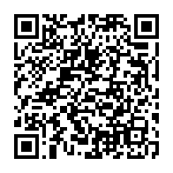
Round 3
Each group will go to Google document to share two things:
In what sense are they similar when portraying female characters
In what sense are they different when portraying female characters

Slide 7
Quiz: Answer 5 questions

Slide 8
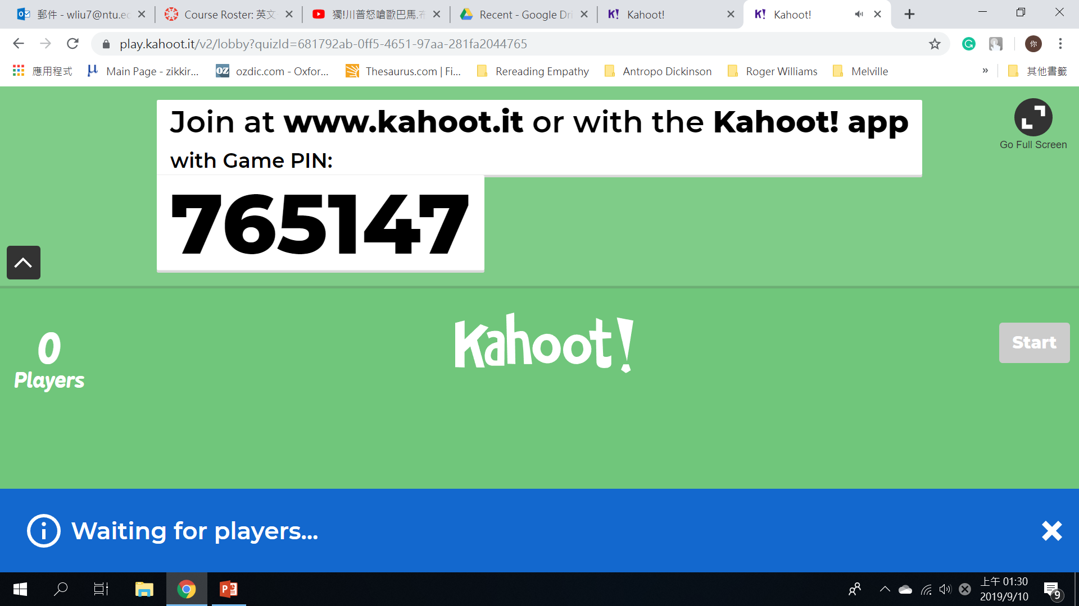
Quiz

Slide 9
Quiz
Put your student ID number here

Slide 10
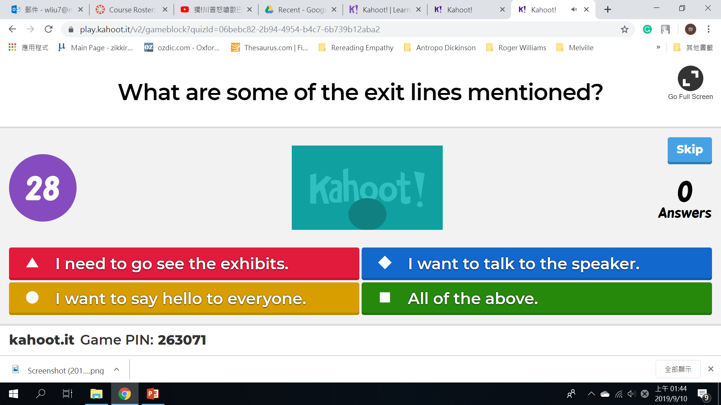
Quiz

Slide 11
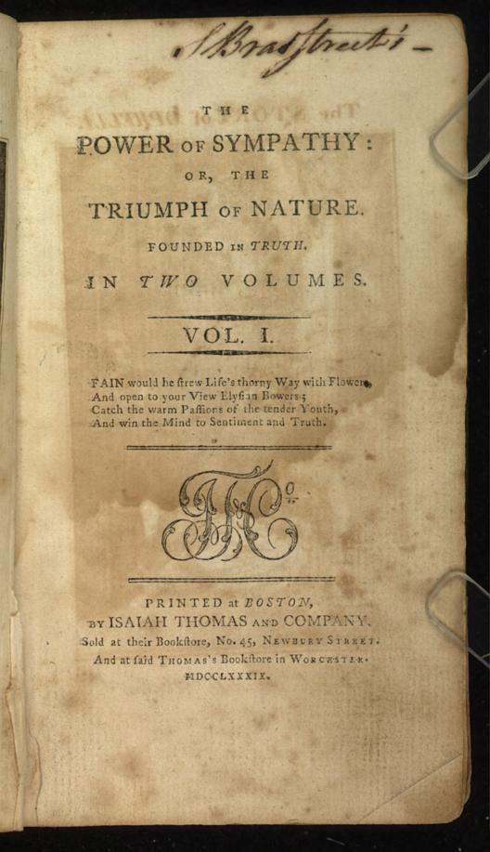
The Power of Sympathy
William Hill Brown (1765-1793)
Epistolary novel (=letters)
Didactic purpose (=warning)
Paternalism
Is Harriot a character of agency?

Slide 12
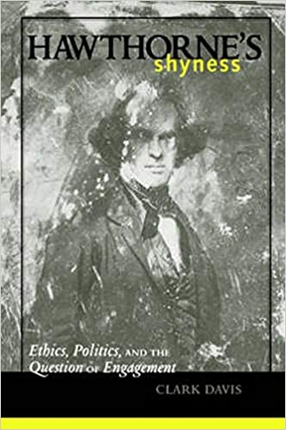
“The Birth-Mark”
Nathaniel Hawthorne (1804-1864)
A short story
Science vs. spirit
Defect vs. perfection
Is Georgiana a character of agency?

Slide 13
Activity: Thinking about female agency

Slide 15
Writing a Breakup Note
You feel that your girlfriend/boyfriend is cheating on you and you want to breakup with him/her.

Slide 16
Breakup Note Instructions
Duration: 10 minutes
Length: 5-6 sentences
Facts:
1. Last Saturday, s/he told you that s/he was having dinner with family, but your friend spotted him/her outside of a movie theatre.
2. S/he is on Tinder all the time.
3. S/he has spent less time with you.
When you finish, put it in the box (You don’t have to put your name on the paper.)

Slide 17
Writing a Response
Your boyfriend/girlfriend thinks that you are seeing someone else and is breaking up with you. You can choose between the following two options:
(a) explain to him/her that you are not cheating
(b) admit it and apologize

Slide 18
Response Writing Instructions
Pick one breakup note from the box and start responding to his/her accusations.
Duration: 10 minutes
Length: 5-6 sentences
When you finish, staple your response and the breakup note together and put them in the box (You don’t have to put your name on the paper).

Slide 19
Discussion
On your own (3 minutes): You are a concerned friend of the couple. Read through the accusations and the responses and predict the outcome. Will they break up?
With the group (7 minutes): Take turns describing the situation of each couple and analyze what factors (attitudes, misunderstandings, etc.) lead to the breakup or the patch-up.

Slide 20
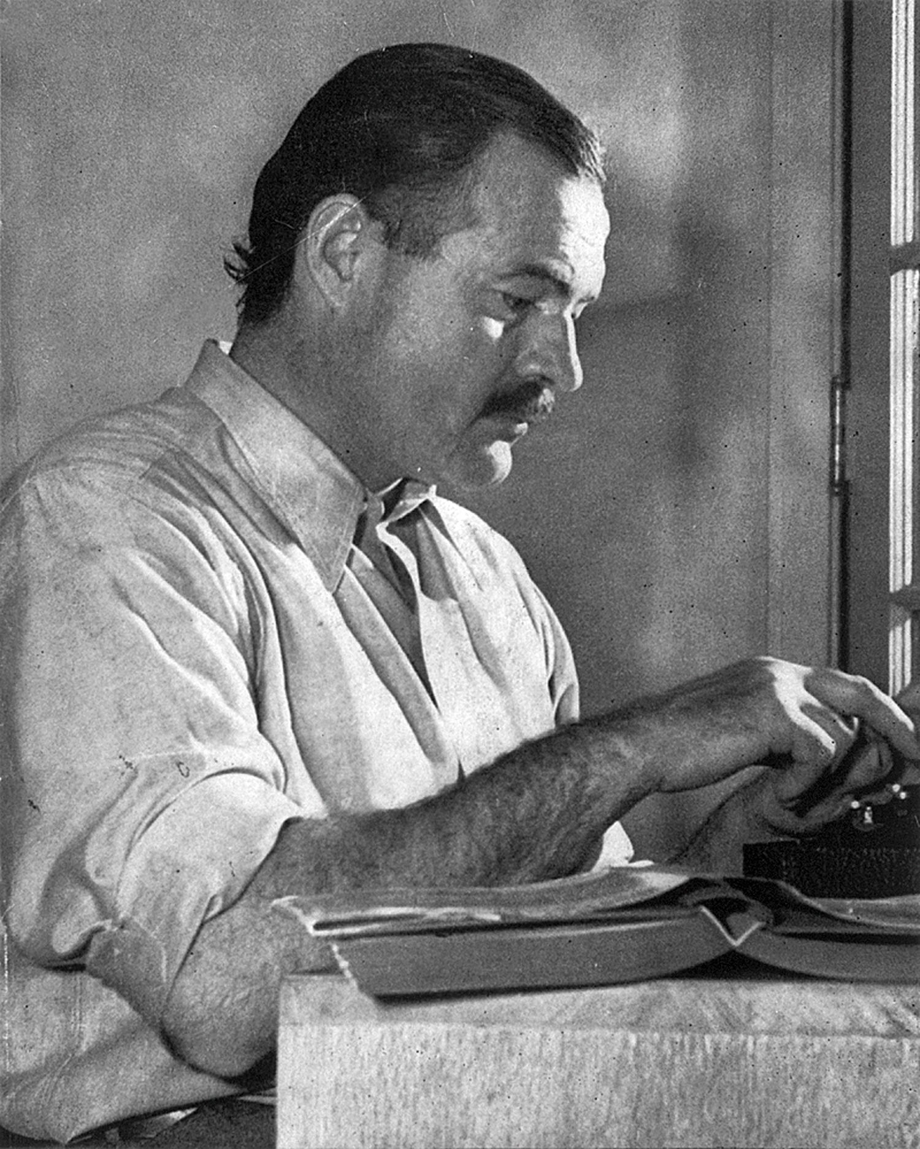
Literary Analysis
“Hills like White Elephants” 〈白象群山〉(1927)
https://en.wikipedia.org/wiki/Ernest_Hemingway

Slide 21
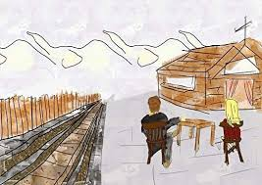
Plan
Correct the text
See images related to the story
Listen to the story
Figure out what they are talking about
Analyze conflicts
Study symbols
https://thebharaths.com/digging-hills-like-white-elephants-short-story-deep/

Slide 22
Correction of the text
Page 3
“What did you say?”
“I said we could have everything.”
“We can have everything.”
“No, we can’t.”

Slide 23
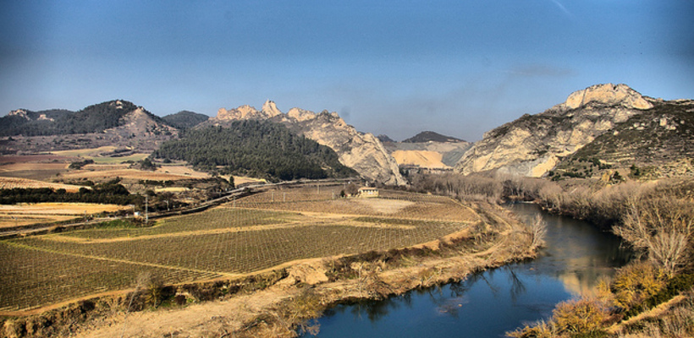
Ebro River Valley

Slide 24
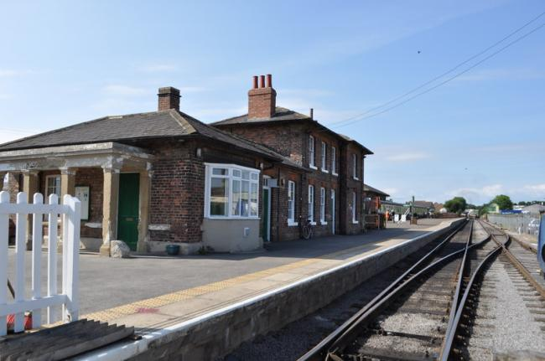
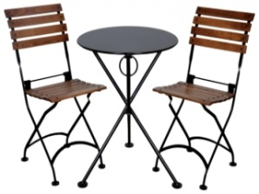
The Train Station Bar

Slide 25
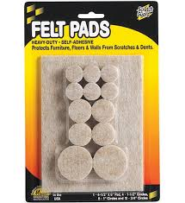
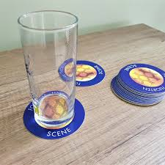
Felt pads

Slide 26
Anis del Toro

Slide 27
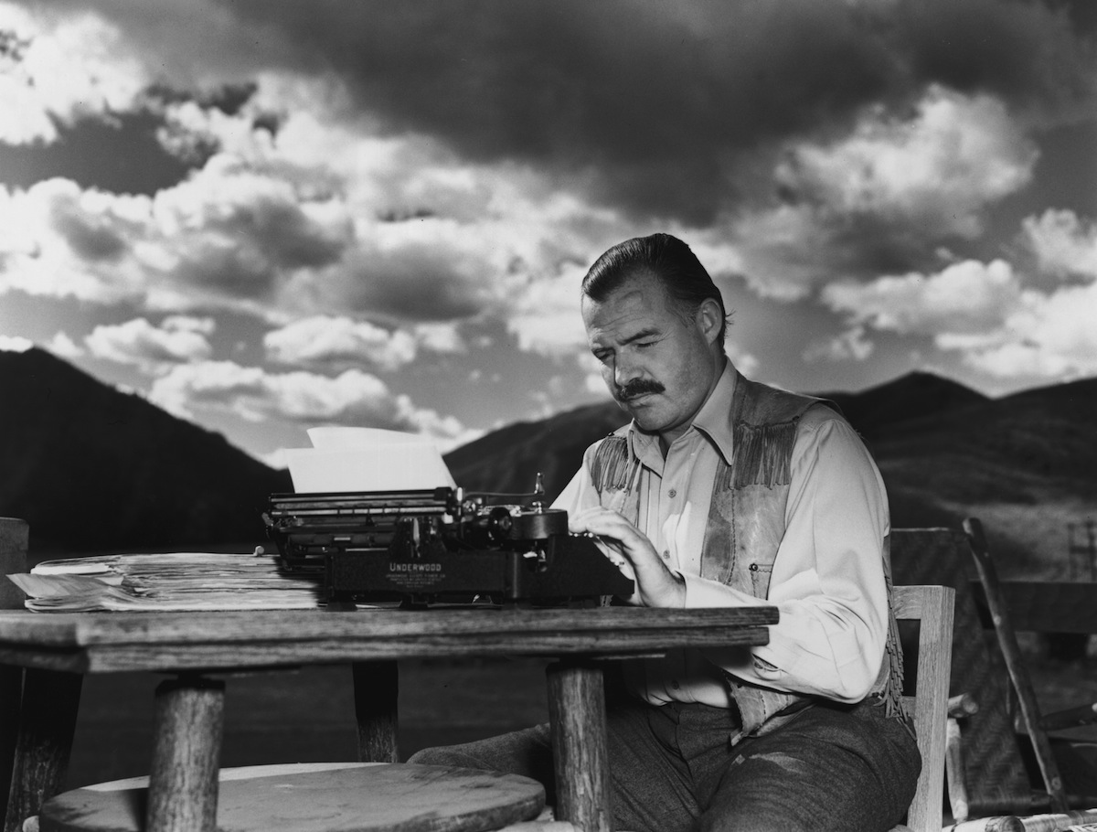
Listening to the story https://youtu.be/oCZcPM1HzPM

Slide 28
What are they talking about?
“Everything tastes of licorice. Especially all the things you've waited so long for, like absinthe.” (page 1, bottom)
“It's really an awfully simple operation, Jig," the man said. “It's not really an operation at all.” (page 2, top)
“I know you wouldn't mind it, Jig. It's really not anything. It's just to let the air in.” (page 2, middle)

Slide 29
What are they talking about?
"You've got to realize," he said, "that I don't want you to do it if you don't want to. I'm perfectly willing to go through with it if it means anything to you."
"Doesn't it mean anything to you? We could get along."
"Of course it does. But I don't want anybody but you. I don't want any one else. And I know it's perfectly simple.“ (page 3, middle)

Slide 30
First Conflict
Page 1, middle
"They look like white elephants," she said.
"I've never seen one," the man drank his beer.
"No, you wouldn't have."
"I might have," the man said. "Just because you say I wouldn't have doesn't prove anything."

Slide 31
Second Conflict
Page 1, bottom
"We want two Anis del Toro."
"With water?"
"Do you want it with water?"
"I don't know," the girl said. "Is it good with water?"
"It's all right." "You want them with water?" asked the woman.
"Yes, with water."

Slide 32
Third Conflict
Page 2, bottom
“And you think then we'll be all right and be happy."
"I know we will. You don't have to be afraid. I've known lots of people that have done it."
"So have I," said the girl. "And afterward they were all so happy."

Slide 33
Fourth Conflict
Page 3, top
"I said we could have everything."
"We can have everything."
“No, we can't."
"We can have the whole world."
"No, we can't."
"We can go everywhere.“
"No, we can't. It isn't ours any more."
"It's ours."
"No, it isn't. And once they take it away, you never get it back."
"But they haven't taken it away." "We'll wait and see."

Slide 34
Is she a character of agency?
https://theoutline.com/post/6583/female-agency-in-movies-feminist?zd=1&zi=n3euzboq

Slide 35
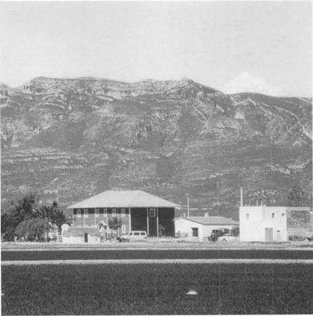
https://youtu.be/hGpj283-8oo

Slide 36
Lecture: Gaze and Camping

Slide 37
Gaze
Review: seeing vs. other senses (Emerson)

Slide 38
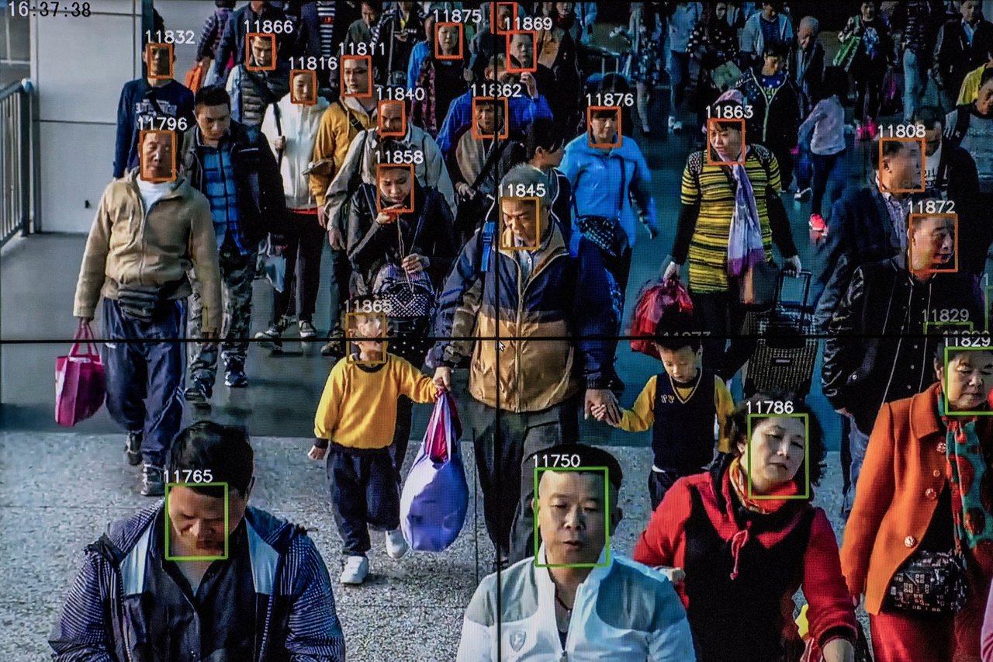
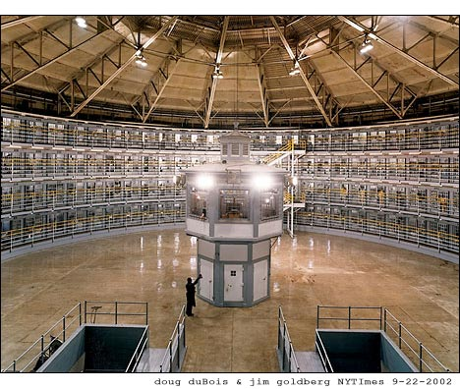
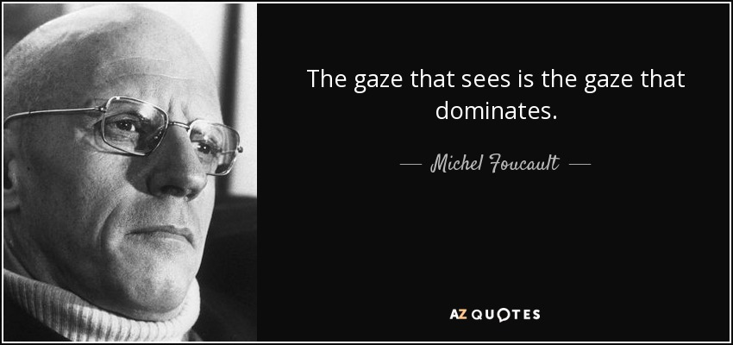
Gaze
https://www.azquotes.com/quote/1434094
https://www.brown.edu/Departments/Joukowsky_Institute/courses/13things/7121.html
https://peakd.com/surveillance/@thermoplastic/7-billion-suspects-the-surveillance-society

Slide 39
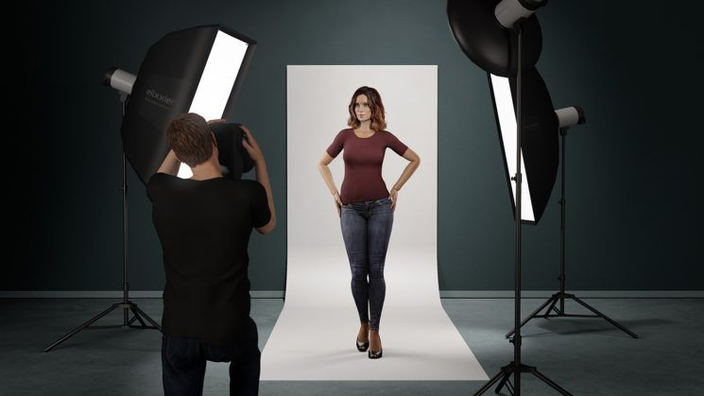
Gaze
female object
male subject
https://www.diyphotography.net/high-power-posing-vs-low-power-posing-how-body-language-influences-your-pictures/

Slide 40
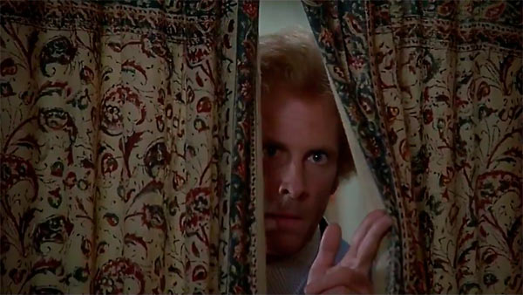
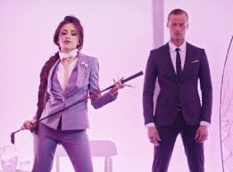
Gaze
Male gaze and voyeurism
https://youtu.be/YBHQbu5rbdQ
https://www.alfred-hitchcock-films.net/theme-voyeurism.htm
https://www.bigtop40.com/features/top-ten-singles-5th-july-2015/fifth-harmony-worth-it-kid-ink/

Slide 41
Camping
https://www.harpersbazaar.com/tw/fashion/news/g27356502/2019-met-gala-theme-camp/

Slide 42
https://www.harpersbazaar.com/tw/fashion/news/g27356502/2019-met-gala-theme-camp/

Slide 43
https://www.harpersbazaar.com/tw/fashion/news/g27356502/2019-met-gala-theme-camp/

Slide 44
Camping
https://www.freeimages.com/tw/photo/book-eyes-1251357
https://womany.net/read/article/8997

